Slide 1
Statewide Geospatial Advisory Committee
September 24, 2014

Slide 2
AGENDA
Call to order and introductions
Approval of June18 meeting minutes
General fund proposal update
Hexagon ELA Offer
NSGIC national update
ArcGIS Online at Hennepin County
Break – Networking
Met Council sector report
DNR sector report
Geocoding project and discussion
MnGeo priority efforts updates
Data sharing initiatives update
Adjourn

Slide 3
Introductions

Slide 4
Approval of June 18 Minutes
Nancy Rader, MnGeo

Slide 5
General fund update and discussion…
Dan Ross, MnGeo

Slide 6
Key Points to the Proposal
No longer a Recorders Fee request
MN Geospatial Commons as a focal point for delivery and collaboration
Proposal identifies key items to pursue
Amount is yet to be determined
Focuses on aggregation, standardization and statewide
Publicly available – data and services
This Council will guide investments

Slide 7

Hexagon ELA Offer
Statewide ELA
  Who is included
    State of Minnesota agencies
    Local governments
    Accredited colleges and universities within the State

Slide 8
Hexagon ELA Offer
What is included?
Image Processing
Geospatial Serving (including SDI)
Crowd Sourcing
Cadastral
Linear Referencing
Programmable Workflows
Zero administration clients
GeoMedia® Webmap
ERDAS IMAGINE®
GeoMedia
Mobile MapWorks
Mobile Alert
Photogrammetry
ERDAS APOLLO
What is missing?
Dispatch
Additional recipients – non profits

Slide 9
Hexagon ELA Offer
Term
Initial three-year term
Cost
Flat subscription price of $3,000,000 - ($1,000,000 per year)
www.hexagongeospatial.com/products

Slide 10
NSGIC national update
Dan Ross, MnGeo

Slide 11
NSGIC Key topics…
Geospatial Data Act of 2014 (NSDI)
Promote and guide cooperation and coordination among agencies of the Federal Government, State, tribal, and local governments, institutions of higher education, and the private sector in the collection, production, sharing, and use of geospatial information, the implementation of the National Spatial Data Infrastructure, and the identification of proven practices;

Slide 12
NSGIC Key topics…
Emergency Management
  Remote Sensing
  Next Generation 9-1-1
Transportation and Addressing
Collaboration
Data Sharing and Open Data
GIS Inventory - http://gisinventory.net
Climate and Resiliency
Corporate Leaders
Federal Activities and Initiatives
  Addresses

Slide 13
ArcGIS Online at Hennepin County
Andrew King-Scribbins, Hennepin County

Slide 14

ArcGIS Online at Hennepin County
Andrew King-Scribbins, GISP
GIS Coordinator for Public Safety

Slide 15
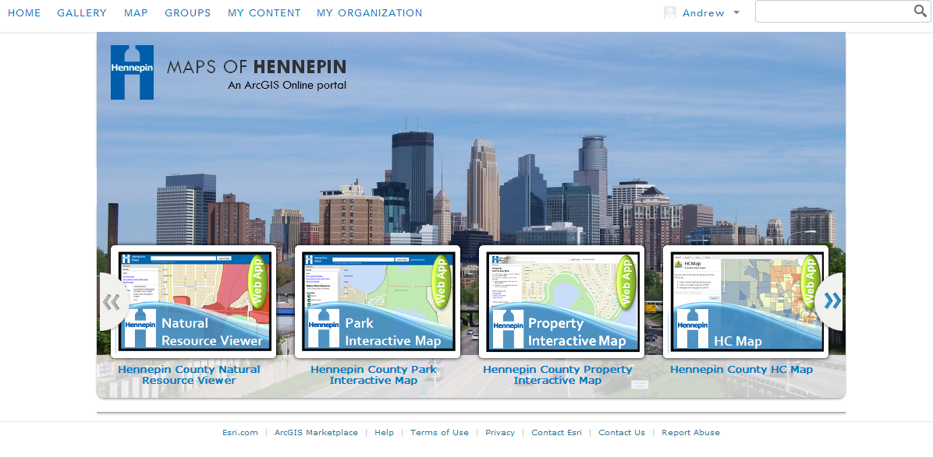
Planning and Collaboration for
One Organization

Slide 16
Administrators
Multiple departments represented
Control data/maps from their dept
Monthly admin meetings
Currently 131 Users

Slide 17
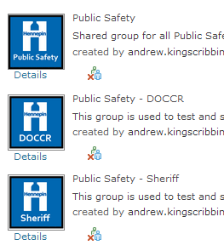
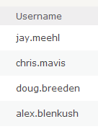
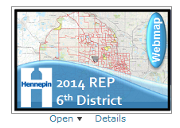
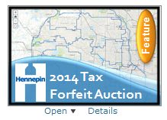
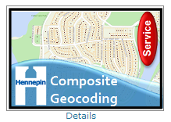
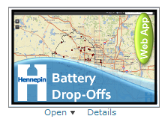
Standardization
Group names
User names
Thumbnails

Slide 18
Publishing process
Maps developed by department
Pushed to admin group for review
Ownership transferred to HC Maps user
Added to public site

Slide 19
Beaches
Battery Recycling
Elections
Cool Options
Road Construction
Torrens Application Status

Slide 20
What’s next?
Formalized trainings
Expanded use
Public map portal
AGOL Open Data Portal (beta)
Custom templates and widgets
ESRI Web AppBuilder (beta)

Slide 21
?

Slide 22


30 minutes…
+

Slide 23
Member sector report
Mark Kotz, Metropolitan Council

Slide 24
GIS at the Metropolitan Council
Mark Kotz
GIS Manager, Metropolitan Council
September 2014

Slide 25
Metropolitan Council Background

Slide 26
Mission
Metro Transit
Wastewater services
Guide efficient growth in Metro Area
  Comprehensive plans
  Transportation planning
Administer housing & other grant programs

Slide 27
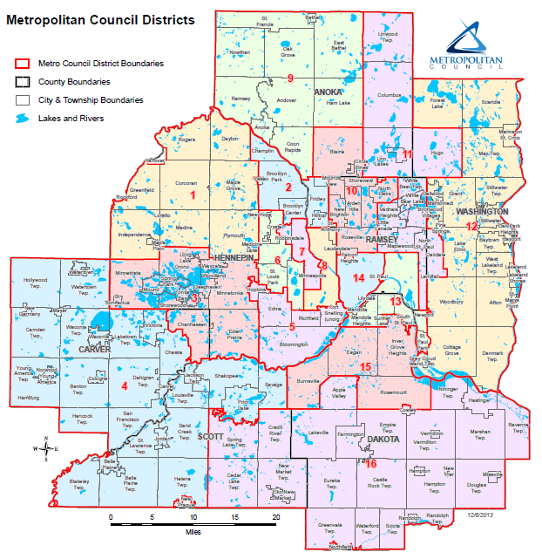
Governance
16 members represent districts
Chair serves at large
Appointed by Governor
State Senate confirms appointments

Slide 28
Other Regional Agencies
Metropolitan Mosquito Control District
Metropolitan Emergency Services Board
Metropolitan Airports Commission

Slide 29



Metropolitan Council
Regional Administration
Environmental
Services
Community
Development
Transit &
Transportation

Slide 30
Using Geospatial Technology
Examples:
Operations
Research & Analysis
Communication & Collaboration

Slide 31
Operations

Slide 32

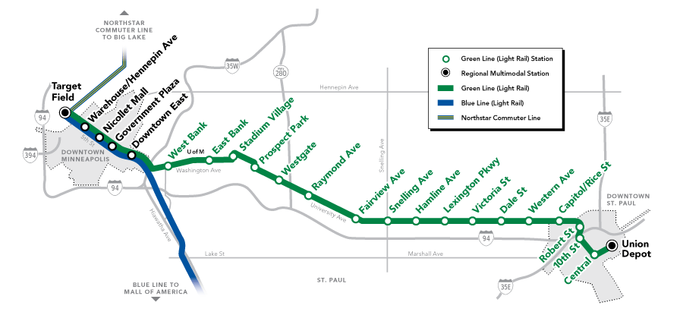
Metro Transit
  81 million rides (2013)
    87% bus
    13% rail
  128 routes, 3 trains

Slide 33
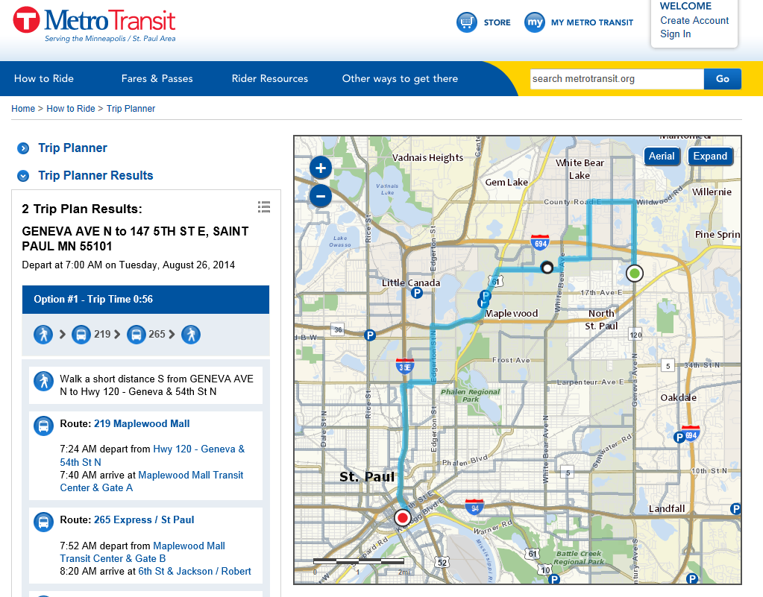
Notes:
Transit feed data comes from MetroTransit.

Slide 34
GIS Data Flow For Transit
Web-Based
Trip Planner
Non-Transit Data
Employment
Transit Information Center
Commuter
Metro Transit
Service
Development
Bus Route
Data
Land Use
Parcel
Transit Control Center
GIS Library
Other
Other Web
Development
MetroGIS Data Finder
NexTrip Mapping
Streets
Notes:
Changes to IT methods and standards. Started with quarterly data transfers.

Slide 35
Metro Transit
  Predictive policing
  Shelter maintenance
  Bus shelter equity
  Rail mobile documents

Slide 36
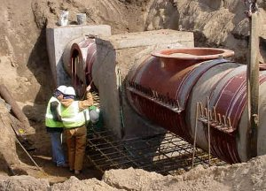
Wastewater Treatment
  7 Treatment Plants
  600 miles of pipelines
  70 pumping stations
  188 metering sites

Slide 37
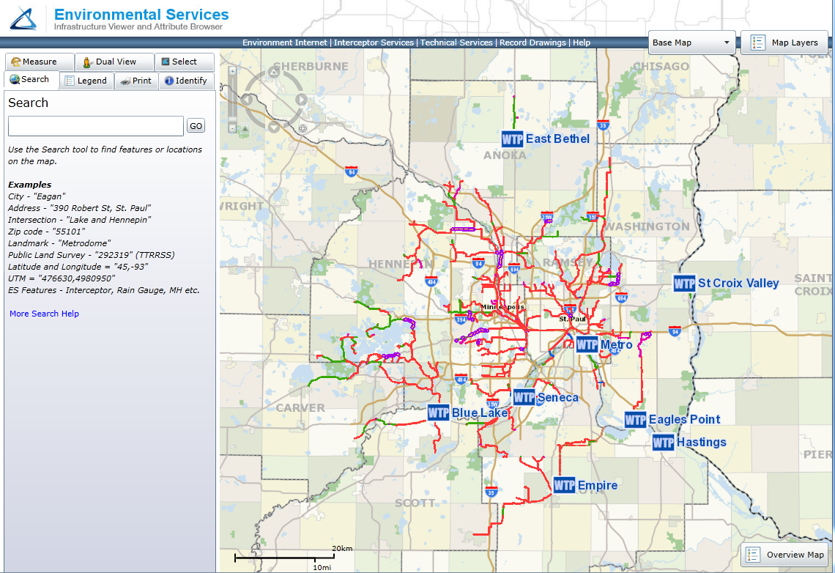

Slide 38
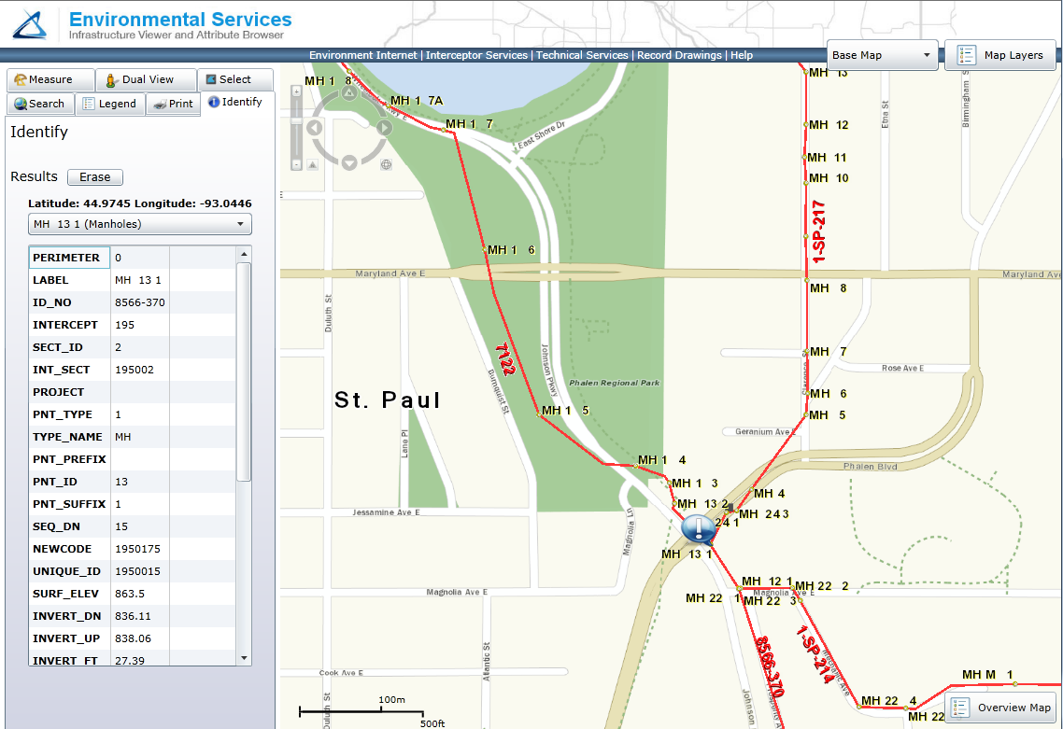

Slide 39
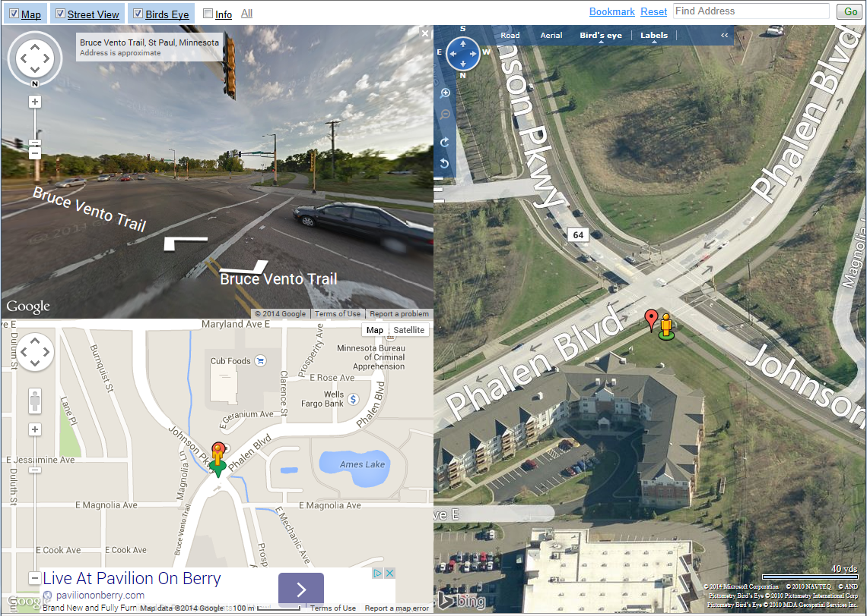

Slide 40
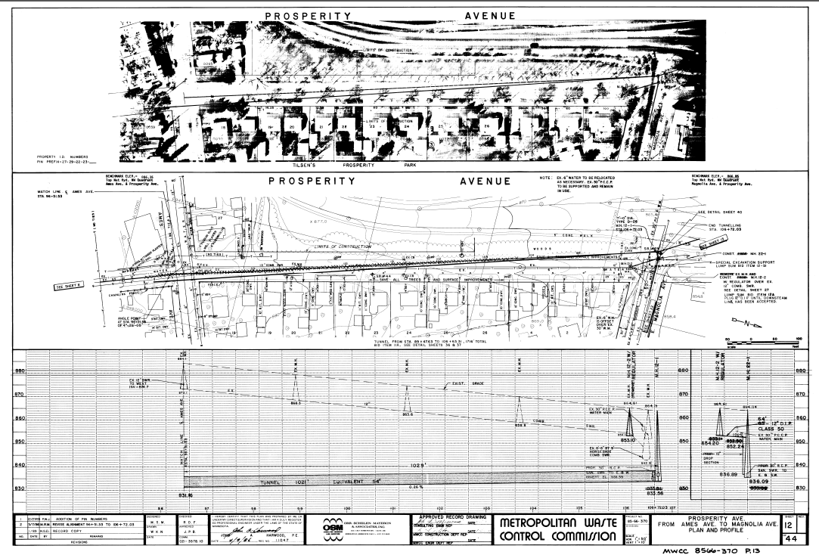

Slide 41

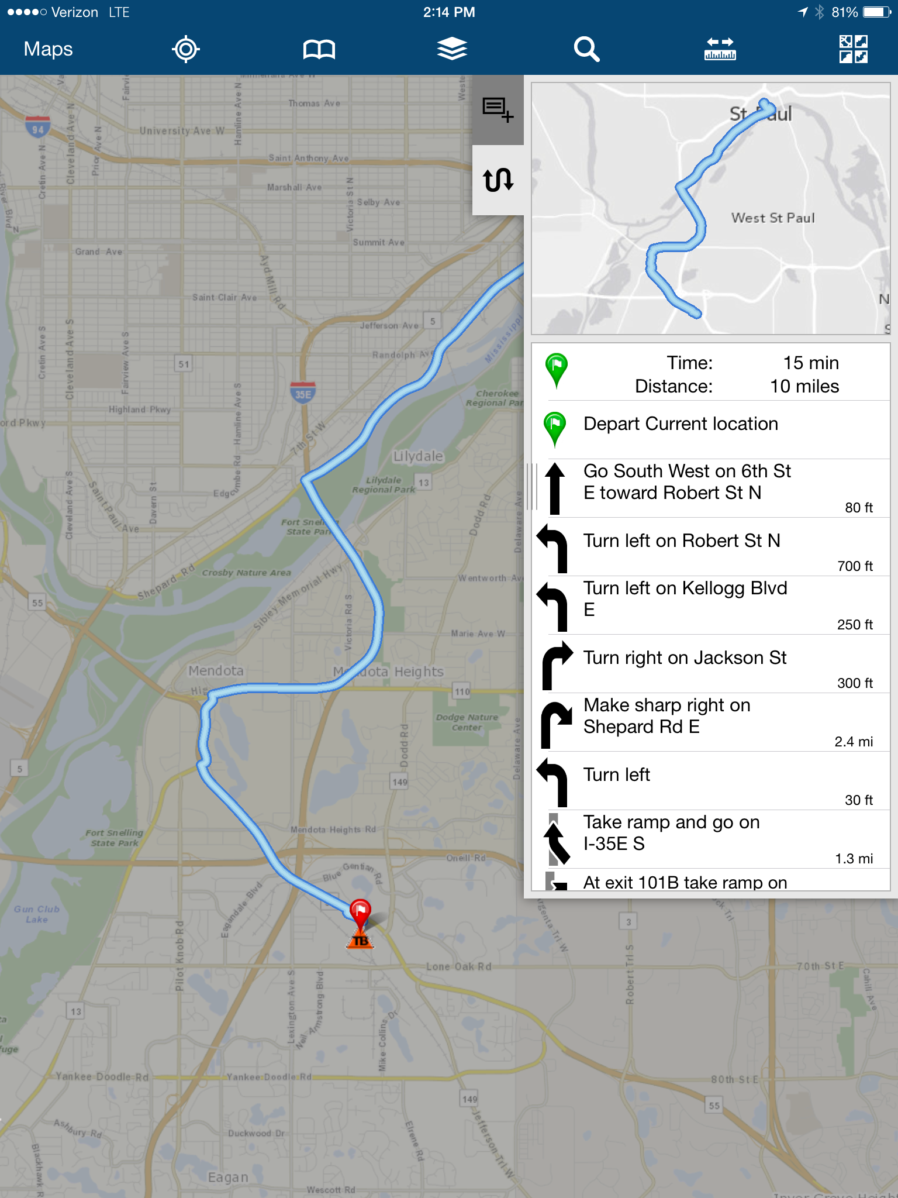

Slide 42
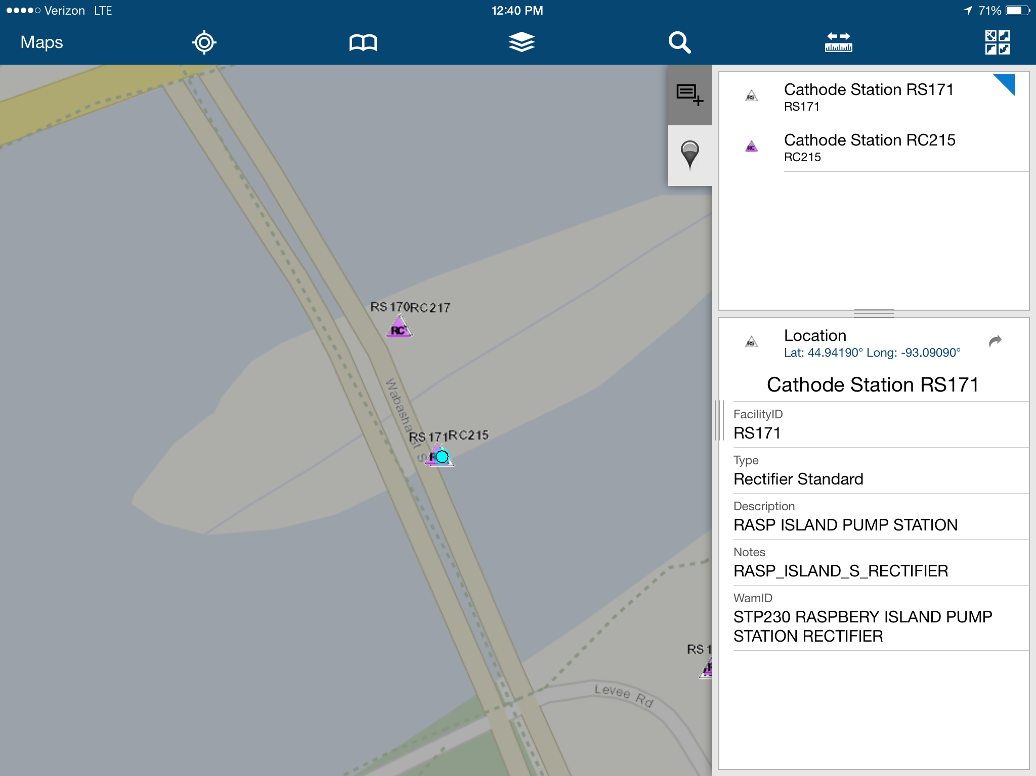

Slide 43
Land Records Management
$1.5 Billion in Property
Search for Property Rights
Link Land Records to Location

Slide 44
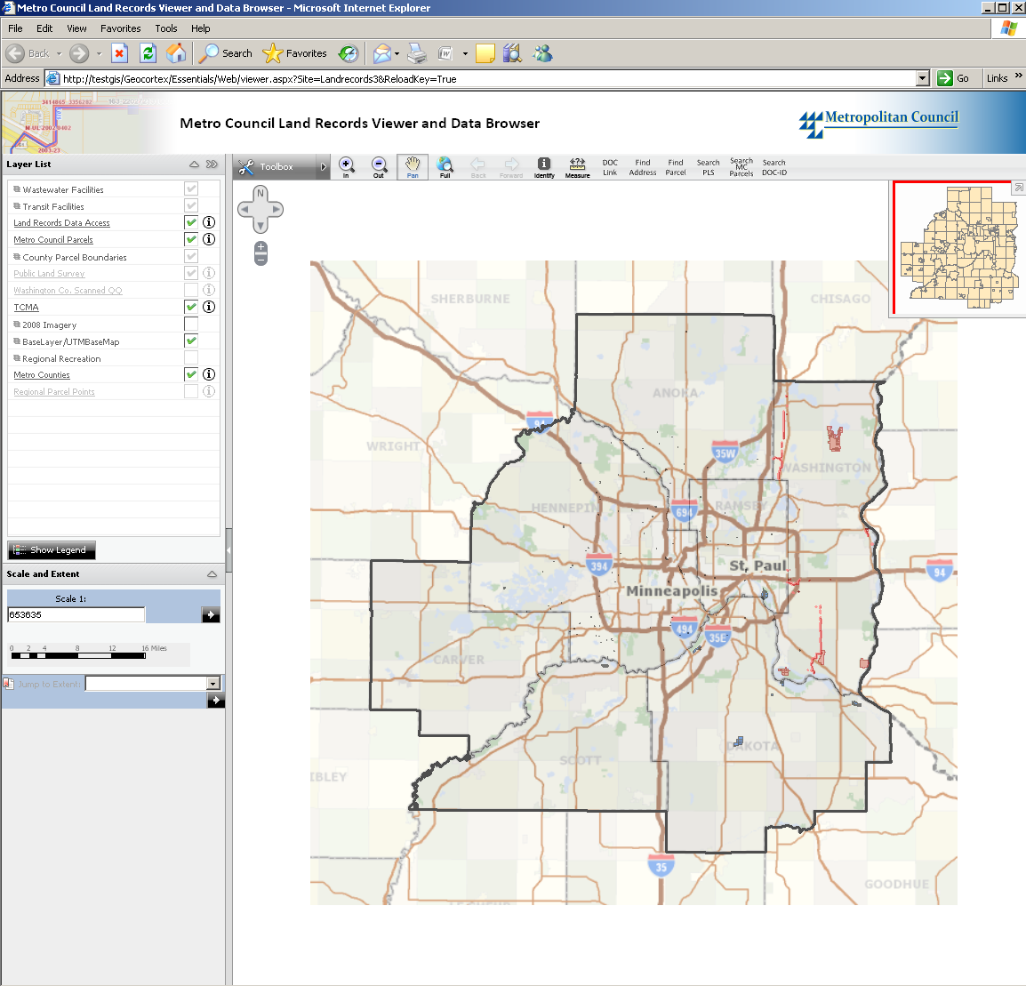
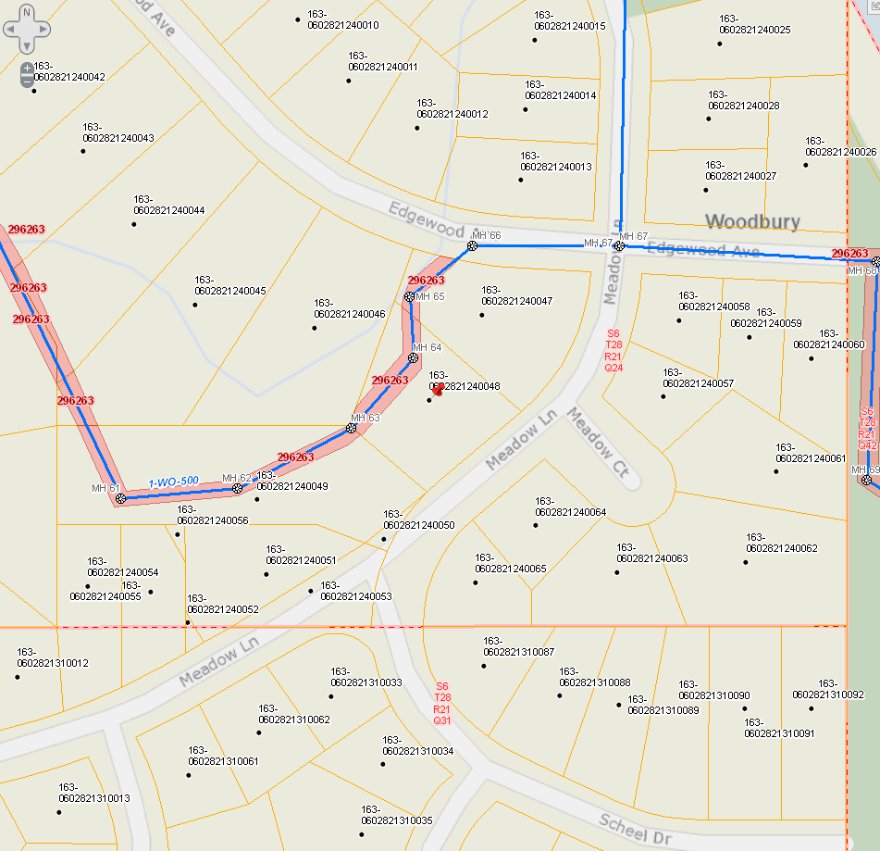
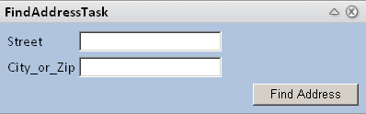

Slide 45
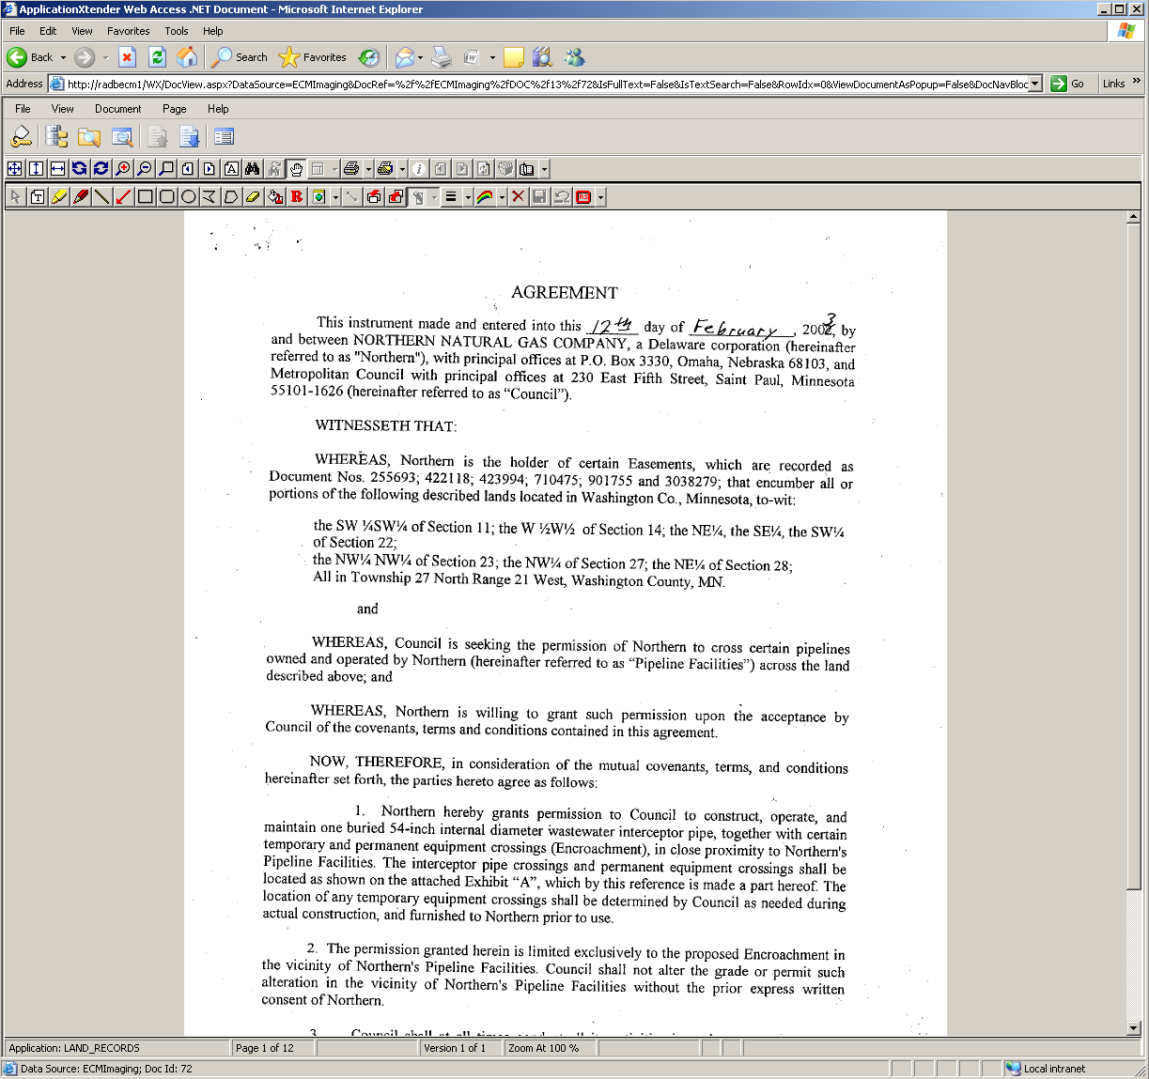

Slide 46
Research & Analysis

Slide 47
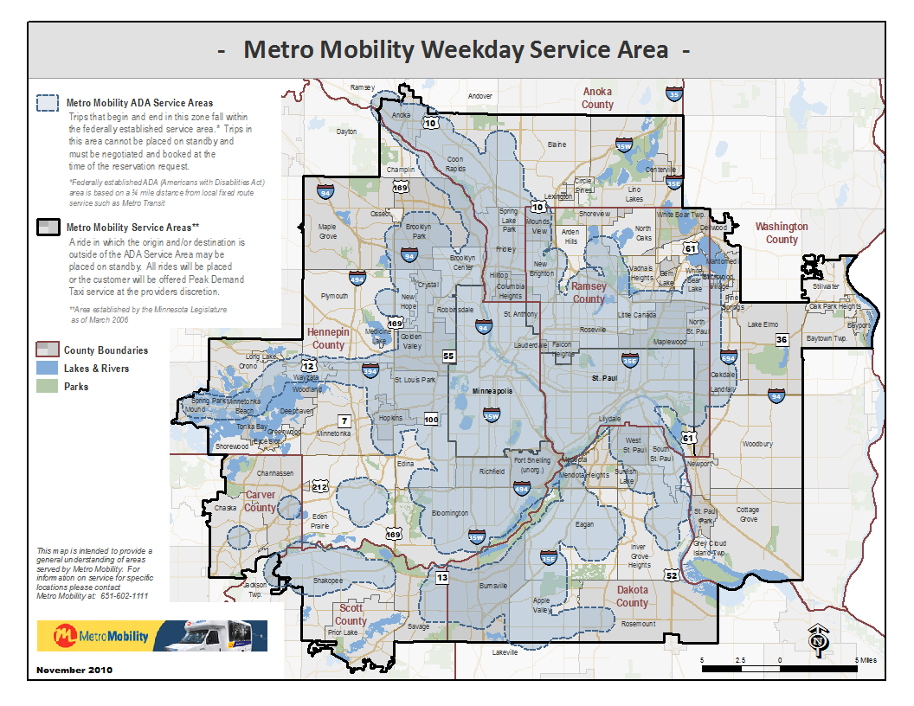

Slide 48
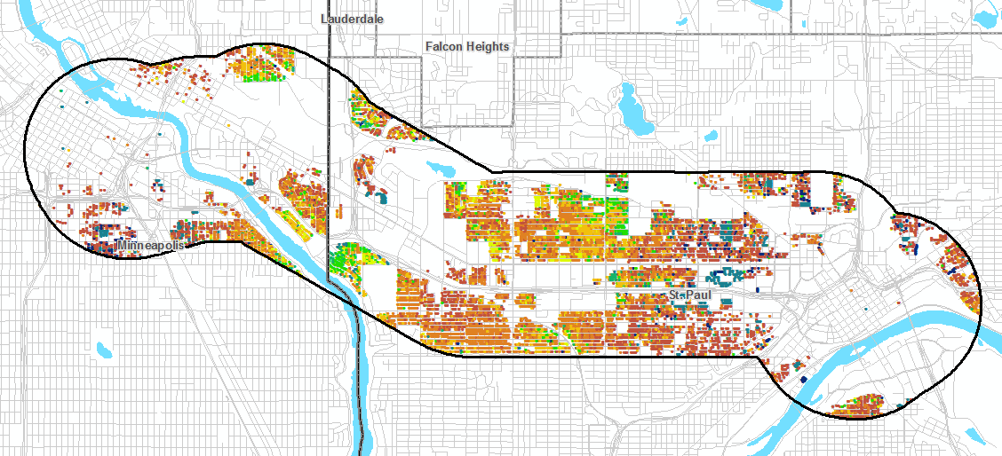
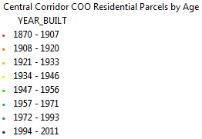
Residential Parcel Development
Age of Existing Housing in the CCLRT Corridor of Opportunity

Slide 49
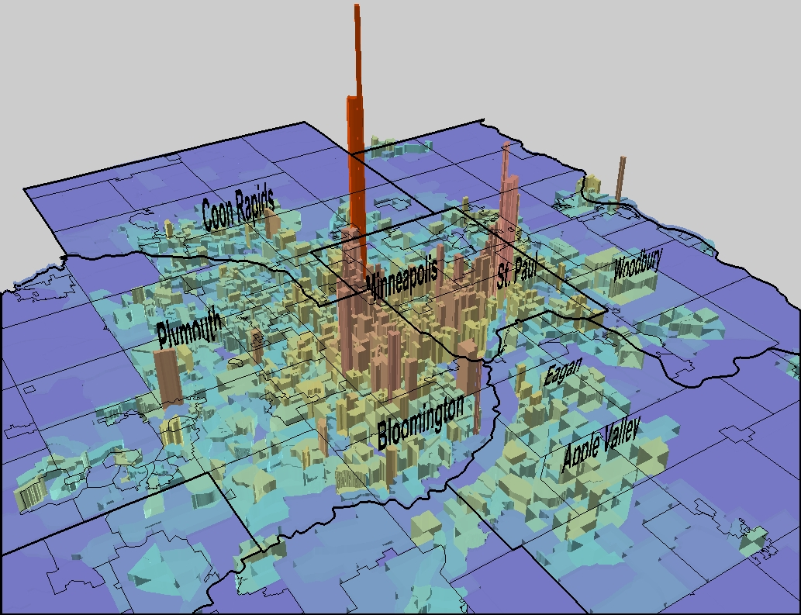
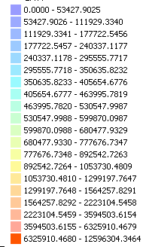
Total Estimated Market Value per Acre by Census Block Group
Fourth Quarter 2005
2000 US Census block group boundaries
using County Assessor data shared
through MetroGIS.
$12.8 Million
$50,000 or less
$500,000
$6,000,000 or more
$5.0 Million

Slide 50
Communication & Collaboration

Slide 51
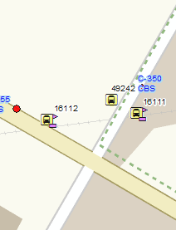
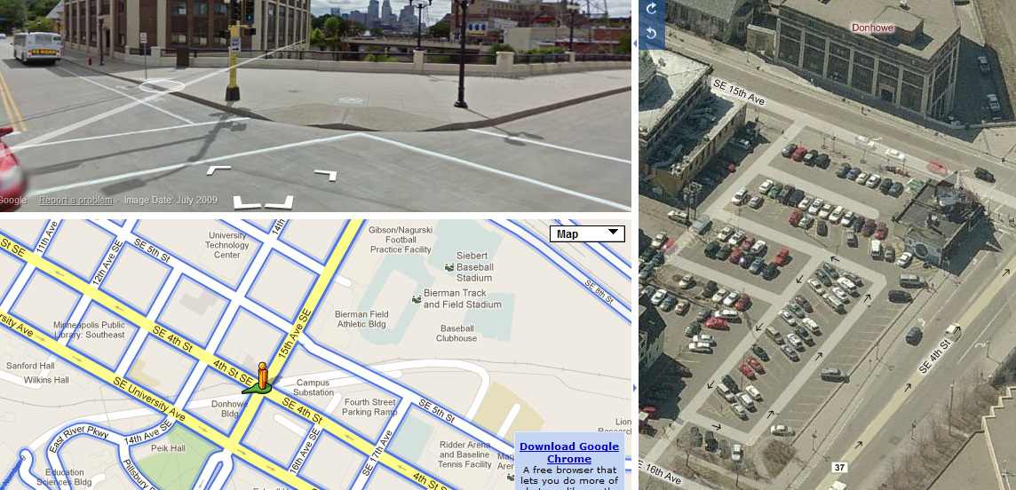
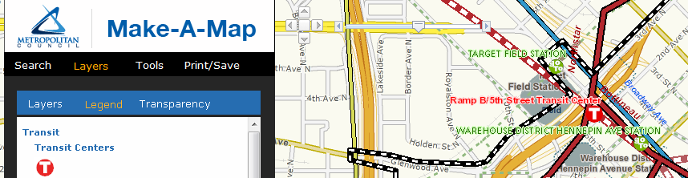
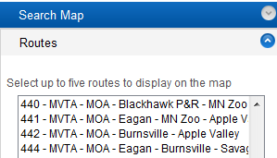
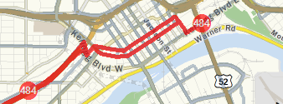
Applications and Tools
Transit
Facilities
Viewer
Make-a-Map
Transit
Interactive
Map
Notes:
Now that information was being updated at a defined interval data consumers, users had more reliable information whether those using ArcGIS desktop or once of our web mapping application such as our internal Transit Facilities Viewer or public facing applications like Maka-a-Map or the Transit Interactive Map

Slide 52
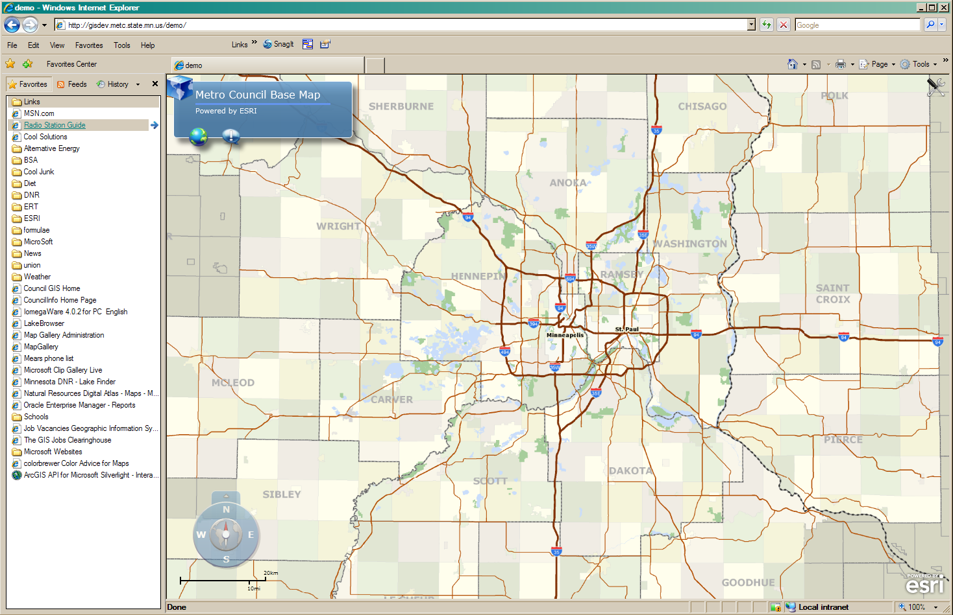
Metro Base Map Web Service
Notes:
Performance. New map at each layer. Changing cartographic process.

Slide 53

Sponsor
  Budget
  Coordinator
Regional data custodian
  Centerlines
  Parcels
  Address Points

Slide 54
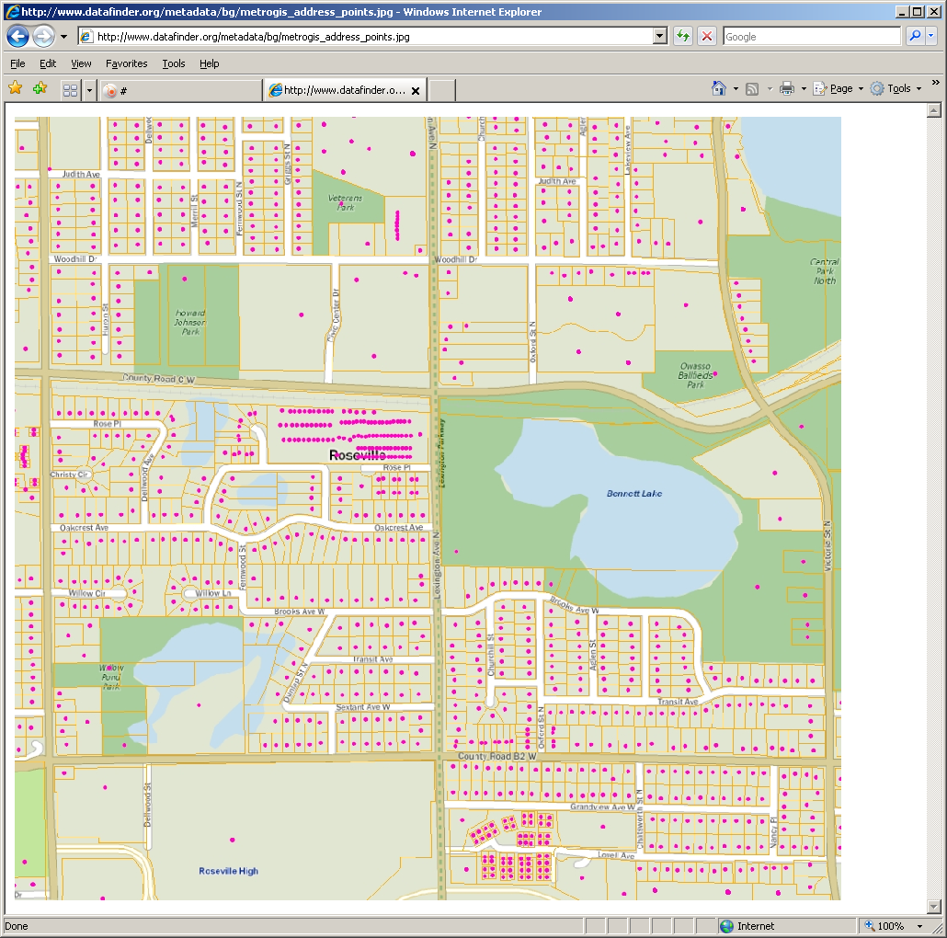

Slide 55
GIS at the Metropolitan Council
Mark Kotz
GIS Manager, Metropolitan Council
September 2014

Slide 56
Member sector report
Kari Geurts, Minnesota Department of Natural Resources

Slide 57

What’s Happening At The DNR
Presented By Kari Geurts

Slide 58
Presentation Outline
Division Projects
  Forestry’s Stand Exam Application
  Ecological Service’s MN Permitting and Reporting System
  Lands and Mineral’s Land Records System
Department Wide Project
  Data Governance Project
Data Projects
  National Wetlands Inventory Update Project
  MN Topo Project

Slide 59
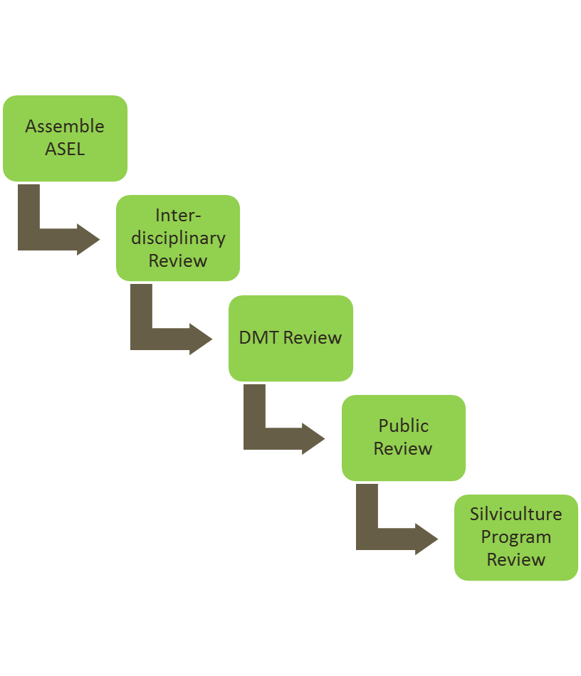
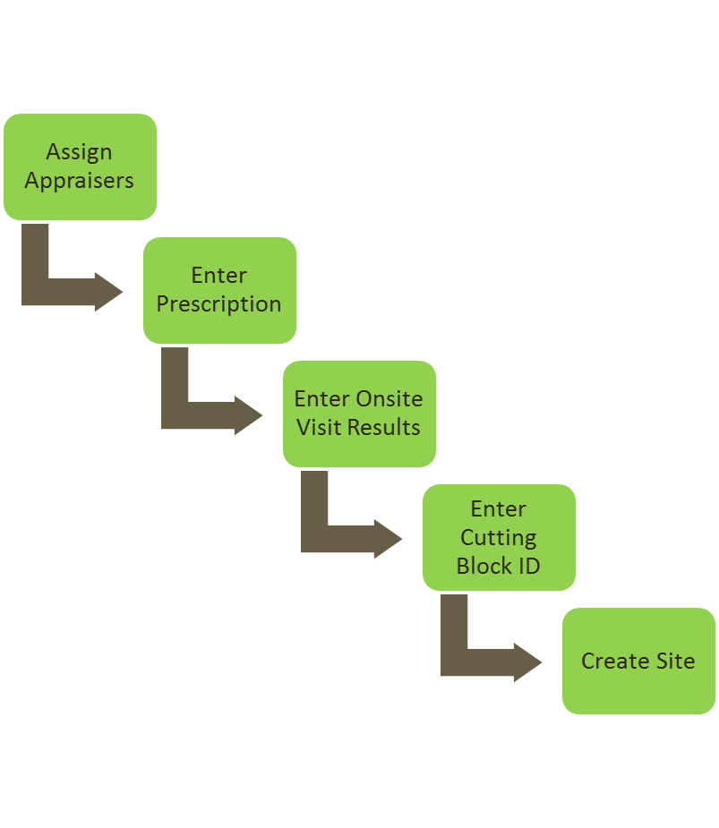
Forestry’s Stand Exam Project
SEL is an application to help Forestry manage the annual stand exam process
  Managing multiple SFRMP shapefiles will be simplified
  Replaces the data entry for disposition acres
  Replaces the prescription worksheet
  Provides an easy way to enter annual plan additions
  More accurate reporting
  Consistent roles and responsibilities

Slide 60
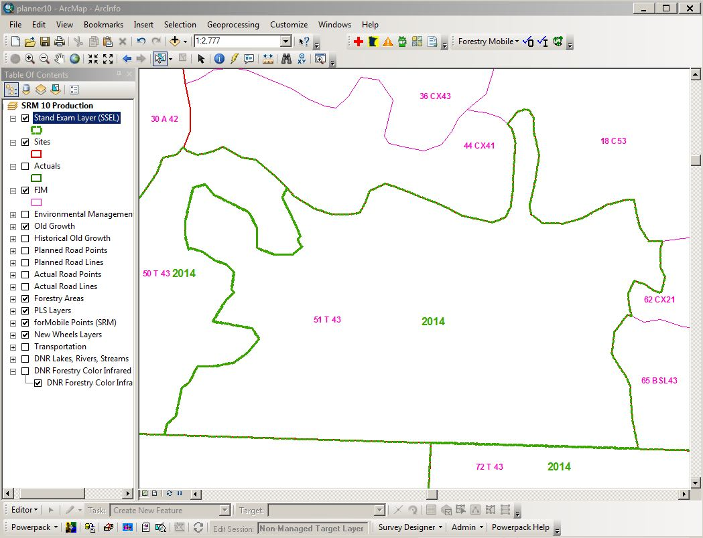
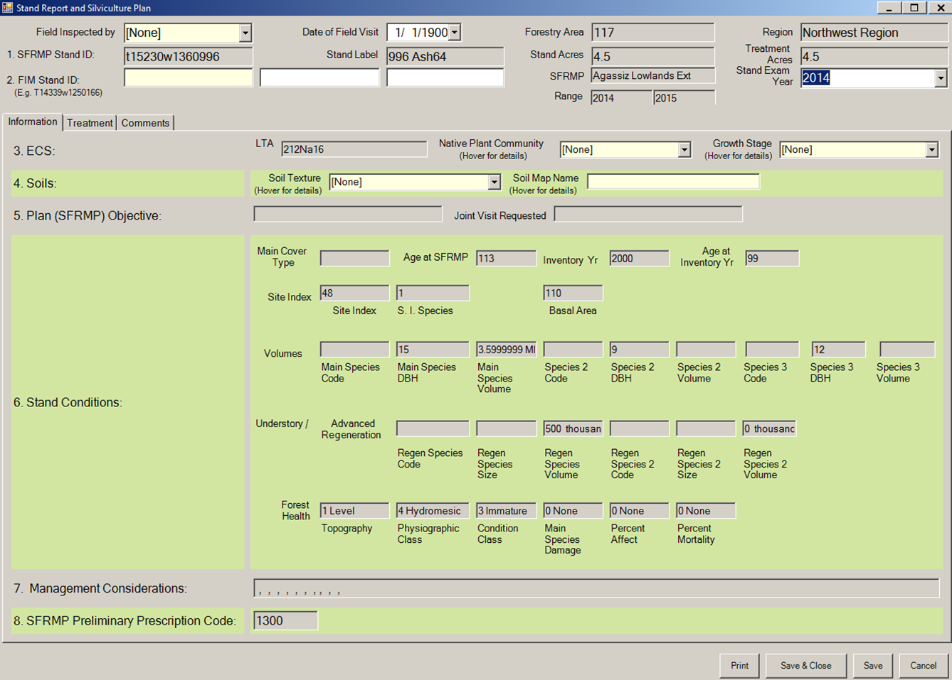
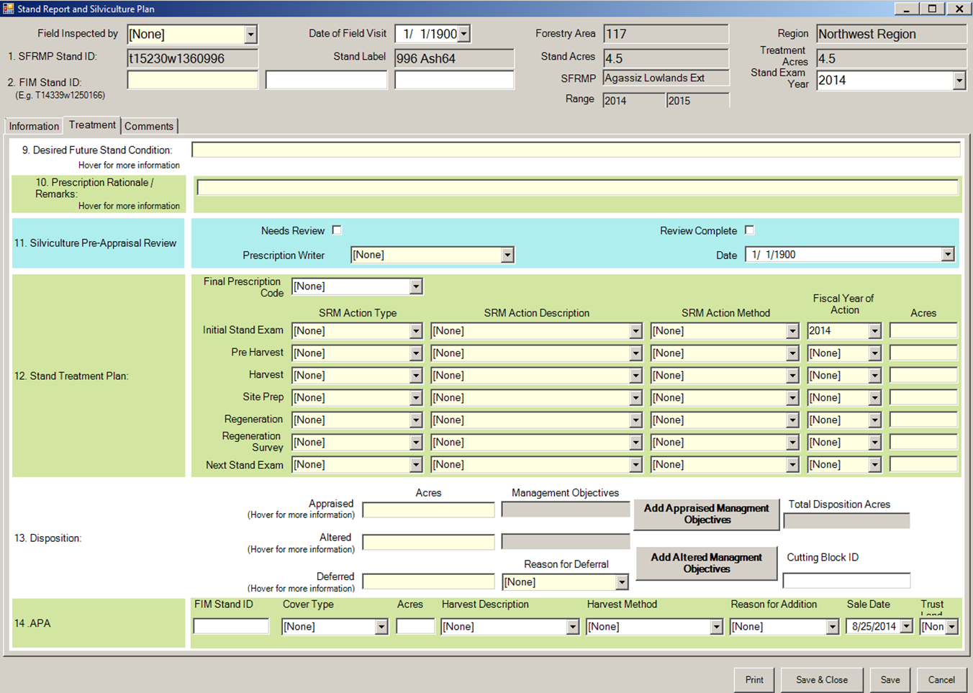
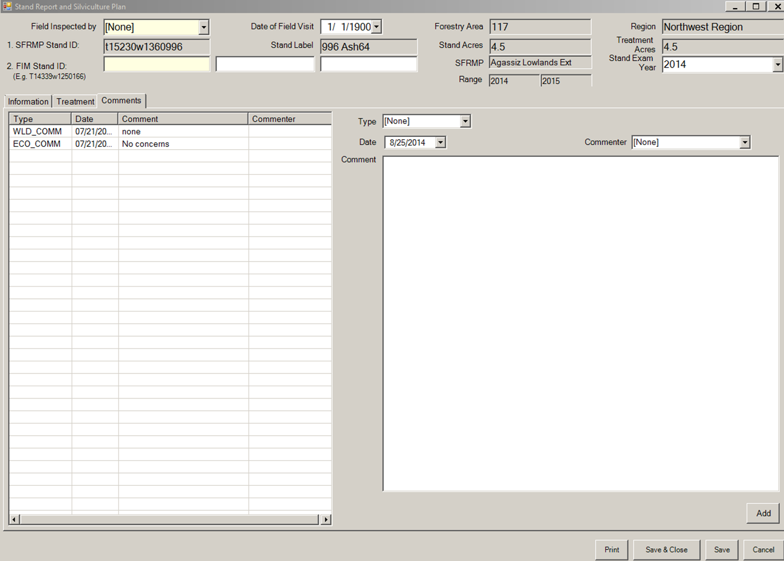
For questions contact: Kari.Geurts@state.mn.us

Slide 61
MPARS Project
In 2011 state Executive Order 11-04 and a new state law specified that:
  Water permitting be accelerated and simplified by enabling electronic applications
  Applicants be notified as to whether their applications were complete within 30-days of receipt
  A 150-day goal for permitting decisions be established
  The DNR received $900,000 in Clean Water Legacy funding to develop an electronic permitting system to meet these objective:
  The system is efficient and easy to use
  The system has positive impact on businesses and other stakeholders by providing 24/7 access
  Increases transparency, consistency and clarity in decision-making
  Increases DNR ability to track permit compliance and violations
  Is an example of a ‘Better Government for a Better Minnesota’ project
  Technology solution:
  A web-based solution for both staff and public
  Technology stack of Ruby on Rails, Postgres, free Google Earth, ArcServer, MapServer, and SAP Business Objects (reporting)

Slide 62
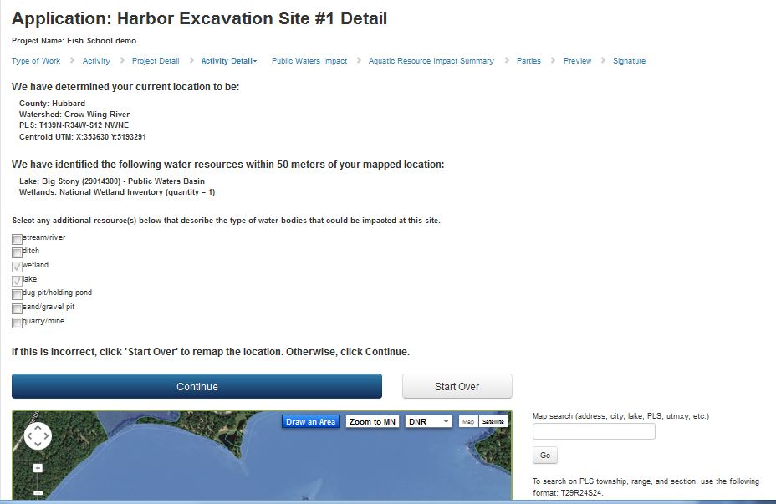
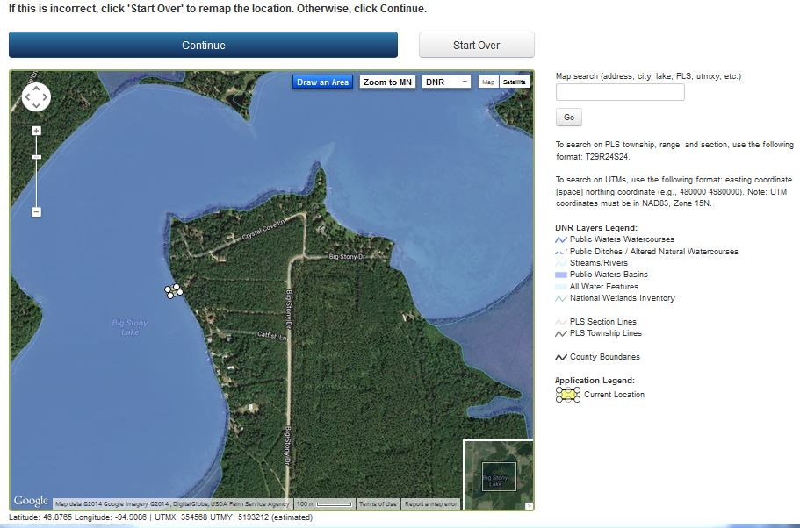
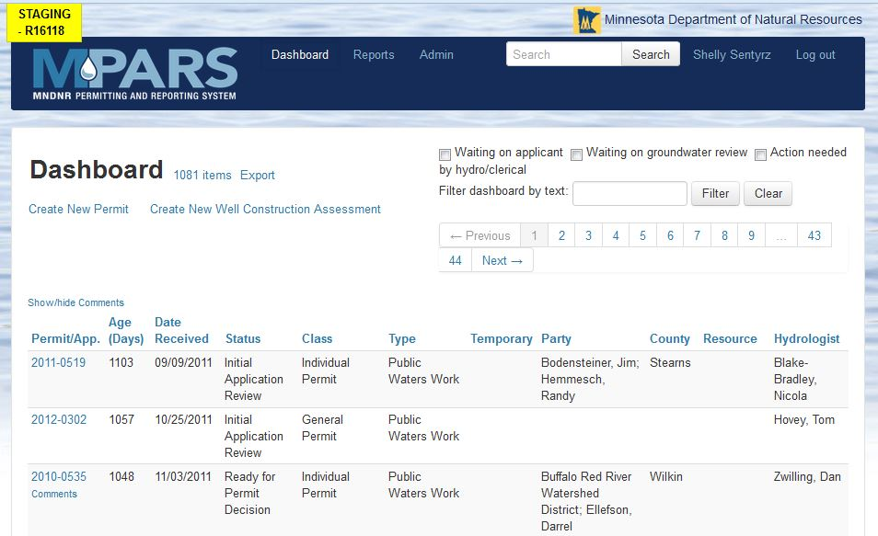
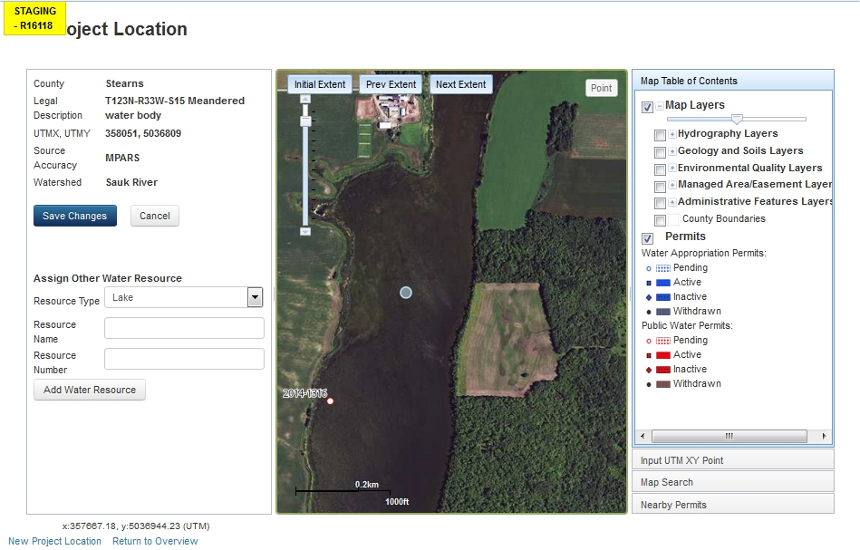
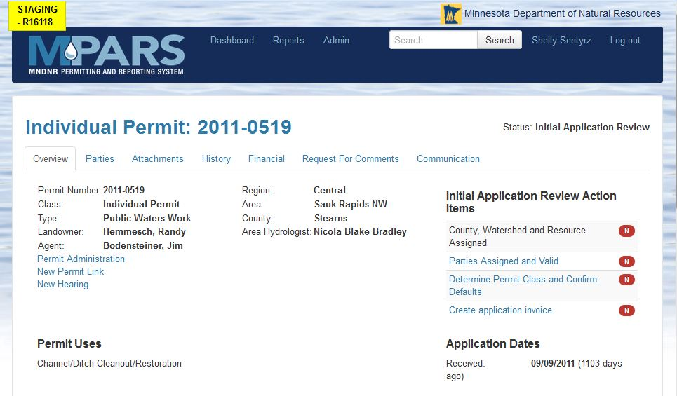

Slide 63
MPARS Project
Post-launch:
  Approximately 10,000 permit transactions annually (~2000 new permit applications)
  99% compliance of 150 day rule (lack of staff cited as reason for 69 permit applications taking longer than 150 days)
  Staff time savings for new applications, change requests, and reviewing permit details: 6965 hours annually (~$255,000)
  Approximately 95% compliance in collecting water permitting fees
  Resources :
  http://www.dnr.state.mn.us/mpars/index.html
  https://webapps11.dnr.state.mn.us/mpars/public/authentication/login
  http://hometownsource.com/2014/05/16/dnr-rolls-out-new-online-water-permit-application/
  http://news.dnr.state.mn.us/2014/09/04/speeding-up-government-dnr-achieves-99-percent-permit-efficiency-2/#more-15248
For questions contact: Shelly.Sentyrz@state.mn.us

Slide 64
Land Records System Project
Inventory of 5.5 million acres of surface rights and 12 million acres of mineral rights owned by the state
  Support for processes that buy, sell and exchange land interests, administer easements, leases, and utility crossing licenses
  Objectives:
  Data and documents easily available to all DNR staff charged with administering state land
  Improvements in efficiency and transparency in land rights conveyances
  Reliable information for land management strategy-making
  More information for the public about outdoor recreation opportunities
  System:
  Commercial off-the-shelf software with substantial configuration and customization
  Aumentum Registry from Thomson-Reuters including:
    Workflow management – jBPM
    GIS - Silverlight consuming ArcGIS Server services
    Document management - Alfresco

Slide 65
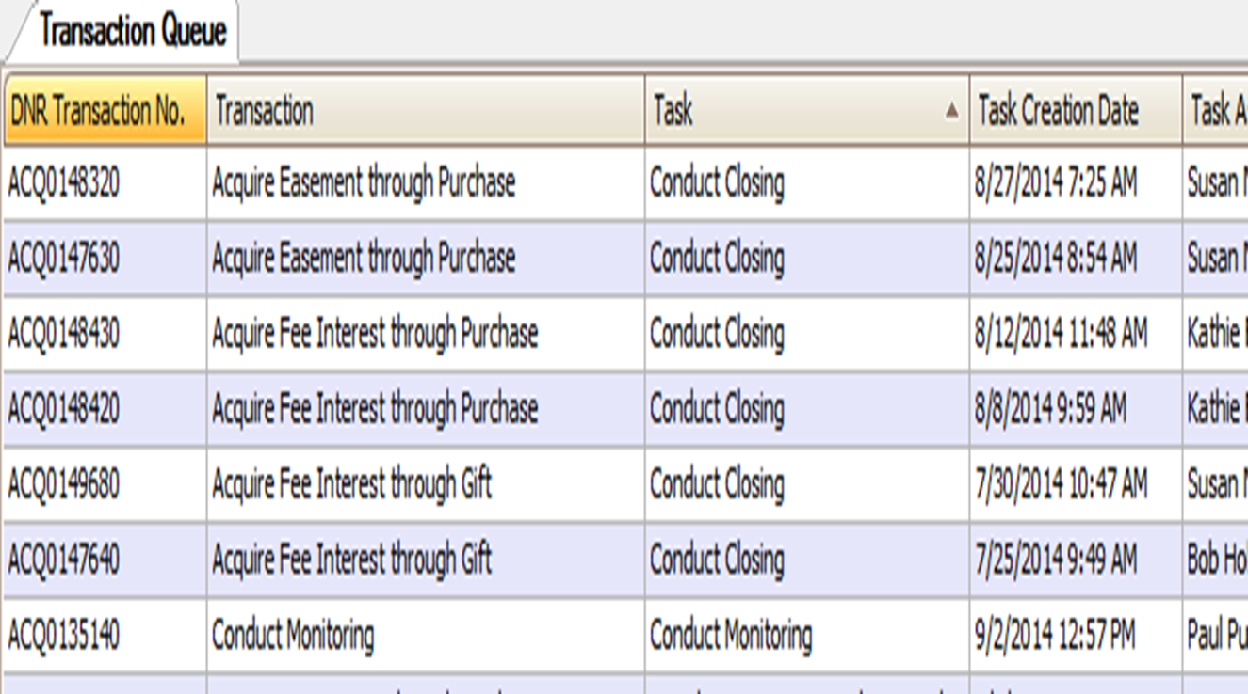
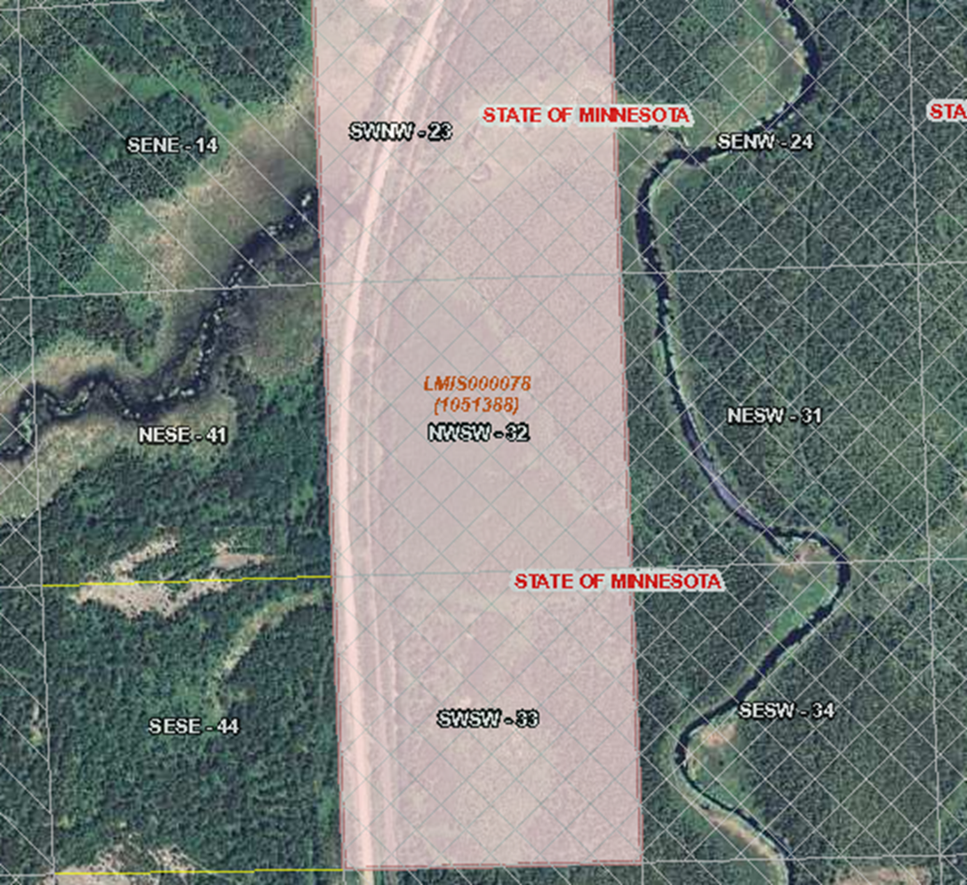
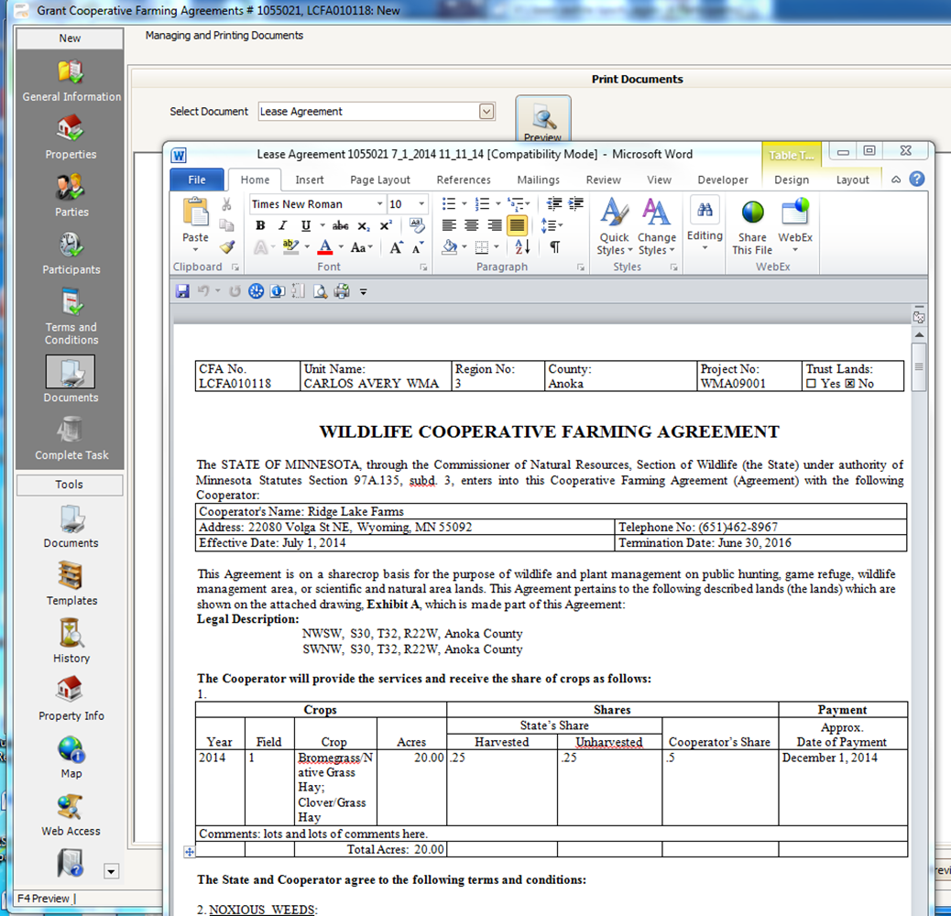
Land Records System Project
For questions contact: Mike.W.Jordan@state.mn.us

Slide 66
Data Governance Project
Developing the policies, processes, procedures, organization and technologies required to leverage data as an enterprise asset at DNR
Data policies, processes, procedures
Developing, formalizing, and integrating agency-wide data policies, processes and procedures
Assembling inventories of data and metadata, integrating data in priority domains, and making it available in useful form to DNR staff, other agencies, and the public
Data
+
Systems
Pilot
Projects
Decision Support
Organizational Capacity
Fostering improved natural resource management decision-making with various methods and software tools that integrate social, economic and ecological data
Developing and supporting key staff to develop the knowledge and skills to better manage data as an enterprise asset that advances DNR's conservation mission

Slide 67
Data Governance Project
  Following four key Strategies:
  Engage business-side, partner with IT
    Place program in DNR policy & planning office, hire lead staff
    Establish Data Governance Advisory Team
  Demonstrate value, gain buy-in
    Select & implement four pilot projects
  Leverage what we have
    Existing agency initiatives, processes, projects
  Empower data stewardship community
    Train key staff, formalize roles and responsibilities
  Pilot projects: relatively small projects that address pressing data integration and analytic challenges and that inform and test prototype data governance policies for DNR
For questions contact: Andy.Holdsworth@state.mn.us

Slide 68

Wetland Inventory Update Project
Update the National Wetland Inventory in MN
  Status and Trends program for quantity & quality
  On-line permitting and restoration database

Slide 69
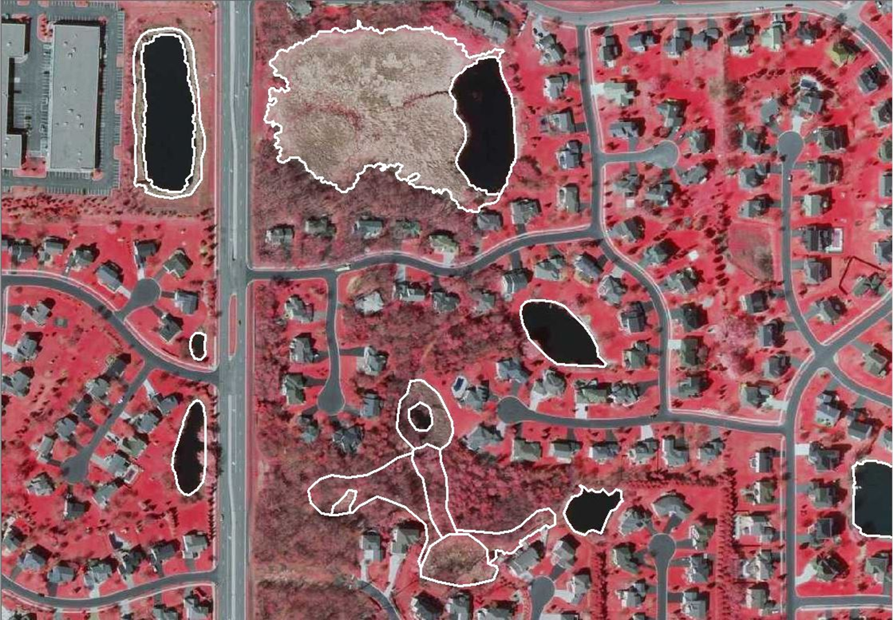
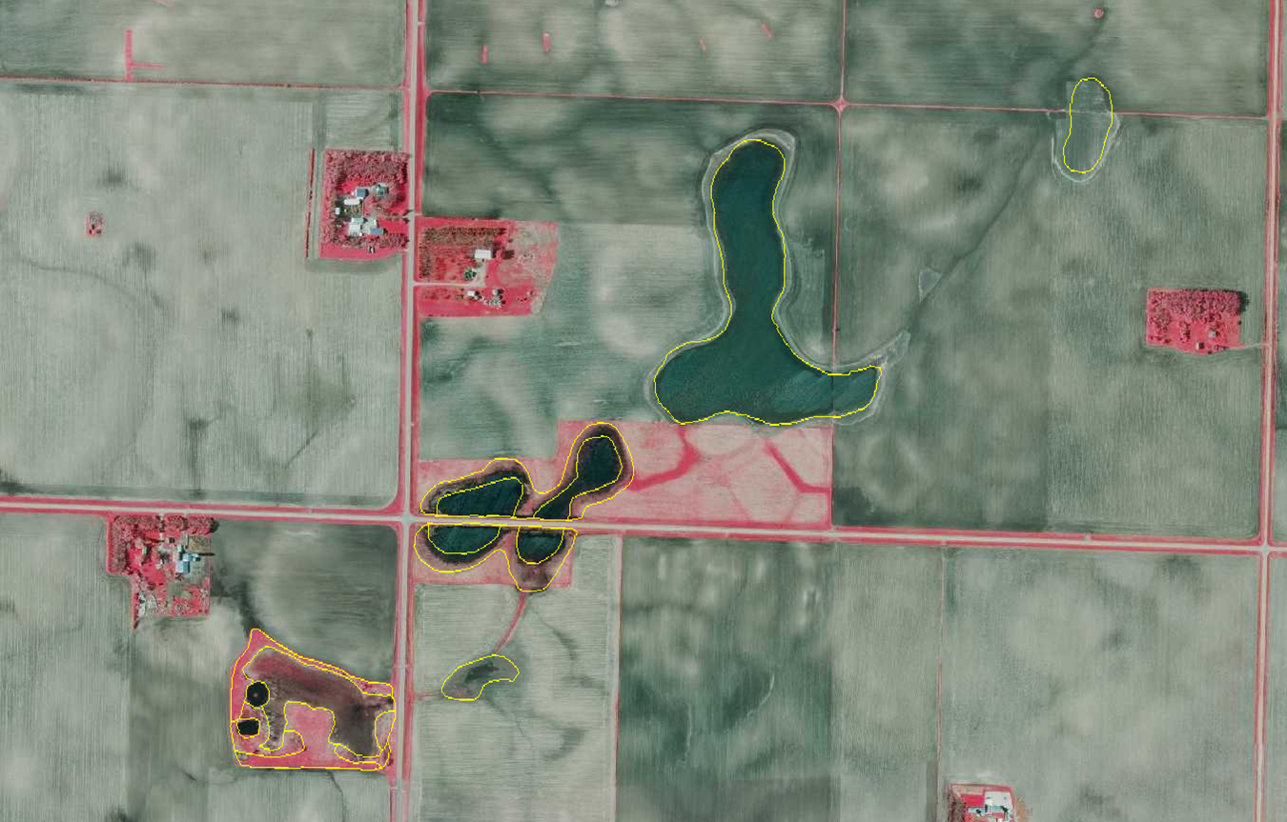
Why do we need an NWI update?
Some things have changed
Some things were probably missed

Slide 70
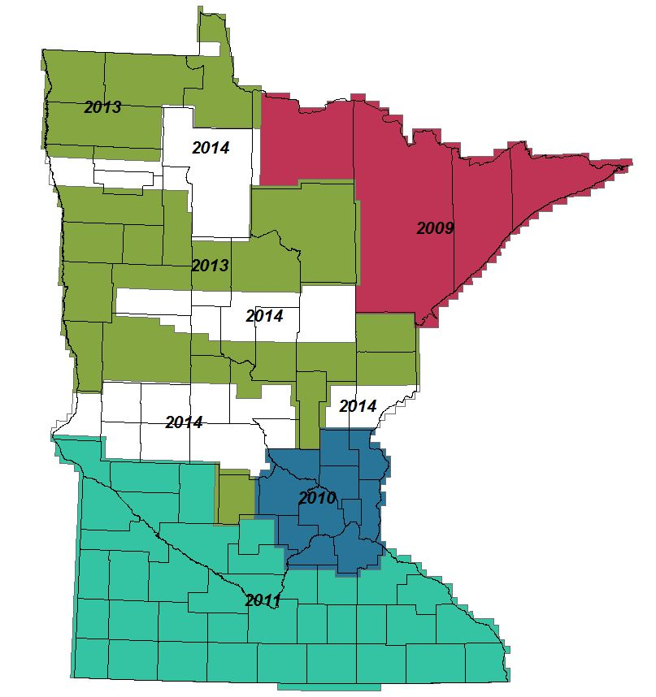

Wetland Mapping
Spring Imagery Acquisition
High resolution (0.5-m & 1-ft)
Acquisition 100% complete
Previously funded
Delivery complete by Dec 14
Conducted in Geographically Defined Phases
Complete = 9%
In-progress = 46%
Pending = 45%

Slide 71
National Wetlands Inventory Update
Data Access
  Download from DNR Data Deli
  Also download through USFWS
  Online viewing at: http://www.dnr.state.mn.us/eco/wetlands/map.html
  Benefits
  Reviewing impacts of proposed projects
  Assessing watershed water storage capacity
  Evaluating groundwater-surface water interaction
  Conducting waterfowl habitat assessment
  Stream bank buffer assessment
For questions contact: Steve.Kloiber@state.mn.us

Slide 72

MnTOPO Project
On-line Access to Elevation/LiDAR Data
Viewing and Obtaining Data
Mobile Device Ready

Slide 73


Who is using MnTOPO?
Upon its release, MnTOPO proved to be an instant success with users viewing and downloading elevation data for a wide variety of business needs:
  General public
  Real Estate Agents
  Private Sector
  Academics
  State, County, and City staff
  Non-profit organizations

Slide 74




MnTOPO: Elevation Portal
Browser Based Application
Mobile Device Ready

Slide 75






Viewing and Obtaining Data
Profile Tool
Downloading
Printing
For questions contact: Sean.Vaughn@state.mn.us

Slide 76
Questions?
Division Projects
  Forestry’s Stand Exam Application
  Ecological Service’s MN Permitting and Reporting System
  Lands and Mineral’s Land Records System
Department Wide Project
  Data Governance Project
Data Projects
  National Wetlands Inventory Update Project
  MN Topo Project
For questions contact: Kari.Geurts@state.mn.us
For questions contact: Shelly.Sentyrz@state.mn.us
For questions contact: Mike.W.Jordan@state.mn.us
For questions contact: Andy.Holdsworth@state.mn.us
For questions contact: Steve.Kloiber@state.mn.us
For questions contact: Sean.Vaughn@state.mn.us

Slide 77
Geocoding project and discussion
Mike Dolbow, MnGeo

Slide 78
Available for internal use?
No
Yes
Supports batch processing?
No
No
Statewide coverage?
Yes
Yes
Developed with local data?
Sometimes
Geocoding Option
Google Maps
Esri
MetroGIS
Yes
No
No
No
Yes
Minnesota Focused?
No
No
Yes
MSGS**
Yes
Yes
Yes
Yes
Yes
Publicly accessible?
Yes
Yes
Yes
No
Bing*
Yes
Yes
Yes
No
No
No
*Enterprise Purchase for State Agencies **NEW: MnGeo Secure Geocoding Service

Slide 79
MnGeo priority efforts and updates
Dan Ross, MnGeo

Slide 80

Statewide Addresses
Developed as part of NG9-1-1
Shaping the project now
Collaboration with DPS, State Patrol, MnDOT, local partners
AIigned with Street Centerlines
Will begin moving forward this fall

Slide 81

Statewide Aerial Imagery Partnerships
Project Overview:
Statewide 4-band, leaf-off aerial imagery
(ortho and stereo) at ½-meter resolution over 5-seasons
Sponsored by DNR for National Wetlands Inventory (NWI) update efforts; support provided through the Environment and Natural Resources Trust Fund
Buy-up opportunities offered where feasible: 12 & 6-inch resolution
22 Buy-up Partnerships:
Federal (2) f State (2) f County (15) Tribal (2) f Regional (1)
Financial Support
State Funds: $1,100,000
Partner buy-ups: $1,000,000

Slide 82


Future Proposal Under Development
Goal:
Develop a sustainable, collaborative imagery program involving state and local partners
Step 1: 2016
Meet Metropolitan Council needs for 2016 metro-wide imagery
Seek partners
Strategy:
Explore multi-year, multi-vendor flexible master contract concept
Seek State funds/in-kind contribution
Conduct county needs survey
(in progress)
2016 Imagery Plans

Slide 83




Preliminary Survey Indications
Cost Share Interest and 2016 Imagery Plans
Interest in Cost Share Opportunity

Slide 84

ArcGIS Online for State Agencies
Project Goal: Create an authoritative, multi-purpose, public-domain site of maps and web applications from Minnesota State agencies. Assist state agencies in developing their ArcGIS expertise.
Project Status: The governance document was completed in mid-June. The Minnesota Maps site is open to the public and proper metadata has been created for the maps and apps available to the public on the site.
Project Funding: There is no specific project funding for this effort.

Slide 85

Drainage Records Modernization
Project Goal: Develop a GIS database template along with data standards and a web-based data portal for Minnesota’s public drainage system records.
Project Status: A project plan has been written and a Service Authorization (SA) between the Board of Water and Soil Resources (BWSR) and MnGeo has been written but not yet executed.
Project Funding: $230,000

Slide 86



Statewide Parcels
Align with Revenue efforts
Exchange Guideline - shared
Regional Collaborations - happening
MnGeo to do parcel collect 2014
  Will obtain, aggregate, standardize, make available to state agencies
What is the best way to engage local partners?

Slide 87

MN Geospatial Commons
Data Collaboration for
Minnesota’s Geospatial Community
  Current focus:
    Publish the data resources of seven state agencies
    Streamline the publication process
  Goal:
    Today: 88 resources
    by year’s end: contain primary holdings of Data Deli, DataFinder, Clearinghouse
  At the Conference:
    Wednesday Afternoon Workshop
    Friday Presentation; Session 33
    Poster

Slide 88










Set up - MnGeo instance of Esri Roads and Highways for the partners
Conflation of non-state data
Align with Metro counties GIS Centerlines efforts
Statewide Centerline Initiative
Minnesota Geospatial Information Office Minnesota Department of Transportation
Metropolitan Council MetroGIS
To develop, test, refine, publish and perpetuate a single state- wide roadway dataset that meets the needs of a diverse user community…

Slide 89
Data sharing Initiatives
Dan Ross/Geoff Maas

Slide 90


Slide 91


Slide 92


Slide 93

Data Sharing Agreements
Goal – single agreement with partners
Approach
  MnGeo makes agreement, obtains and aggregates
  Publishes, shares as needed
    GeoCommons?, GDRS, Service
MN.IT makes agreements with individual agencies
  Why is that needed?

Slide 94
Adjourn…
See you next meeting (date TBD soon)

