Slide 1



Minnesota Geospatial Advisory Council
May 24, 2023

Slide 2
Welcome
Introductions
Approve agenda
Approve March minutes

Slide 3
Introductions
City, Greater Minnesota
  Shawn Strong, City of Brainerd
County, Twin Cities metro
  Victoria Reinhardt, Ramsey County
Regional government, Twin Cities metro
  Matt McGuire, Met Council
Regional government, Greater Minnesota
  vacant
State agencies
  Kari Geurts, DNR
  Ben Timerson, MnDOT
Federal government
  Mitch Bergeson, U.S. Geological Survey
  Jeff Bloomquist, Risk Management Agency, USDA
Tribal government
  Ryan Bonney, Shakopee Mdewakanton Sioux Community
Non-profit organizations
  vacant
Business
  Kendis Scharenbroich, Pro-West & Associates
  Gerry Sjerven, Minnesota Power
Higher Education
  Stacey Stark, U-Spatial / UMN Duluth
K-12 Education
  Shanna Crosson, U-Spatial / UMN Twin Cities
MetroGIS
  David Brandt, Washington County
MN GIS/LIS Consortium
  Leanne Knott, City of Red Wing
Surveyor
  Chris Mavis, Hennepin County
At-large
  Alex Steele, Minnehaha Creek Watershed District
  Heather Albrecht, Hennepin County

Slide 4
Agenda
Time | Topic |  | Time | Topic
11:00 | Introductions, approve agenda and previous minutes |  | 12:05 | Break & networking
11:15 | Review and Accept Committee Reports |  | 12:35 | Climate Resiliency Introductory Discussion
11:25 | Contributing to Nationwide and Commercial Data Assets Workgroup |  | 12:40 | Types of LiDAR
11:30 | Governor's Certificate Awards for Exemplary Geospatial Projects |  | 12:50 | Sector Report: K-12 Education
11:35 | Next GAC term applications |  | 1:00 | Legislative Updates
11:40 | PLSS Legislation Update |  | 1:10 | GAC priority projects and initiatives update
11:50 | PLSS remonumentation grant oversight |  | 1:30 | Announcements
11:55 | Utilizing First Generation Legacy Breachlines with new High-Resolution Lidar Derived DEM’s |  | 2:00 | Adjourn

Slide 5
Agenda Item 2
Committee Reports – Review and Accept
All

Slide 6
Agenda Item 3
Contributing to Nationwide and Commercial Data Assets Workgroup
David Brandt

Slide 7
Agenda Item 4
Governor's Certificate Awards for Exemplary Geospatial Projects
Len Kne

Slide 8
Agenda Item 5
2023-2025 GAC term applications
Cory Richter, Nancy Rader

Slide 9
Next GAC Term
All member terms end June 30, 2023
The next two-year term will run July 1, 2023 – June 30, 2025
Applications are submitted through the Open Appointments process administered by the Minnesota Office of the Secretary of State
Current GAC members who wish to continue will need to re-apply

Slide 10
Agenda Item 6
PLSS Legislation Update
Pat Veraguth

Slide 11
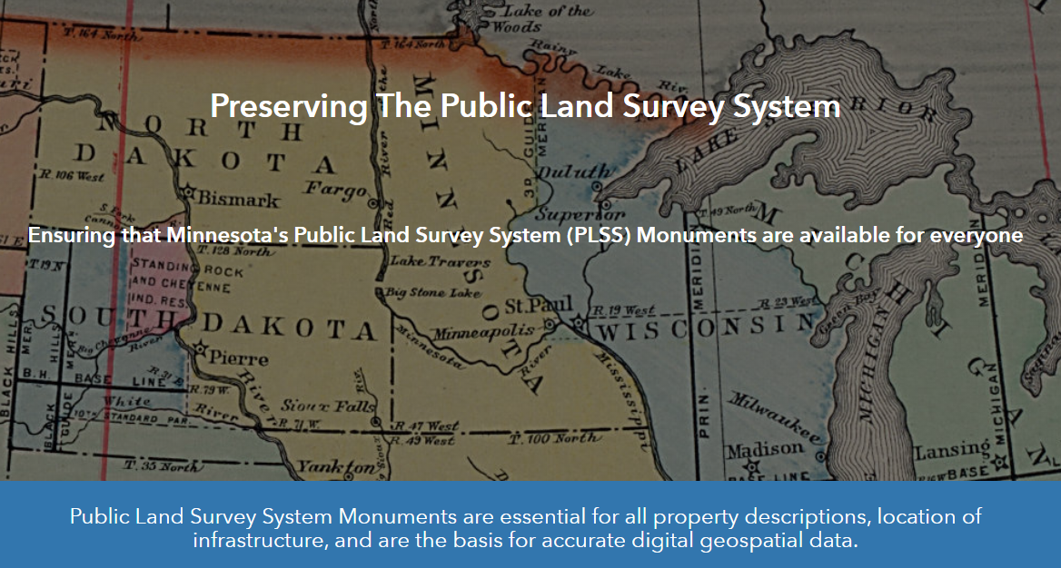

Slide 12
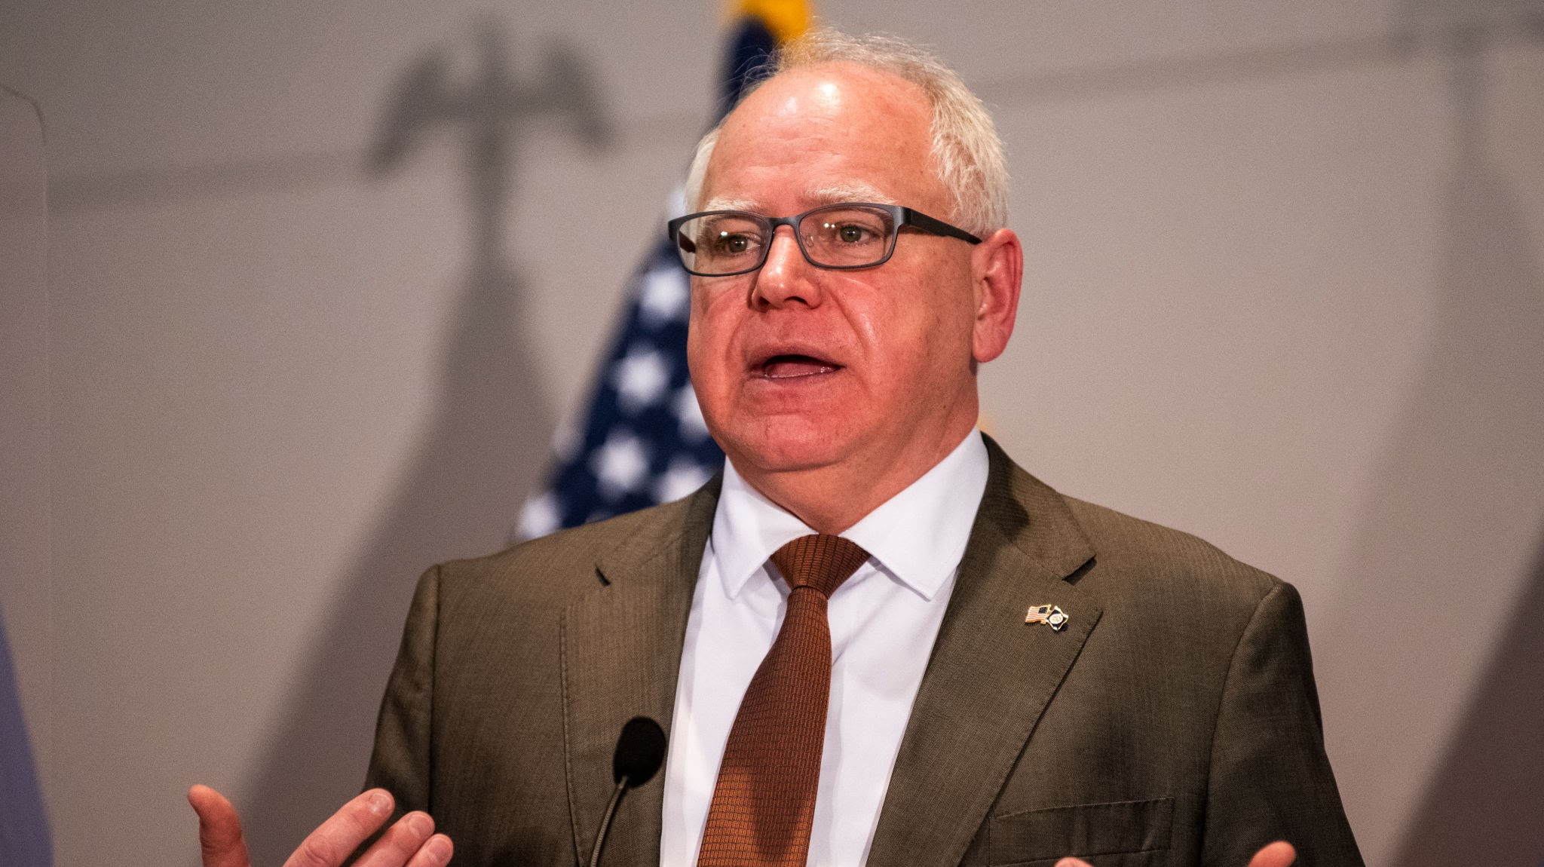
Governor’s Signature

Slide 13
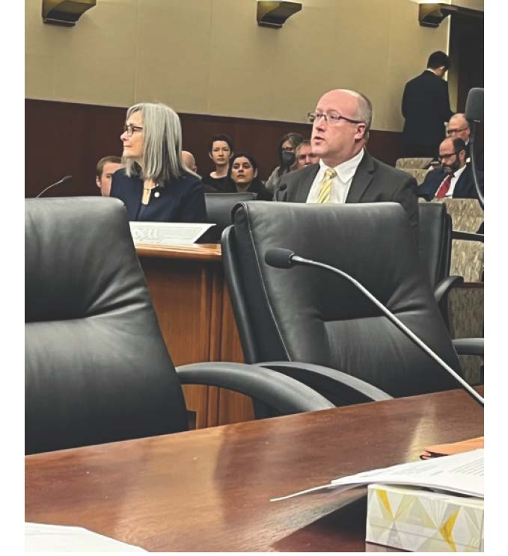

MSPS hired a Lobbyist
Phil Raines

Slide 14
House File 1231 and Senate File 1659
Sec. 2. [381.125] PUBLIC LAND SURVEY SYSTEM MONUMENT GRANT PROGRAM.
Subdivision 1. Grant program. The chief geospatial information officer, through the Geospatial Advisory Council established under section 16E.30, subdivision 8, shall work with the stakeholders licensed as land surveyors under section 326.02, to develop a process for accepting applications from counties for funding for the perpetuation of monuments established by the United States in the public lands survey to mark public land survey corners, as provided in section 381.12, subdivision 2, clause (1). Grants may also be used to update records and data regarding monuments. The chief geospatial information officer must establish criteria for prioritizing applicants when resources available for grants are not sufficient to award grants to all applicants. The criteria must favor providing grants to counties that demonstrate financial need for assistance.
Subd. 2.Report.By October 1, in each odd-numbered year, the chief information officer must submit a report to the chairs and ranking minority members of the committees in the senate and the house of representatives with jurisdiction over state government and local government. The report must include the following:
(1) a summary of the chief information officer’s activities regarding administration of this grant program for the previous fiscal year, including the amount of money requested and disbursed by county.
(2) an assessment of the progress toward completion of necessary monument restoration 2.16 and certification by county; and
(3) a forecast of the amount needed to complete monument recertification in all counties.
Subd. 3.Nonstate match. No nonstate match is required for grants made under this program.

Slide 15
House File 1231 and Senate File 1659
Sec. 3. APPROPRIATION.
$10,000,000 in fiscal year 2024 is appropriated from the general fund to the chief information officer for the grant program under section 381.125. Up to four percent of this appropriation may be used by the chief geospatial information officer for administration of this program. The base for this appropriation in fiscal years 2025 through 2029 is $10,000,000. The base for this appropriation in fiscal year 2030 and each fiscal year thereafter is $0.
(b) $1,000,000 in fiscal year 2024 is appropriated from the general fund to the chief information officer for grants to counties to employ county technical staff to aid surveyors marking public land survey corners. The base for this appropriation in fiscal years 2025 through 2029 is $1,000,000. The base for this appropriation in fiscal year 2030 and each fiscal year thereafter is $0.

Slide 16
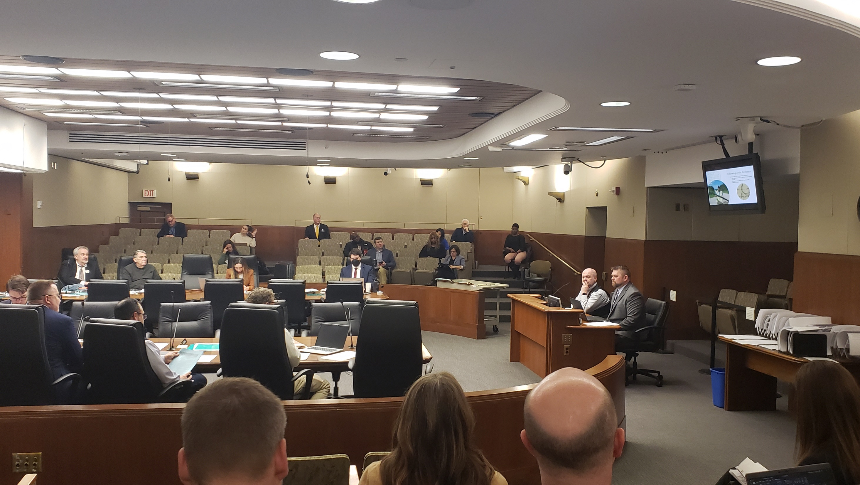
State Government Committees
Bill was submitted in the House and Senate
Bill was assigned to the State Government Committees
Had a hearing scheduled on February 23rd. Cancelled due to snow.
Rescheduled for March 3rd.

Slide 17
House State Government Committee Meeting.
Preston Dowell and Geoffrey Maas both testified with Representative Mike Freiberg.
Bill was included in the House State Government Committee Omnibus Bill HF 1830.

Slide 18
Survey Crew after the hearing.

Slide 19
Senate State Government Committee
We thought we had a hearing in the Senate State Government Committee, but they ran out of time!
We did not get a hearing in the Senate State Government Committee.
Phil said it could be included without a hearing.
We found out that there was a hearing for the Senate State Government Committee Omnibus bill. SF 1426 March 31 and found out that we were included!!
Phil Raines and Geoffrey Maas testified.

Slide 20
House File 1830 and Senate File 1426
State Government Omnibus Bill
Public Land Survey System Appropriation
$16,000,000 the first year and $4,000,000 the second year are for the grant program authorized by Minnesota Statutes, section 381.125. Up to four percent of this appropriation may be used by the chief geospatial information officer for the administration of the grant program. This is a onetime appropriation and is available until June 30, 2027.
$1,000,000 each year is for grants to counties to employ county technical staff to aid surveyors marking public land survey corners. This a onetime appropriation.

Slide 21
House File 1830 and Senate File 1426
State Government Omnibus Bill
The House State Government Committee omnibus bill has been sent to the House Ways and Means Committee.
The House Ways and Means Committee heard State government Omnibus bill HF1830 on Wednesday April 12th and it was placed on the House General Register.
The Senate State Government Committee omnibus bill has been sent to the Senate Finance Committee.
Omnibus bill went to the House Ways and Means Committee, Approved
Omnibus bill went to the Senate finance committee, Approved.

Slide 22
House File 1830 and Senate File 1426
State Government Omnibus Bill
House approved it April 18th,
Senate approved it. April 21, 34-33
Went to Conference Committee.
Conference Committee reallocated funds from $22 Million for two years to $9.7 Million for one year.
Conference Committee Approved May 13th.
House approved final bill on May 19th, 69-62
Senate approved final bill on May 21st, 34-31
Waiting on Governor’s signature

Slide 23
House File 1830 and Senate File 1426
State Government Omnibus Final Bill
Public Land Survey System Appropriation.
$9,700,000 the first year is for the grant program authorized by Minnesota Statutes, section 381.125, and for grants to counties to employ county technical staff to aid surveyors making land survey corners. Up to six percent of this appropriation may be used by the chief geospatial information officer for the administration of the grant program. This is a onetime appropriation and is available until June 30, 2027.

Slide 24
The Next Steps
PLSS Preservation Committee Charter
Hire Surveyor Coordinator to work in MnGeo.
Develop a model plan.
Develop a Grant application.
PLSS Data Standards
Supplemental Budget Bill for next year
Outreach
Get all counties to apply.

Slide 26
Agenda Item 7
PLSS remonumentation grant oversight
Chris Mavis

Slide 27
Agenda Item 8
Utilizing First Generation Legacy Breachlines with new High-Resolution Lidar Derived DEM’s
Rick Moore

Slide 28
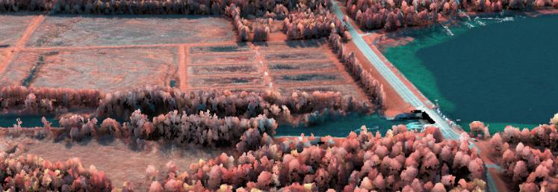
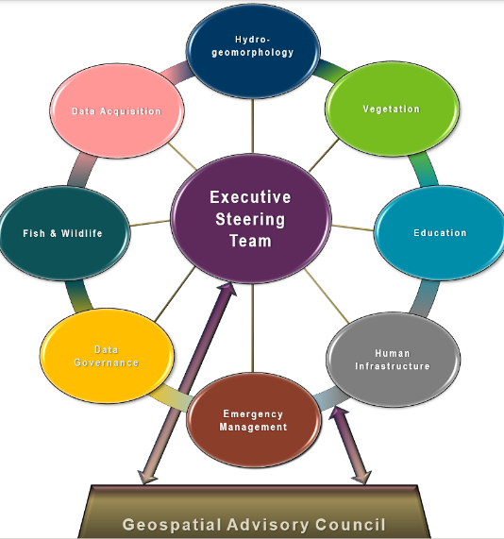
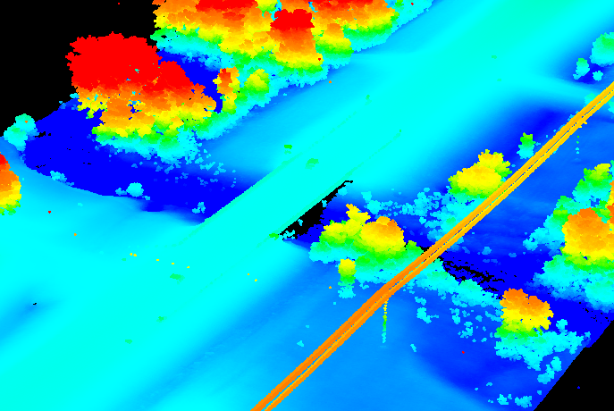
3D Geomatics DEM Hydro-modification Subgroup
Standards, Methodology & Breachline Pilot Project
Rick Moore , MNIT@DNR DEM Hydro-mod Subgroup Chair Kiah Sagami, Houston Engineering DEM Hydro-mod Subgroup Member | Sean Vaughn, MNIT@DNR DEM Hydro-mod Subgroup Liaison Sarah Porter, USDA-ARS DEM Hydro-mod Subgroup Member Jeff Knopf, St. Mary’s University of Minnesota DEM Hydro-mod Subgroup Member
Tuesday, May 24, 2023
11:00 PM
GAC hydroMOD Presentation

Slide 29
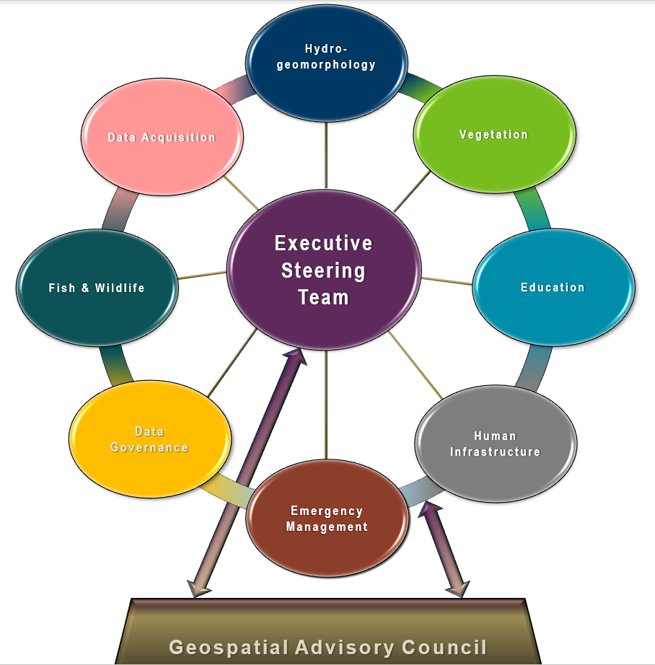
Geospatial Advisory Council (GAC) 3D Geomatics Committee
3D Geomatics Committee
The 3D Geomatics Committee (3DGeo) is a committee under GAC that works to identify and promote the need for planning, funding, acquisition, and management of three-dimensional geomatic data and derived products.
Notes:
Sean – 3DGeo Background
What is the GAC?
The Minnesota Geospatial Advisory Council is the coordinating body for the Minnesota geospatial community.
Cross-section of organizations that include counties, cities, universities, business, nonprofit organizations, federal and state agencies, tribal government, and other stakeholder groups.
What is the 3D Geomatics Committee?
The 3D Geomatics Committee (3DGeo) is a committee under GAC that works to identify and promote the need for planning, funding, acquisition, and management of three-dimensional geomatic data and derived products.
Sector Expertise
Lidar acquisition relies on subject matter expertise from different sectors in 3DGeo

Slide 30
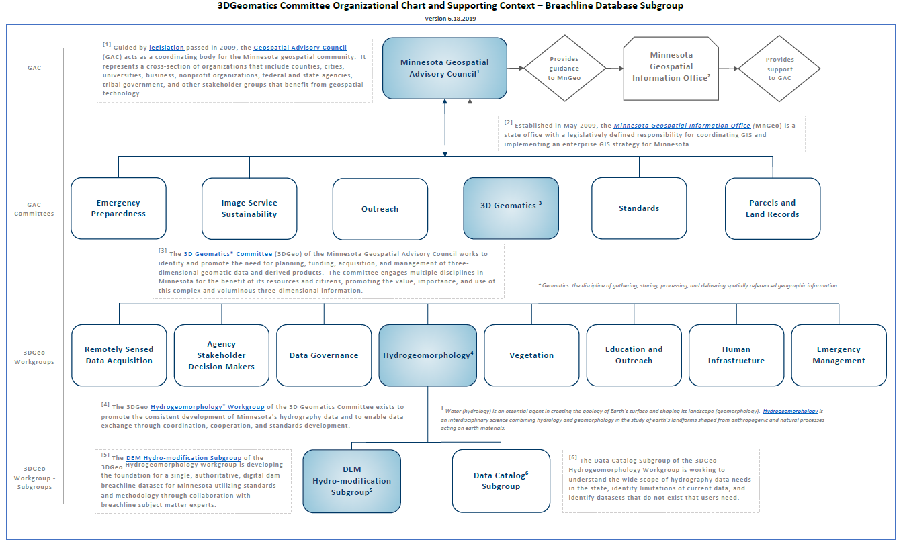
3D Geomatics Organizational Chart

Slide 31

Digital Elevation Model (DEM) HYDRO-MODIFICATION
Note: DEM Hydro-modification = DEM Conditioning
DEM HYDRO-MODIFICATION - IS - DIGITAL DAM REMOVAL
DEM Hydro-modification: is a digital depression examination process that uses terrain analysis tools in a geographic information system (GIS) to modify lidar-derived, raster-cell elevation values (Z-values) in digital elevation models (DEM) resulting in a hydro-modified DEM (hDEM).

Slide 32
Next
DEM Hydro-modification Subgroup
Notes:
Rick Moore
LiDAR Data Steward and Watershed Data Steward
Involved in DEM Hydro-modification for past 10 years – 5 with the MNIT @ MN DNR
Co-Chair the Hydro-geomorphology Workgroup and Chair the DEM Hydro-modification Subgroup

Slide 33
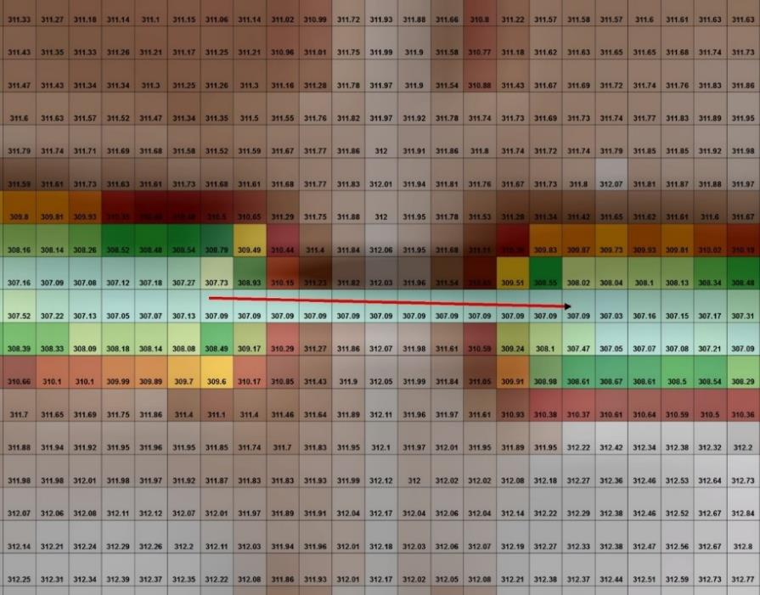
3D-Geomatics → Hydro Workgroup → DEM Hydro-modification Subgroup
Mission:
Dedicated to developing the foundation for single, authoritative, digital dam breachline and hDEM datasets for Minnesota utilizing standards and methodology developed through collaboration with breachline subject matter experts
Workgroup
Co-chairs
  Rick Moore
  Liaison
    Sean Vaughn

Slide 34
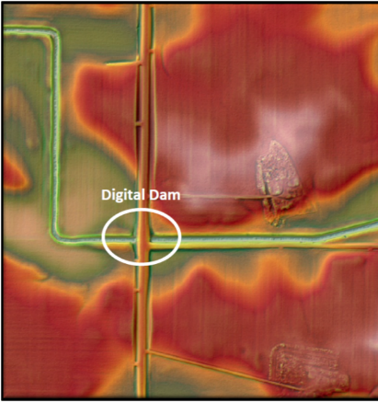
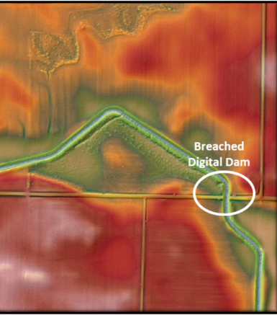
3D-Geomatics → Hydro Workgroup → DEM Hydro-modification Subgroup
Purpose of the DEM Hydro-modification Subgroup
Capitalize on knowledge of subject matter experts who have built their own individual digital dam breachline datasets and perform hydro-modification.
Develop Standards, Methodology, and QA/QC Protocol to support DEM hydro-modification and development of the breachline dataset.
Publish these features into one authoritative breachline dataset for use in developing hydro-modified digital elevation models (hDEMs).
Support public and private business needs associated with hydrologic modeling of the landscape using hydro-terrain analysis tools (e.g., PTMApp and ACPF).

Slide 35
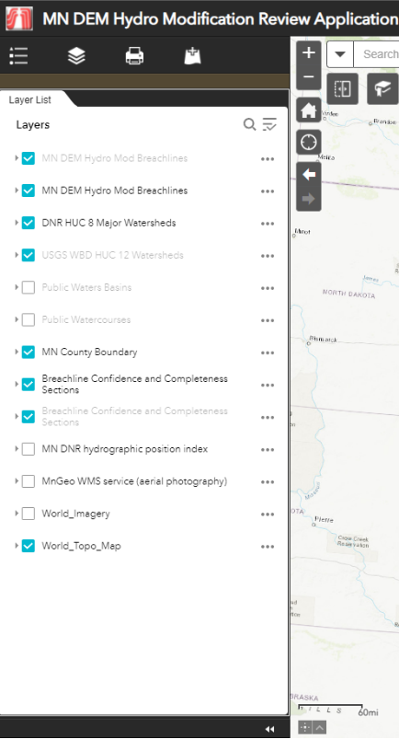
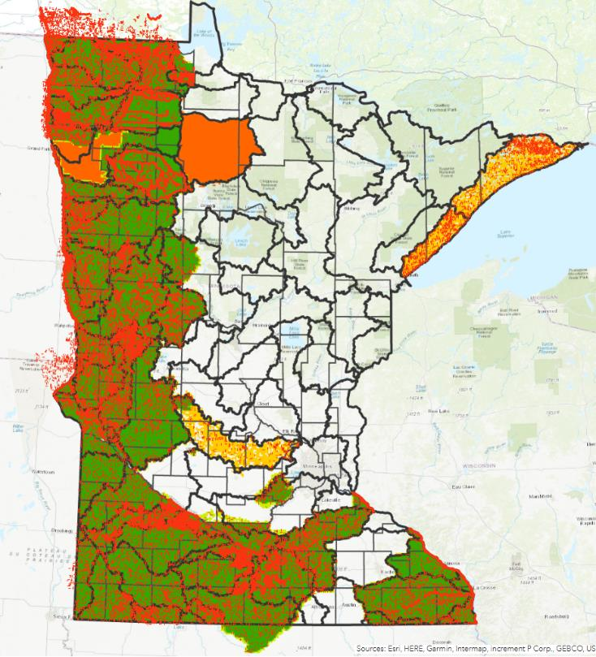
Breachline Data and Work Area Identification
MN DEM Hydro-modification Review Application
Clean Water Funded Breachline Database
Confidence and Completeness of Breachlines
Breachline Data and Hydro-modification Work Area Identification
https://geospatialservices.smumn.edu/portal/apps/webappviewer/index.html?id=0ca8324417194a82b9b748192d1d175f

Slide 36
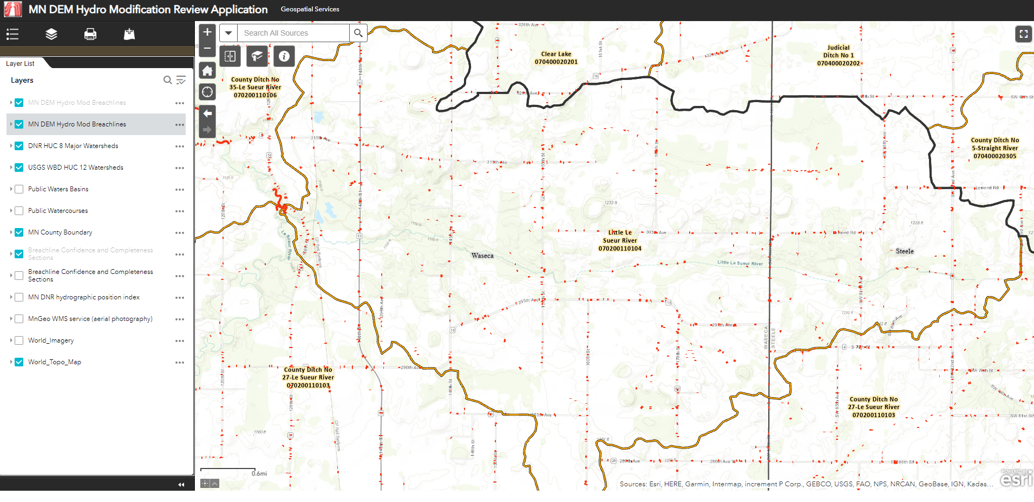
Breachline Data

Slide 37

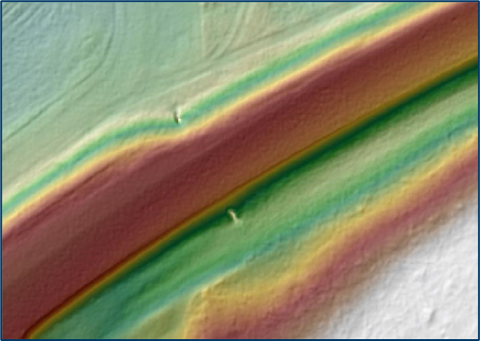
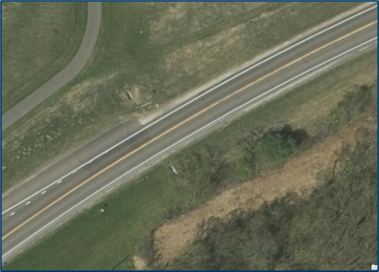

High Resolution DEM – Breachline Pilot Project
3-meter DEM (2008-2012 Lidar Collect)
1-foot DEM
(2021 30 Points per m² Lidar Collect)
1-meter DEM (2008-2012 Lidar Collect)

Slide 38
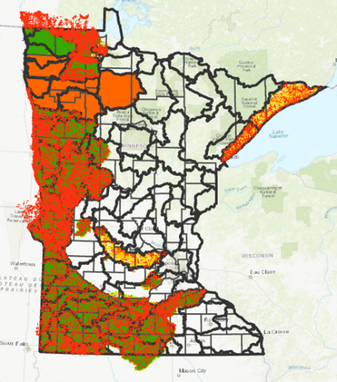
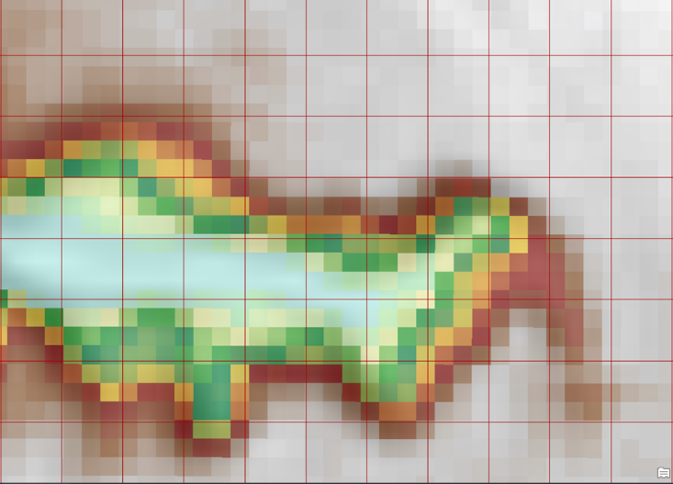
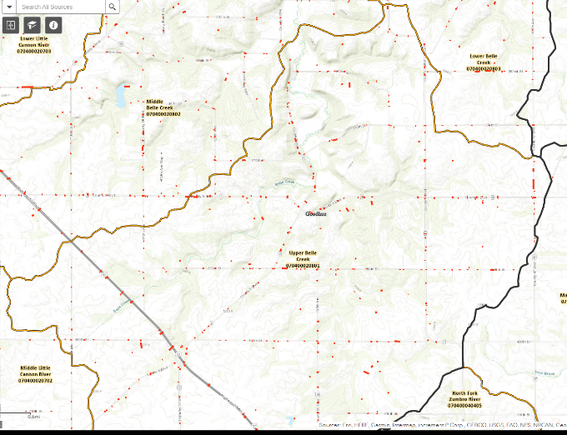
High Resolution DEM – Breachline Pilot Project
How well do the First Generation breachlines work with the newly collected LiDAR datasets?
1-foot (Pilot Project) and 0.5-meter Digital Elevation Models (DEMs)
1stGen Breachlines
1-foot DEM
Belle Creek HUC 12 Pilot Project
Notes:
Goodhue County High Resolution DEM - Breachline pilot project: Pilot project to inform future efforts of using existing breachlines with the high-resolution DEMs from the current Lidar collect. Lessons learned and best practices from the research will help inform future DEM hydro-modification projects. A research paper detailing the study area, data, methods and conclusions is in process and will be available in last quarter of 2022.

Slide 39
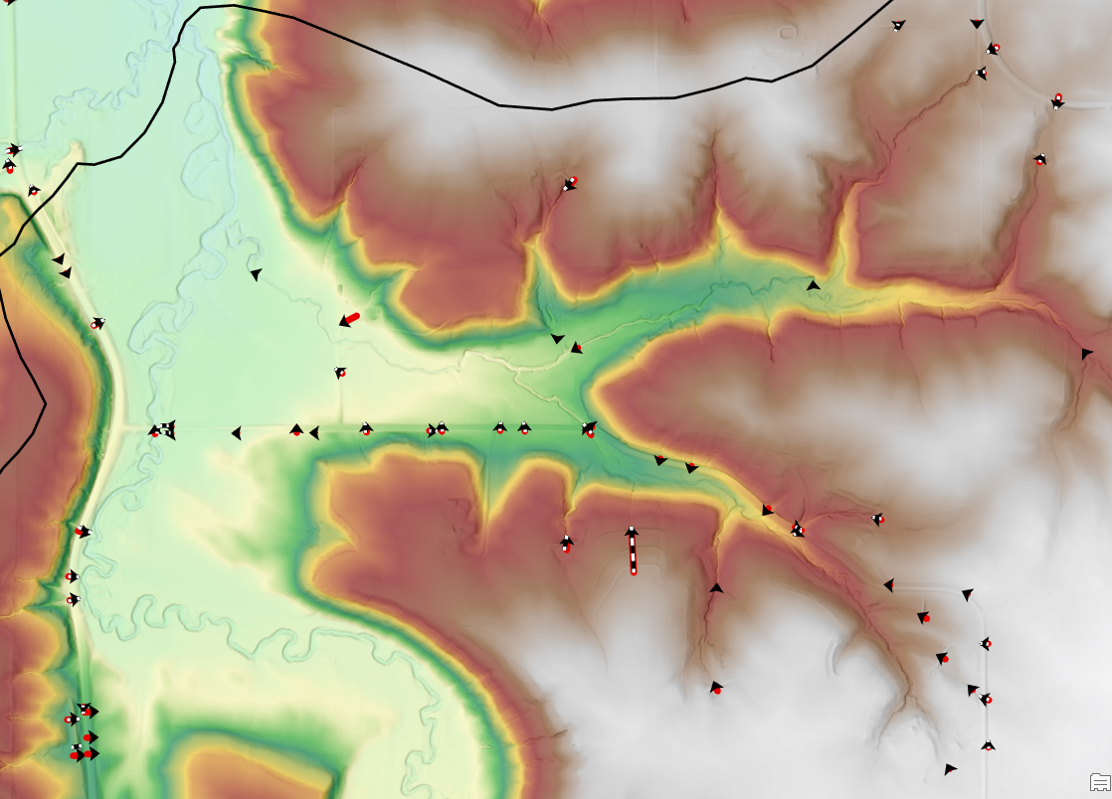
High Resolution DEM – Breachline Pilot Project
Objectives:
Inform future efforts of using existing First Generation Breachlines with the high-resolution DEMs from the current Lidar collect.
Lessons Learned and Best Practices from the research will help inform future DEM hydro-modification projects.
Notes:
Goodhue County High Resolution DEM - Breachline pilot project: Pilot project to inform future efforts of using existing breachlines with the high-resolution DEMs from the current Lidar collect. Lessons learned and best practices from the research will help inform future DEM hydro-modification projects. A research paper detailing the study area, data, methods and conclusions is in process and will be available in last quarter of 2022.

Slide 40
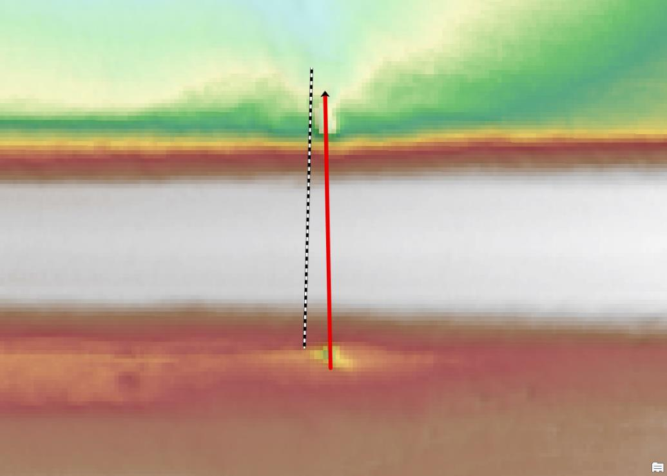
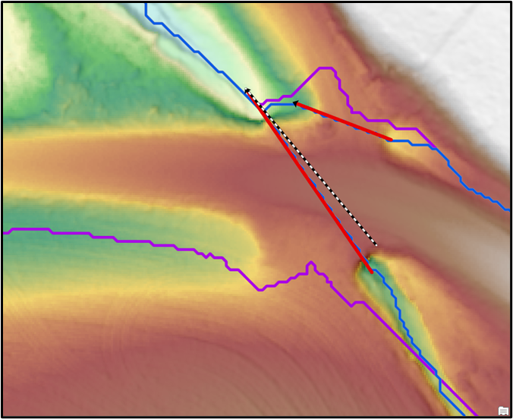
High Resolution DEM – Breachline Pilot Project
Black and white dashed line = Legacy Breachline
Red line with arrow = High Resolution Breachline
Purple line = Legacy Breachline Flow Pathway
Blue line = High Resolution Breachline Flow Pathway

Slide 41
Question and Technique
Question:
How well do First Generation Breachlines work with the newly collected LiDAR dataset (1 ft DEM)
Technique
Run hydro-modification process using 1stGen breachlines (digitized from 3-m DEM circa 2008-2012)
Create flowpaths for 1-acre drainage areas
Inspect every legacy breachline and resultant flowpath - classify breachline as “acceptable” or “not” based on business need
Adjust every legacy breachline to match the low cells upstream and downstream on the new DEM
Add new breachlines where necessary
Run hydro-modification process using edited 1stGEN (Step 4) and newly created breachlines (Step 5)
Create flowpaths for 1-acre drainage areas and compare with first generation breachline flowpaths

Slide 42
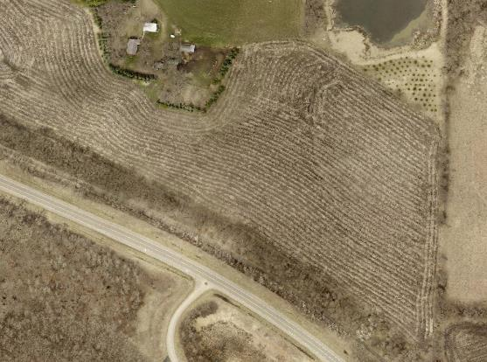
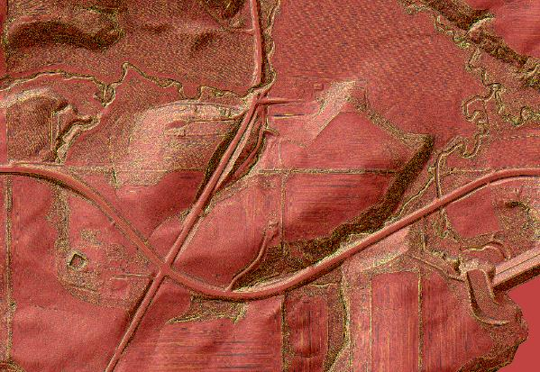
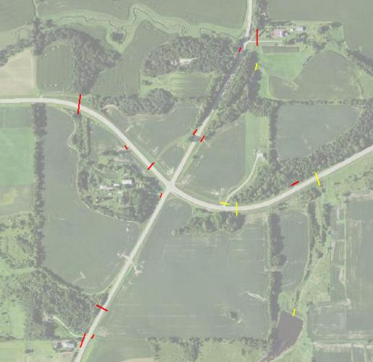
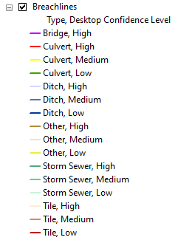
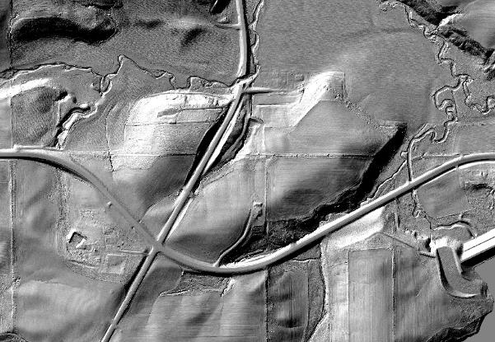
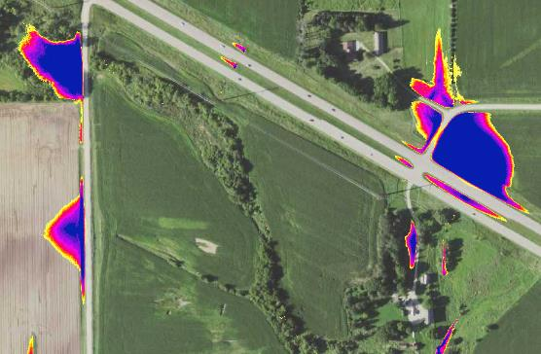
Technique
Collateral Datasets
High Resolution
Imagery
Hydrographic Position Index
Impeded Flow Model
Hillshade
Notes:
Numerous collateral data are used to determine if there is a culvert crossing at a specific location. One of the best datasets is legacy breachlines. The other and what I want to speak to is the new high resolution dem

Slide 43
Results
492 legacy breachlines: 475 (96%) produced acceptable output using new DEM
310 new breachlines created – this is significant
54% of omitted breachlines considered unacceptable given my intended usage
Category | Breachline Acceptance | Count of Breachlines
Legacy | Acceptable (without editing) | 475
 | Not Acceptable (without editing) | 17
New | Acceptable (if omitted) | 142
 | Not Acceptable (if omitted) | 168

Slide 44
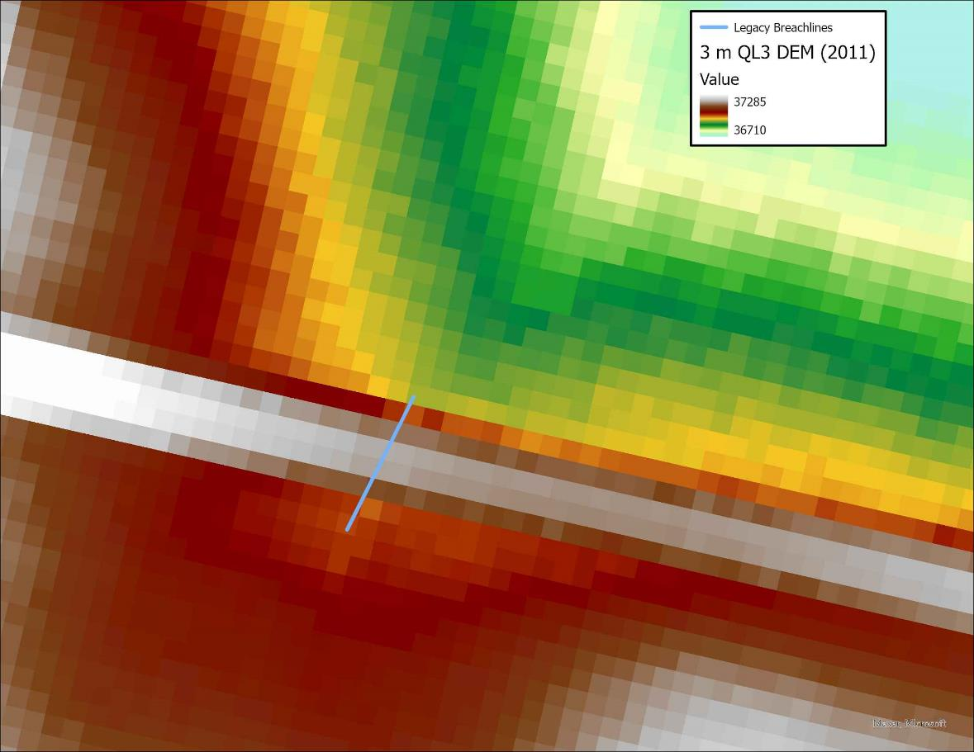
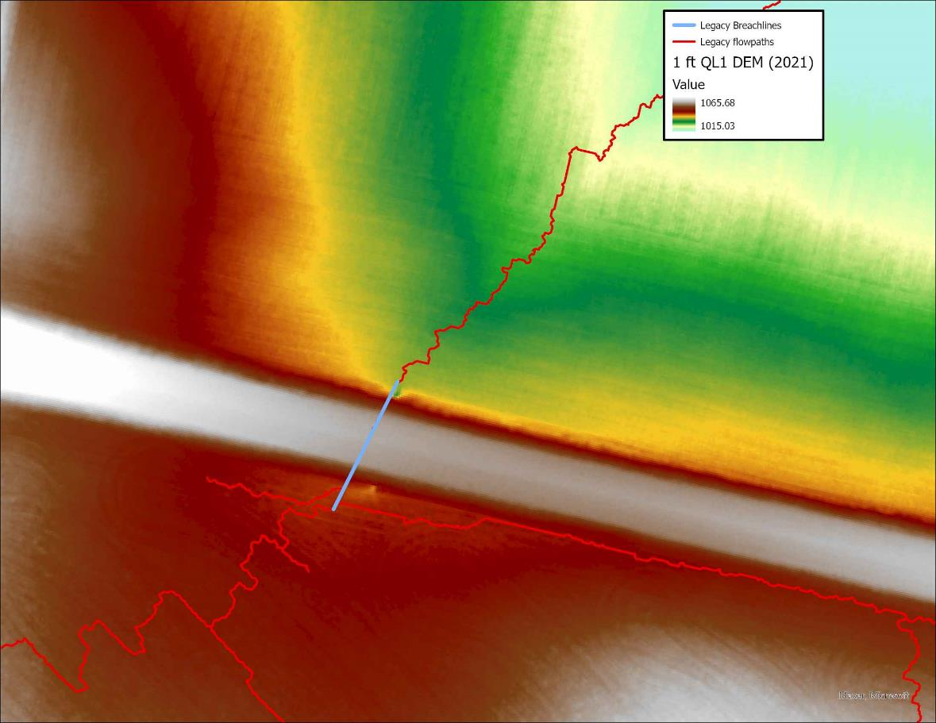

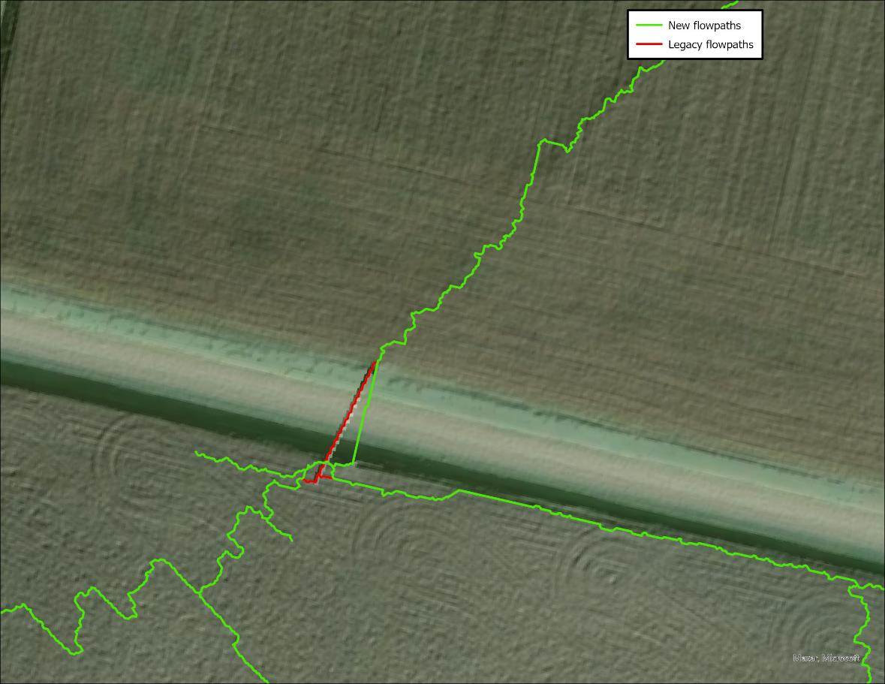

Acceptable Breachline
Road

Slide 45
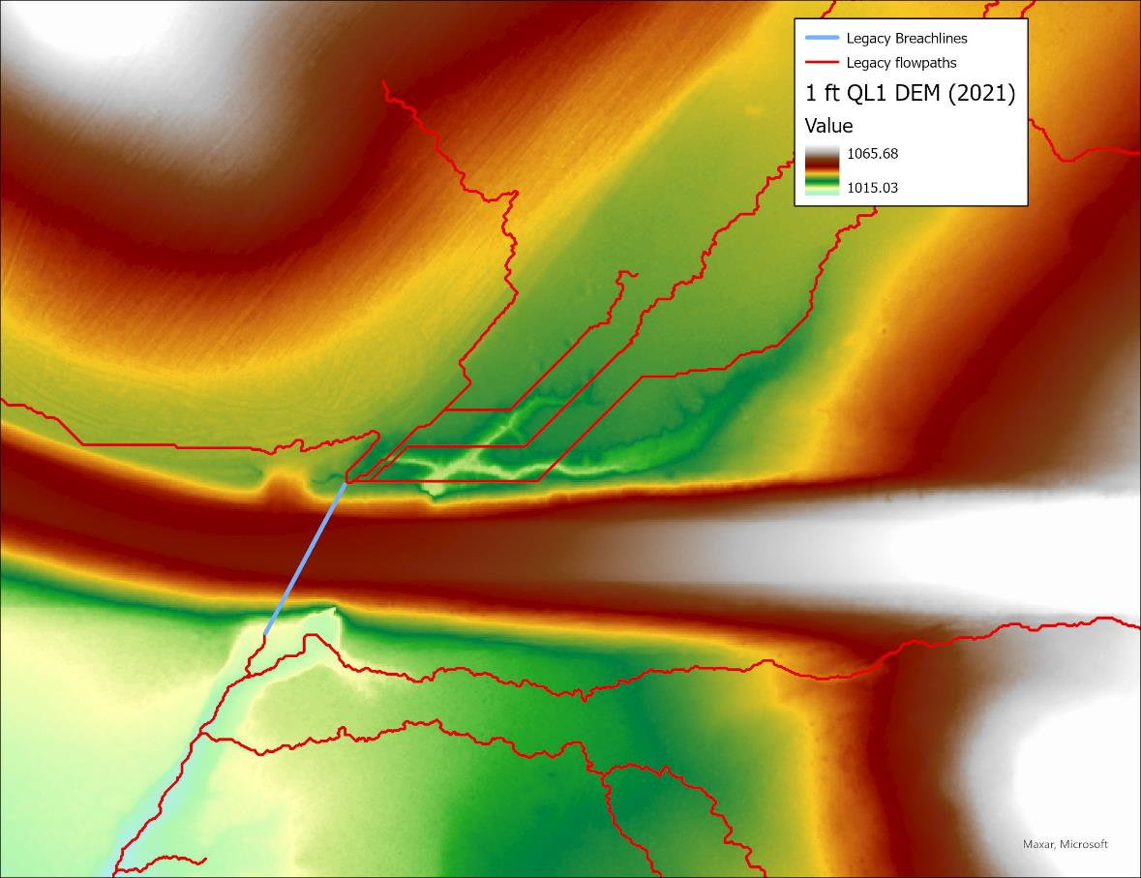
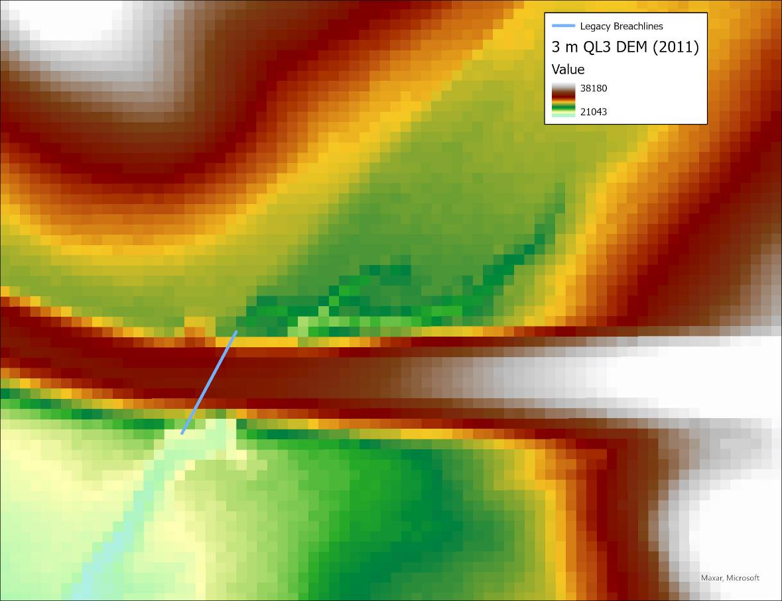
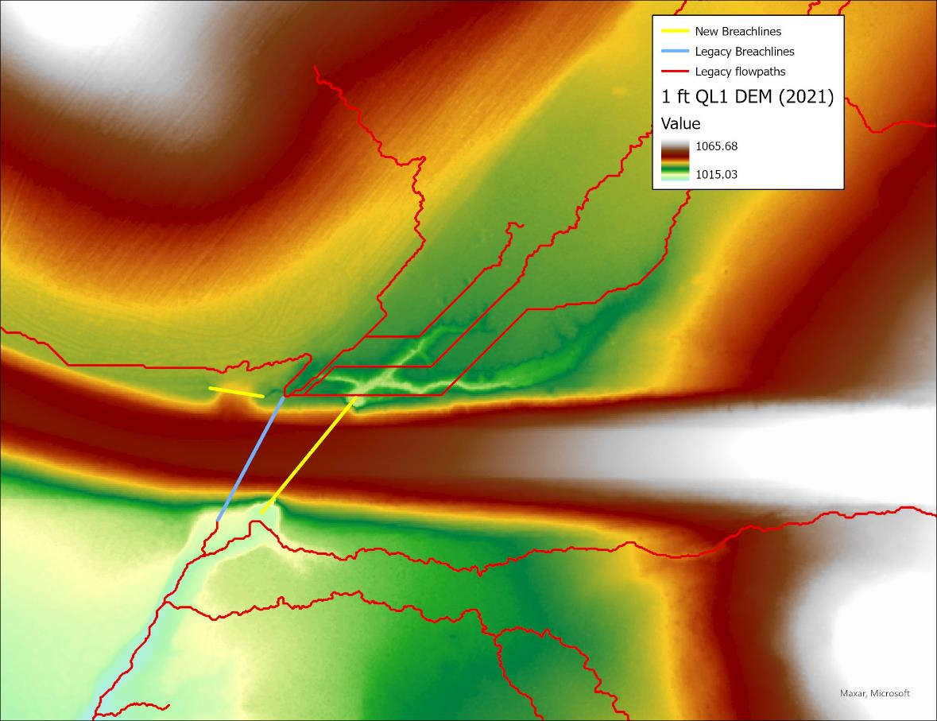
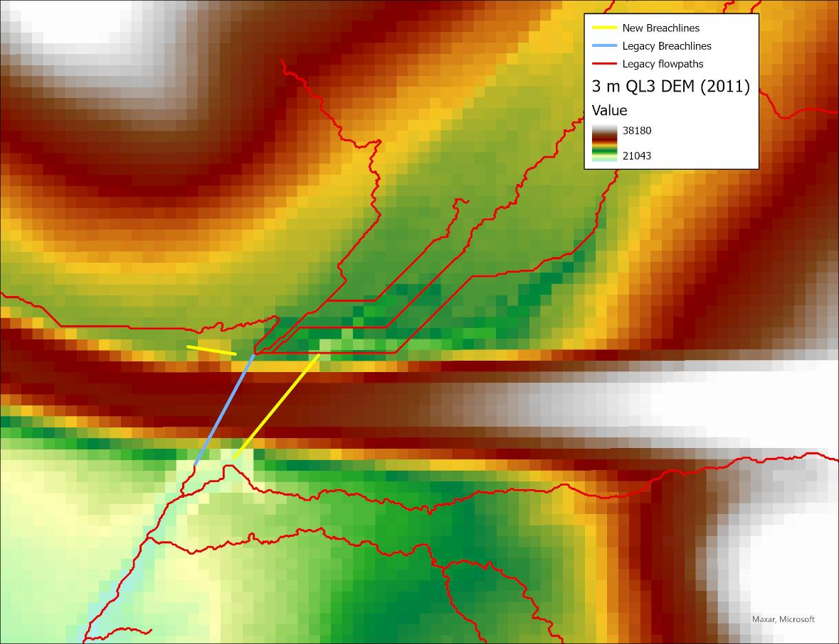
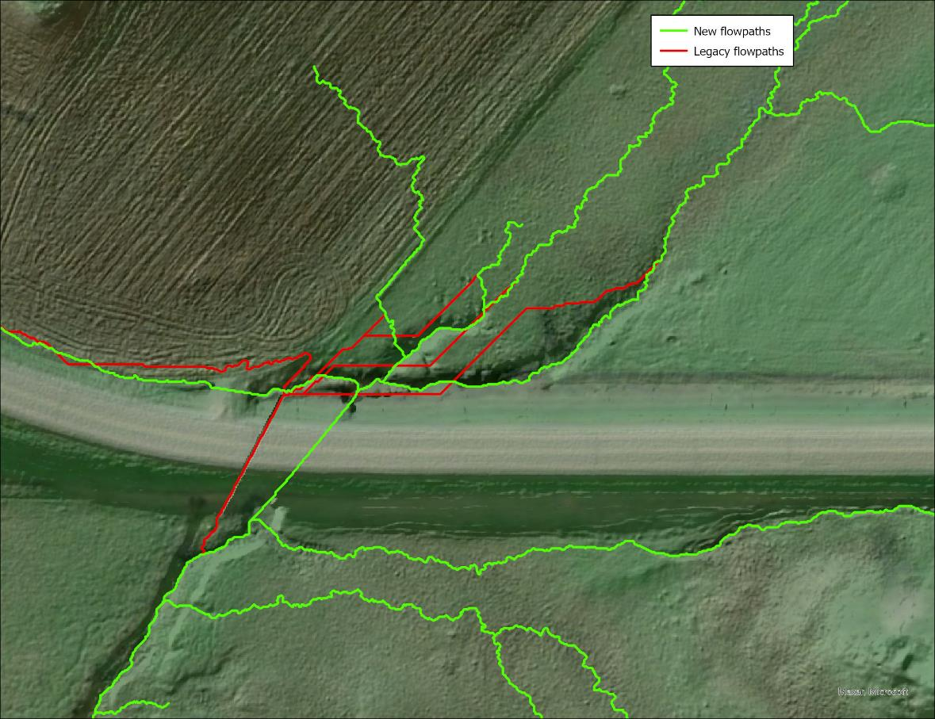
Not Acceptable Breachline
Road

Slide 46
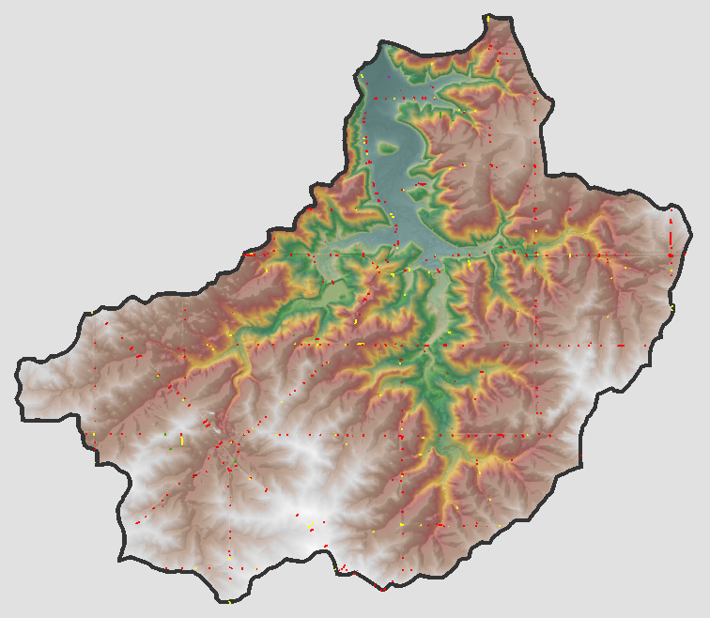


Findings
How will DEM resolution affect processing speed?
Processing Time:
1-foot DEM = 1 hour 42 minutes
3-meter DEM = 3 minutes 12 seconds
Notes:
Determining the resolution of the dem that will be used for processing, right at the start of the project, will be helpful in that the new high resolution dem will require more computer processing power for hydro-modification than a 3 meter dem.
Factors in this decision include 1) time and budget 2) computer processing capabilities.
The pilot project consisted of one HUC12 (subwatershed). Results of hydro-modifying both dems shows there is significant difference in processing time.

Slide 47
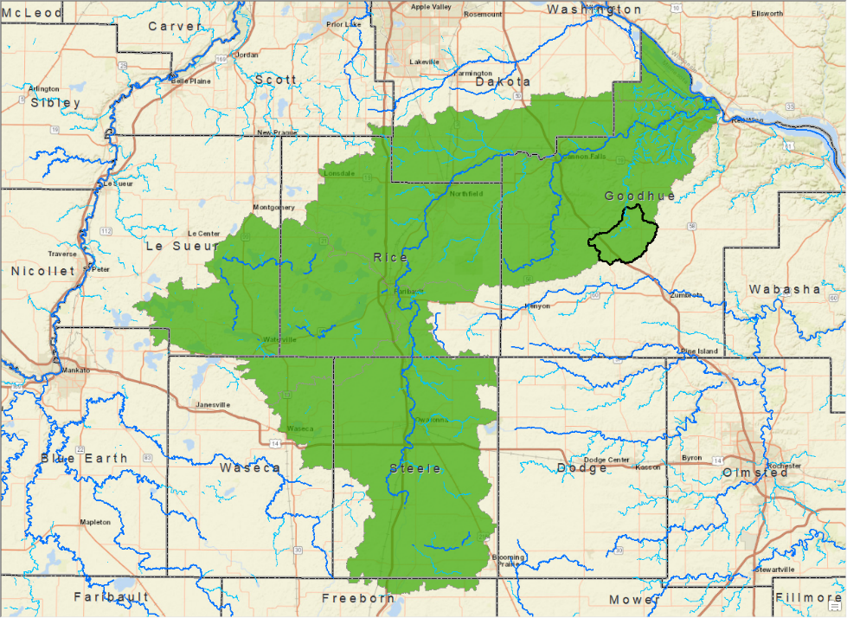



Acceptability Depends on Business Need
The First-generation LiDAR and DEM are from (2008/2012)
The Breach line data depends on the business need and acceptability of existing data.
  What was the original data created for?
    In This case PTMApp was run for the 1w1p
  Was scale a factor?
    For a large size watershed HUC 3-meter cell size was chosen.
For new projects, evaluation of the existing data is needed if the business need has changed.

Slide 48
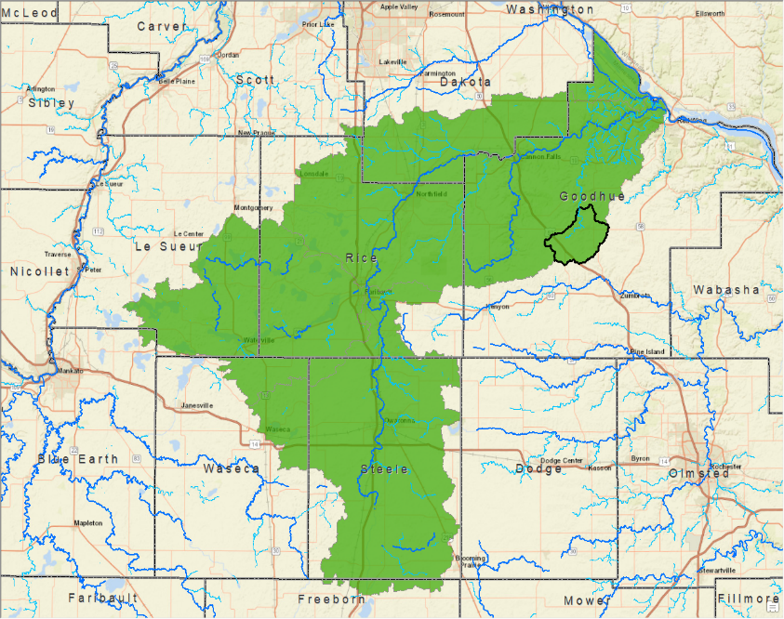
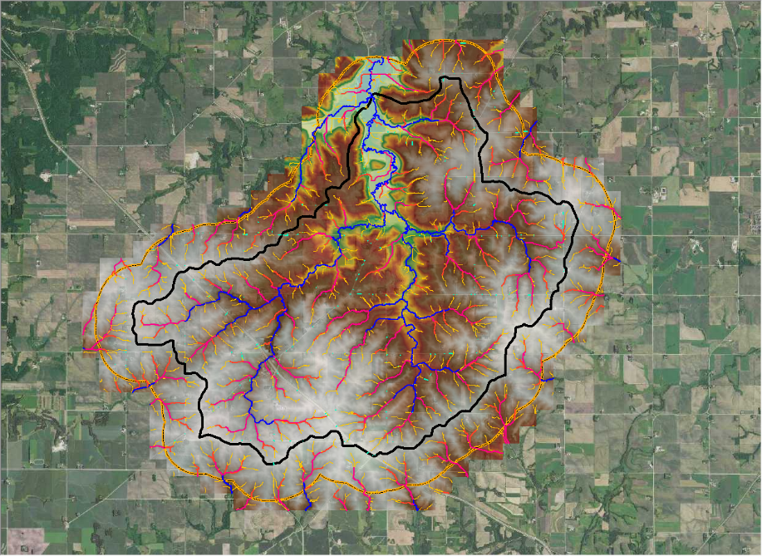
New Project – New Business need
Going from Large HUC 8 to a small HUC12
Has the business need changed?

Slide 49
Takeaway Messages
First Generation Breachlines support DEM hydro-modification work on Second Generation Lidar Data
Legacy breachlines are valuable, producing acceptable results with new LiDAR >96% of the time
Large number of new breachlines that can now be visualized with higher confidence.
LiDAR does its job, lack of flow in DEMs is not a flaw of lidar
Proper replication of landscape hydrology in DEMs is required
Hydro-modified DEMs (hDEMs) are foundational data (Point Cloud, DEMs)
The business need of hydrologic modeling is dependent on removing digital dams
  Flood Prediction Modeling - Precision Conservation Planning - Modeling Pollution Transport within a Watershed
Notes:
LiDAR did it’s job
hDEMs are foundational data
Proper replication of landscape hydrology in DEMs
Tools & Models have dependencies on foundational hydrography data.
Build awareness for discussion - Continue to build recognition and support for statewide foundational NXG-Hydro.

Slide 50
Thank You!
Sean Vaughn | Rick Moore | Sarah Porter | Kiah Sagami | Jeff Knopf
3D Geomatics Committee
www.mngeo.state.mn.us/committee/3dgeo
3D Geomatics Hydrogeomorphology Workgroup – DEM Hydro-modification Subgroup www.mngeo.state.mn.us/committee/3dgeo/hydro/hydromod/

Slide 51

Break

Slide 52
Agenda Item 10
Climate resiliency introductory discussion
Victoria Reinhardt

Slide 53
Commissioner Victoria Reinhardt
GIS used in Climate Resilience Analysis
Minnesota Geospatial Advisory Council

Slide 54
A Changing Climate in Ramsey County Story Page
https://ramseygis.maps.arcgis.com/apps/Cascade/index.html?appid=c49fba3d2d194fa29ac960c48d2283da
Notes:
Ramsey County Staff used GIS to create the Vulnerabilty index in 2016 and are currently us

Slide 55
Public Health Vulnerability Assessment
  Purpose:
  Identify people and groups of people most vulnerable
  Analyze the risks to events related to climate change
  Evaluate the impact of climate-sensitive health outcomes
  Provides information to focus actions to address the risks.
Notes:
Saint Paul – Ramsey County Public Health has, as one of its key strategic goals, to assess and plan for public health impacts of climate change. A first step was to scope out public health issues through an evolution completed in 2014, which identified those health issues for future analysis. In 2015 we prepared a vulnerability assessment, which will be reviewed and updated on a regular basis. This assessment provides a basis for Department planning.

Slide 56
Public Health Vulnerability Assessment
Quantitative Assessment
GIS analysis – spatial overlays of data
Data limitations
Qualitative Assessment
When data are not available
As evidence-based as possible
Notes:
The CCVA consisted of both quantitative and qualitative assessment.
The quantitative portion used GIS and spatial data to identify regions in Ramsey County with environmental risk factors as well as show where people vulnerable to the effects of climate hazards reside.
In the absence of sound spatial data or when mapping was not possible, a qualitative assessment was conducted.
While qualitative assessment is not ideal, it nevertheless highlights the need to address particular health impacts of climate change, such as its effects on mental health or within the refugee population.
SPRCPH acknowledges the need for these data at the sub-county level.
Because this CCVA is to be updated regularly, there will hopefully be ample opportunity to include these data as they become available.

Slide 57
Vulnerability Assessment
Environmental Risk Factors for a specific hazard
Vulnerability
Impact
Notes:
The terms, hazard, vulnerability, environmental risk factor, and impact are used frequently in this report.
According to MDH, a hazard refers to a weather event (e.g., violent storm or extreme heat), an environmental condition (e.g., compromised water quality), or biological threat (e.g., vector-borne disease) which can harm individuals, property, ecosystems, or livelihoods (MDH, 2014a).
Environmental risk factors refer to aspects of the environment that could increase the negative impact of a climate hazard.
They are independent of the characteristics of the individuals living there.
In other words, they are factors that would increase the severity of the hazard’s impact, regardless of individual vulnerability factors.
For instance: extreme heat is a climate hazard. Environmental risk factors that increase the severity of extreme heat in an area would be: reduced air quality, a high ratio of impervious surfaces to trees and greenery, and large distances to cooling centers and emergency medical services. Indicators of vulnerability (person-specific) would be working outdoors, living with chronic illnesses, experiencing poverty, and being elderly or very young. Therefore, given the presence of several environmental risk factors AND individual vulnerabilities, the impact of extreme heat to the people in that area would be very great.

Slide 58
Vulnerability Assessment
Climate hazards Analyzed
  Extreme heat
  Air quality
  Flash flooding
  Drought
  Vector-borne disease
  Invasive species
  Demographic changes
  Psychological impacts

Slide 59

Poor Air Quality
Air Quality:
Ozone, PM_{2.5}, pollens & allergens
Directly and indirectly caused by ↑ temperatures &↑ precipitation
Health Effects:
Difficulty breathing, lung inflammation, exacerbation of COPD & asthma, prolonged cough, chest illness, ↑ risk of respiratory conditions
Environmental Risk Factors:
Concentrations of ozone, PM_{2.5}, & allergens, proximity to major roadways, extreme heat
Vulnerabilities:
Old & young age, outdoor workers & athletes, existing cardiovascular or respiratory diseases (COPD & asthma)
Notes:
The three main climate trends of concern in Minnesota (i.e., increase in average temperatures, increase in days with high dew points, and changes in precipitation) can directly and indirectly affect the air quality in Ramsey County.
Three factors of poor air quality negatively impact human health in Ramsey County:
Increased levels of ground-level ozone, especially in the summer.
Increased levels of PM_{2.5} (particulate matter 2.5 microns in diameter or less)
Increased levels of pollens and allergens
Together, increased levels of ozone, PM_{2.5}, and allergens lead to an overall poorer air quality in Ramsey County.
Generally, Minnesota has good air quality, which has improved over the past two decades. However, current levels of pollutants still contribute to health impacts (MPCA, 2015a). While, it should be noted that ozone and PM_{2.5} levels are generally low in Minnesota, higher concentrations of these pollutants are found in the metro area, largely due to increased concentrations of people, transportation systems, and industrial processes.
A changing climate and/or stricter air quality standards could rapidly change the air quality status quo in the metro area. For instance, increasing summer temperatures may catalyze ozone production and stimulate VOC emissions from various sources. In addition, increasing temperatures could indirectly increase PM_{2.5} due to amplified energy demands for air conditioning and other needs (MDH, 2014a).
Three environmental risk factors were used to describe the potential severity of poor air quality in Ramsey County. These factors included:
Average concentration of ozone
Average concentration of PM_{2.5}
Proximity to major roadways
Base Vulnerabilities:
Occupied housing units without phone access
Occupied housing units without vehicle access
Occupied housing units in multifamily housing
Occupied mobile homes
Population 25+ without a high school diploma
Population 16+ who walk or bike to work
Population 65+ & living alone
Population 5+ who speak English < “very well”
Population that works outdoors
Population living below 200% of poverty threshold
Population under 5 years
Population 85+
Additional Hazard-Specific Vulnerabilities:
Age-adjusted rates of COPD-related hospitalizations
Age-adjusted rates of asthma-related hospitalizations

Slide 60
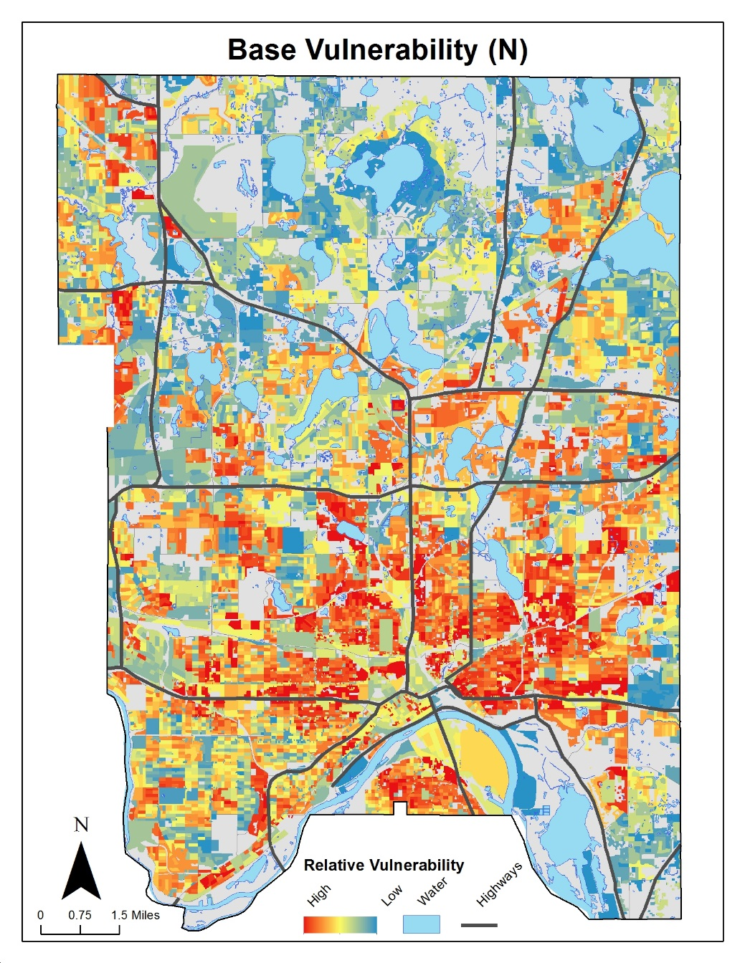
Base Vulnerabilities
Socioeconomic status
(poverty, education)
Age
< 5 years
>80 years
>65 living alone
Communication
Non-English
Mobility
Vehicle access
Other
Housing
Notes:
First, base vulnerability was defined.
Base vulnerability, in this case, refers to the set of characteristics in individuals that are, more or less, equally problematic across all climate hazards relevant to Ramsey County.
This set of indicators created a foundation to which specific vulnerabilities were added when assessing a given hazard.
This additional vulnerability is called hazard-specific vulnerability.
Together, base vulnerability and hazard-specific vulnerability combined to determine overall vulnerability.
For instance, vulnerability due to air quality consisted of base vulnerability with additional specific vulnerability indicators, such as age-adjusted rates of hospital visits for chronic obstructive pulmonary disease (COPD) and asthma.
Socioeconomic status
Age
Barriers in communication
Mobility
Additional factors, such as housing situation and outdoor employment

Slide 61
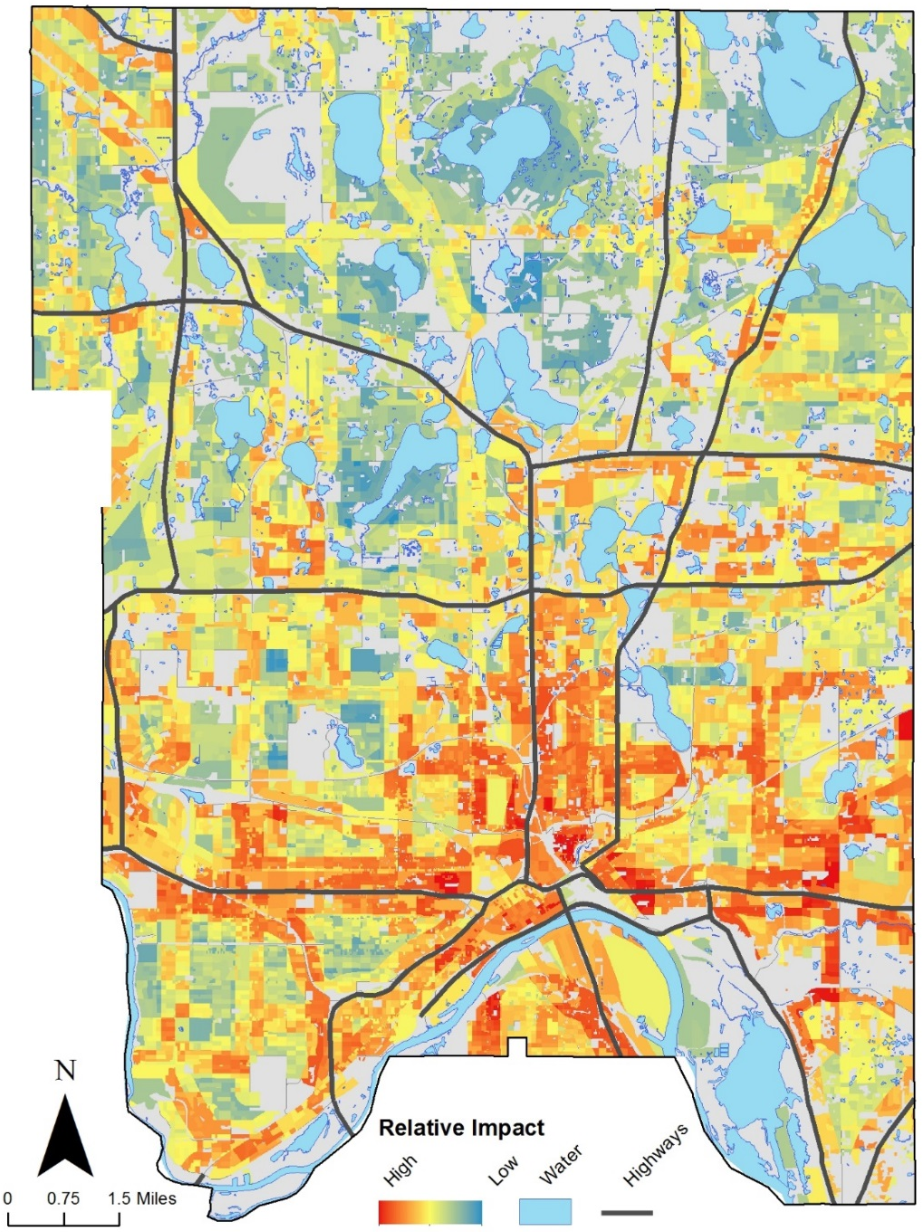
Poor Air Quality
Full Impact Assessment: Air Quality
Strongly impacted areas:
  In & around downtown Saint Paul
  Areas along I-94
  Areas between I-35E & Highway 61
Notes:
The full impact assessment for poor air quality included both environmental risk factors for poor air quality in Ramsey County as well as the outlined individual vulnerabilities.
. Areas with warmer colors (red and orange) indicate regions where poor air quality will likely have a stronger impact relative to the rest of the county.
The impact of poor air quality follows a pattern roughly similar to that of extreme heat. Most of Ramsey County is vulnerable to health effects associated with poor air quality, with those most vulnerable located near major roadways. Populations, such as the young, elderly, and those with respiratory difficulties, are most vulnerable to poor air quality.

Slide 62
Agenda Item 11
Types of LiDAR
Sean Vaughn

Slide 63
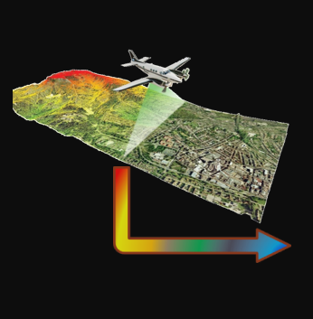
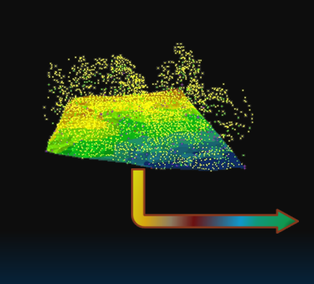
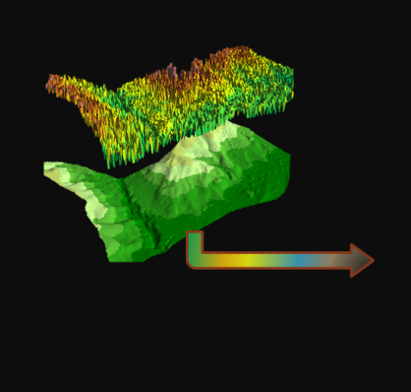
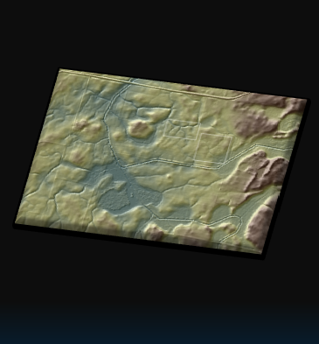


Temporal Lidar Data:
Generational Lidar Data
Sean Vaughn
MNIT DNR, 3DGeo Cochair

Slide 64
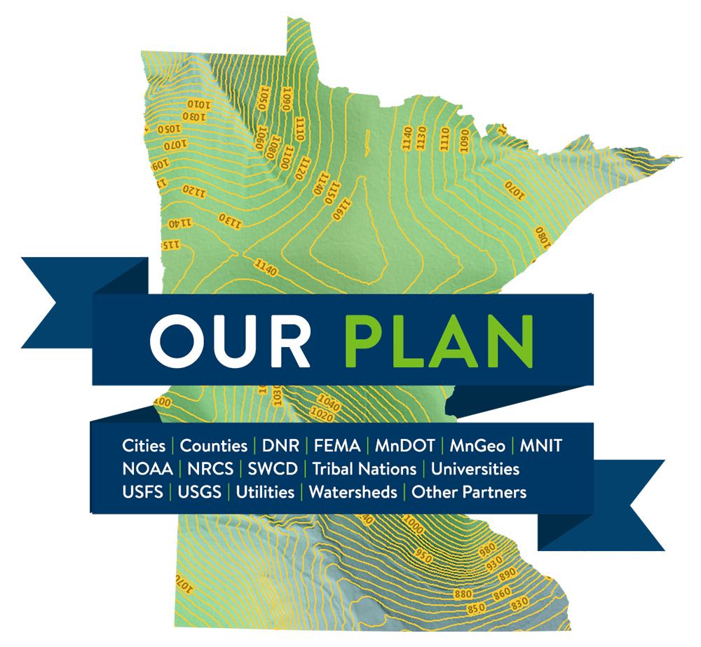
Our Plan – Your Plan – One Plan - Minnesota Lidar Plan
Following our Minnesota Lidar Plan, we continue to have success blanketing the state with QL-1 Lidar.
We will have two temporal representations of lidar for Minnesota
Notes:
Star = Center of Government in Minnesota. However, Lidar acquisition is representative of stakeholders across the entire state serving all disciplines

Slide 65
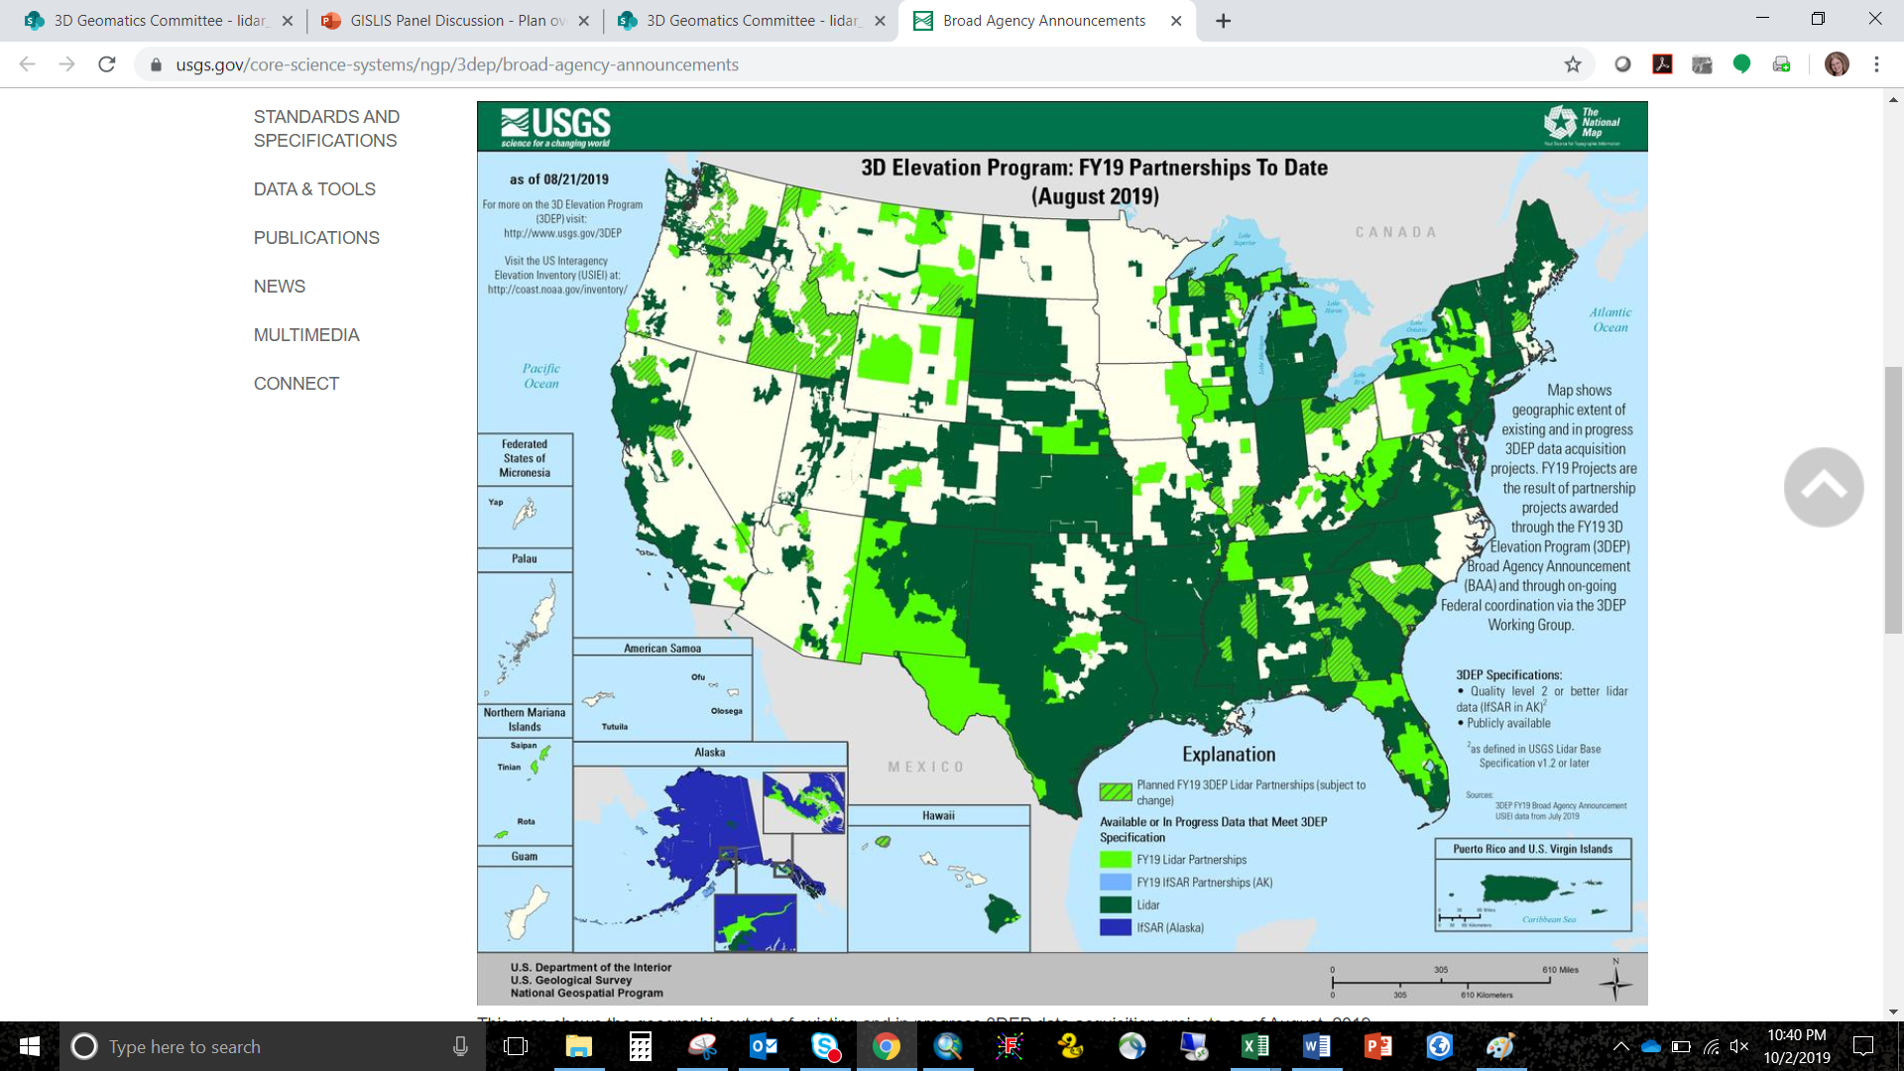
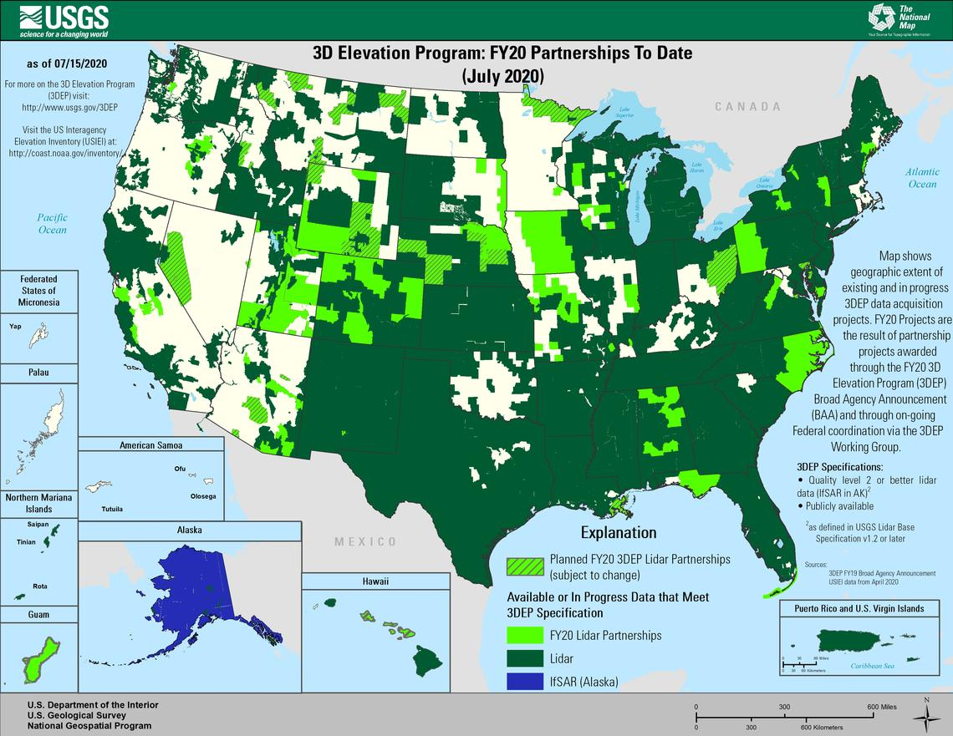



USGS 3DEP - Partnership Funded Compliant Data
2019
Maps show geographic extent of completion of the first-ever national baseline of consistent high-resolution elevation data –both bare earth and 3D point clouds – identified by the U.S. Interagency Elevation Inventory (USIEI) that meet 3DEP base level specification. -USGS https://www.usgs.gov/media/images/fy22-status-3dep-quality-data
2020
2021
2022
2023

Slide 66




3D Geomatics: Funding, Agreements, and Acquisition
Contributions to Minnesota Lidar ($millions)
Minnesota Partners: $ 7.55
USGS 3DEP: $14.72
Other Federal $ 0.45
Total: ~$22.71M
Minnesota Funding Partners
59 Funding Partners
65,359 Square Miles of New Lidar
$115* Cost/mi² For MN Partners
* Estimated cost per square mile paid by 59 unique Minnesota funding partners working collaboratively for consistent lidar data acquisition. $115 Value: 1.) is not specific to a 3DGeo Lidar Acquisition Block, 2.) is based on total Minnesota partner contributions of $7,545,761.44 (03/08/2023), 3.) does not include federal contributions.

Slide 67

Minnesota Lidar → Temporal Lidar Data
Awareness: Two Versions of Authoritative Lidar Data For MN
First Generation Lidar (1stGEN)
  Legacy, Low Density (2008 - 2012), version 1.0 lidar
  Quality Level – 3 Lidar (QL3)
Second Generation Lidar (2ndGEN)
  Current, High Density (2021 - 2025), version 2.0 lidar
  Quality Level – 1 Lidar (QL1)
  Quality Level – 2 Lidar (QL2) [2019, Pine County]

Slide 68

Minnesota Lidar → Temporal Lidar Data
DEMs (as an example)
Minnesota’s first-generation Quality Level-3 DEM resolutions:
  1-meter
  3-meter (derived from 1m DEM)
Minnesota’s second-generation Quality Level-1 (and QL2) resolutions:
  0.5-meter (provided as a 3DEP deliverable)
  1-meter
  3-meter
Notes:
This slide identifies what we served with Gen-1 data and will serve with Gen-2 Data

Slide 69
Minnesota Lidar → Temporal Lidar Data
Why Is This Important To Differentiate?
Accuracy and Points Per Square Meter
  Quality Level – 1 Lidar (QL1)
    6.0-cm Absolute Vertical Accuracy (RMSE_{z})
    ≥ 8.0 point/m2
  Quality Level – 2 Lidar (QL2) [2019, Pine County]
    10.0-cm Absolute Vertical Accuracy (RMSE_{z})
    ≥ 2.0 point/m2
  Quality Level – 3 Lidar (QL3)
    20.0-cm Absolute Vertical Accuracy (RMSE_{z})
    ≥ 0.5 point/m2

Slide 70


HD Lidar – Derived Products
Lidar Quality Levels Define Deliverable Specifications
Minimum DEM Cell Size
Minimum Contour Interval
3DGeo Committee Minimum
USGS Base Specification Minimum
Current Minnesota Data Holdings
Notes:
Sean – 3DGeo Background

Slide 71

Minnesota Lidar → Temporal Lidar Data
Take Away
Geospatial community has a responsibility to understand lidar collection periods and Quality Levels that support derived products

Slide 72
Agenda Item 12
Sector Report: K-12 Education
Shana Crosson

Slide 73
GIS in Minnesota K-12 Education
May 24, 2023
Shana Crosson
Spatial Technology Consultant, U-Spatial
University of Minnesota

Slide 74
Guiding Principles of GIS in K12
Engage students in spatial awareness
Empower students to ask questions and find solutions to problems
Apply across the curriculum
Present career options

Slide 75

Where is GIS in Minnesota?
Notes:
These are schools in Minnesota with an Esri ArcGIS Online School Bundle. While definitely not the only way to use GIS, or Digital Mapping (since GIS is not a common term) - we find that the Esri tools are a good way to scaffold schools into using GIS.

Slide 76
What is the Esri School Bundle?
300 School Bundles in Minnesota
Esri makes a School Bundle available for free to all K12 schools
Can also be youth groups and homeschools
Includes ArcGIS Online, ArcGIS StoryMaps, Survey 123, Living Atlas
More info: esri.com/schools

Slide 77
How is GIS Used in K12?
Notes:
GeoInquiries
Map Competition
StoryMaps
Projects

Slide 78
Teachers
We have some amazing teachers in Minnesota using GIS in the classroom. Here are just a few:
Matt Winbigler, Cloquet High School
Cynthia Welsh, Cloquet High School
Mollie Bousu, Burnsville High School
Brianna Wegter, Sauk Rapids Rice High School
Stephanie McCleery, St. Paul Central High School
Emily Yang, St. Paul Harding High School
Brittany Wedlund & Alyssa Larsen, Big Lake Schools
Laurie Bohm, Bloomington Schools
Jess Winkelaar, Moundsview Public Schools
Tami Brass, St Paul Academy
Sara Damon, Retired
Jim Hanson, Retired
Notes:
Teachers are the core. Teachers are the most important element in this work. These are just a few of the superstar teachers using GIS in the classroom.
Also, teaching has been brutal these last few years. If you have any teachers in your life, be extra kind and appreciate of their work.

Slide 79
In the classroom
GeoInquiries
StoryMaps: content replacement AND student projects
Project based learning
Data collection and analysis
History
Geography
Civics
Environmental Science/Earth Science
World Languages
ELA
Climate Change
Equity

Slide 80
Minnesota GeoInquiries
Modeled on Esri’s GeoInquiry activities but focused on Minnesota content
mngiseducation.org

Slide 81

Minnesota on the Map Competition
Sponsored by Esri
MN GIS/LIS is a fiscal agent
Run in MN by Jim Hanson, a retired Geography teacher and GIS wizard
Website
MN Middle School Winner
National Results are announced on May 30. Rumor has it that Minnesota will be happy!

Slide 82
Supporting Teachers
Notes:
This is the most important things we, as GIS professionals, can do

Slide 83


Partners
Notes:
MAGE
U-Spatial, UMN
MDE
MN GIS/LIS

Slide 84

K-12 Educator Day
Teachers mentoring teachers
Free!
Stipends provided for subs
MN /GIS financial and logistical support
2023: Friday, October 6
2017 Educator Day in Bemidji, MN
Notes:
Educator Day has been offered with the support of the Minnesota GIS/LIS Consortium since 2015. This is a free opportunity for teachers across the state to talk with other teachers about their experience, take workshops, set up organizational accounts, and meet GIS professionals who are passionate about working with K12 teachers and students.
Money is provided (as a payment to the teachers school district) to cover a sub, and the conference itself is free and includes meals.
Attending Educator Days (teacher development days, technology days, GeoFest)
Collaborative is the “key” word here as this continuing project has many hands, including many of you GIS professionals around the state! Thank You!

Slide 85

GeoFest & Other Workshops
Hosted by the Minnesota Alliance for Geographic Education (MAGE)
2023: October 28
Full track of GIS and digital map sessions

Slide 86

UMN Support through U-Spatial
2892 Miles to Go - Place based Storytelling of underrepresented communities
Tribal Youth in GIS with the Indian Land Tenure Foundation
GeoInquiry Development
Collaborate with UMN Faculty to make research accessible to the K12 audience as appropriate
NRRI Collaboration
Data and Maps for teachers upon request
Technical support for Esri Org management

Slide 87


Mn GIS/LIS Consortium Support
Education Grants
Mentor Program: matches a GIS Professional with teachers
Distinguished Educator Award

Slide 88
Other content resources
NRRI / MN Atlas
Minnesota Ag in the Classroom
Minnesota GeoCommons

Slide 89

Website for Minnesota
mngiseducation.org
Notes:
This site points to many types of activities and content, as well as workshops and trainings.

Slide 90
How can we help?
Volunteer to collaborate with a teacher
Support GIS and spatial thinking in Minnesota’s academic standards
Provide paid internships to high school students
Create and distribute open maps and data that are usable for K12 teachers
Collaborate on workshops for teachers

Slide 91
Stacey Stark, MS, GISP
Associate Director, U-Spatial
University of Minnesota Duluth
slstark@d.umn.edu
Shana Crosson
Spatial Technology Consultant, U-Spatial
University of Minnesota
scrosson@umn.edu

Slide 92
Agenda item 13
Legislative Updates
Alison Slaats
The omnibus state government and elections finance bill (House File 1830) included $130M in new spending for MNIT, including an increase of about $350,000/year in additional funding to expand the capacity of Minnesota’s Geospatial Information Office (MnGeo)
  Support distribution of lidar data and derivatives, and creation of derivative data
  statewide standardized parcel, address and road data
  sharing of aerial photography and imagery datasets;
  and coordination, creation, and maintenance of accurate boundary and land survey data, and critical infrastructure data
Funding for PLSS preservation and remonumentation ($9.7 M for FY24/25 biennium, can be spent through FY27)

Slide 93
Agenda Item 14
Updates on GAC Priority Projects and Initiatives
David Brandt

Slide 94
Updates on GAC Priority Projects and Initiatives
Most recent success
Experiencing a barrier?
Next task

Slide 95
GAC Priorities
Project or Initiative Description | Status | Project Owner | Champion
Parcel Data | Active | Ryan Stovern | Alison Slaats
Critical Infrastructure Data Workflow | Active | Stacey Stark | Steve Swazee
Updated and Aligned Boundary Data | Active | Preston Dowell | Alison Slaats
Address Points Data | Active | MnGeo | Alison Slaats
Road Centerline Data | Active | MnGeo | Alison Slaats
Culvert Data Standard | Active | Rick Moore | Andrea Bergman
Publication of Open Foundational Data | Active | David Brandt, Randy Knippel | Alison Slaats
Lidar Data | Active | Gerry Sjerven | Alison Slaats
U.S. National Grid Materials | Active | Randy Knippel | Randy Knippel
Remonumentation of All Section Corners | Active | Pat Veraguth | Alison Slaats
MnGeo Image Service Improvements | Active | Alison Slaats | Alison Slaats
Geodata Archive Implementation | Active | Ryan Mattke | many

Slide 96
GAC Priorities
Project or Initiative Description | Status | Project Owner | Champion
Underground Utilities Data Sharing Team | Active | Steve Swazee | Barb Cederberg
Success Stories for Geospatial Technology | Active | Outreach Committee | Len Kne
Geospatial Commons Advisory Group | Recruitment | Ben Timerson
Hydro-DEMs | Active | Sean Vaughn | many
Summary Crime Data | Active | Britta Maddox
NG9-1-1 Geospatial Forum | Recruitment
Parks Data Standard | Inactive | Standards Committee?
State Business License Data | Inactive
Street Parking Restrictions Data Standard | Inactive | Standards Committee?
Snow Emergency Parking Data Practices | Inactive
Strategy Team for All Types of Imagery | Inactive | Imagery Team?
Basemap Services | Inactive
Inventory of MN GeoData Assets | Inactive

Slide 97

Status of Free and Open Data Public Geospatial Data
Status | Number of Counties | Total
Open - Policy | 17 | 50
Open - No Policy | 33
Not Open or Unknown | 37 | 37
Data current as of April 20, 2023 (Stevens County is the newest addition)
https://gisdata.mn.gov/dataset/bdry-mn-county-open-data-status

Slide 98

Statewide Publicly Available Parcel Data
Most recent success:
  Published most recent quarterly update April 28, 2023
  Published an ArcGIS Online webmap and feature layers for both the data and metadata
  New Opt-in: Lac qui Parle County
Next task:
  Secure statewide feature layer for internal use?
  https://gisdata.mn.gov/dataset/plan-parcels-open

Slide 99
Critical Infrastructure Data Workflow
Most recent success:
  Great discussions about agency roles and strategy for geospatial support in MN state emergency response. Identifying gaps and opportunities!
If you are experiencing a barrier:
Next Tasks:
  Compile a “story” about MN Critical Infrastructure data collection - for use on Hub Site
  Reach out to remaining counties for essential (fire, law enforcement, ems) critical infrastructure verification

Slide 100
Updated and Aligned Boundary Data
Most recent success:
If you are experiencing a barrier:
Next Task:

Slide 101
Road Centerline Data & Address Points Data
Most recent success:
  Available Data: Aitkin, Benton, Douglas, Koochiching, Lac qui Parle, Lyon, Martin, McLeod, Pipestone, Stevens, Swift, Wabasha, and Metropolitan Emergency Services Board
  Resources under construction in MnGeo’s GDRS staging area
If you are experiencing a barrier:
Next Task:
  Complete the metadata for the resources
  Work with the Foundational Data Workgroup on Opt-In counties

Slide 102
Culvert Data Standard
Most recent successes:
  Worked closely with MnGeo to create a Survey123 survey based on questions developed in the last few months.
  Collaborated with MnGeo based on their experience with sending out GovDelivery GIS Newsletter to targeted audiences.
If you are experiencing a barrier:
  Field season is approaching so responses may be delayed.
Next Tasks:
  Completing the narrative for the GovDelivery and will send out the survey in early June.
  Process the results as they come in and start the process of refining the attributes for the standard.

Slide 103
Publication of Open Foundational Datasets
Most recent success:
  Drafted a charter
If you are experiencing a barrier:
Next Task:

Slide 104
Lidar Data Acquisition
Most recent success:
  Lidar Acquisition underway in our Minnesota River East and West Lidar Acquisition Blocks (LAB)
  Lidar Acquisition for West portion of Central Miss LAB/3 counties (green) are complete.
If you are experiencing a barrier:
  Funding for lidar acquisition, management, and dissemination remains to be an ongoing need that presents barriers and delays
  Weather: Difficult spring for acquisition
    Late snow
    Flooding
    Smoke
Next Task:
  Continuing to seek our goal of covering Minnesota with Quality Level-1 lidar
  Community of Practice focused on development of lidar derived products

Slide 105
U.S. National Grid Materials
Most recent success:
If you are experiencing a barrier:
Next Task:

Slide 106
Remonumentation of All Section Corners
Most recent success:
  Signed by the Governor
If you are experiencing a barrier:
  Outreach to every county
Next Tasks:
  Hire a Survey Coordinator
  Set up PLSS Remonumentation Committee
  Establish application

Slide 107
MnGeo Image Service Improvements
Most recent success:
  Added Hennepin County 2021 6-inch color imagery
If you are experiencing a barrier:
Next Tasks:
  Build new dev/staging server
  Process Douglas County imagery

Slide 108
Geodata Archive Implementation
Most recent success:
  The Big Ten Geospatial Information Network has gotten the go-ahead to explore what it would look like to build a Geodata Archive for the Big Ten. Much of the work of the Archiving Workgroup will be utilized for this exploration.
Request for Assistance:
  Not so much assistance as input -- how does the community feel about this? Would a Big Ten Geodata Archive serve the need for a Minnesota Geodata Archive?
Next Task:
  Determining costs and software options for different ways of implementing an archive. We are hopeful that we will get the green light to proceed sometime this coming fall.

Slide 109
Underground Utilities Data Sharing Team
Most recent success:
  Chair Cederberg awarded Common Ground Alliance "Groundbreaker" award at recent national conference for the Minnesota Underground Utilities Mapping Project Team (UUMPT) effort.
  Gopher State One Call, Common Ground Alliance, Once Call Concepts and SharedGeo have signed a $125,000 developmental MOU to convert UUMPT proof of concept mapping system into production system for entire state.
If you are experiencing a barrier:
Next Tasks:
  MGAC to be mentioned in Common Ground Alliance national promotional campaign about the UUMPT effort.
  EPC Chair Swazee to assist group forming in Canada who wishes to duplicate the UUMPT effort.
  Next meeting: June 22, 1:00 PM CT

Slide 110
Success Stories for Geospatial Technology
Most recent success:
If you are experiencing a barrier:
Next Task:

Slide 111
Accurate hydro-DEMs (hDEM)
Covered in agenda item 8

Slide 112
Summary Crime Data
Most recent success:
  We are still in the discovery phase of the project, striving to understand the goals and what resources currently exist to accomplish them.
If you are experiencing a barrier:
  The involvement of CJIS and other private data is a stronger barrier to these projects than others.
Next Task:
  Continue the discovery process. Discuss with stakeholders what they're looking to see from this project that they can't find elsewhere.

Slide 113
Agenda Item 15
Announcements

Slide 114
Next Meeting
TBD

Slide 115
Adjourn
Thank you

