Slide 1
Minnesota Geospatial Advisory Council
September 28, 2022

Slide 2
Welcome
Introductions
Approve agenda
Approve May minutes

Slide 3
Introductions
City, Twin Cities metro
Cory Richter, City of Blaine
City, Greater Minnesota
Shawn Strong, City of Brainerd
County, Twin Cities metro
Victoria Reinhardt, Ramsey County
County, Greater Minnesota
Patrick Veraguth, Douglas County
Regional government, Twin Cities metro
Matt McGuire, Met Council
Regional government, Greater Minnesota
vacant
State agencies
Kari Geurts, DNR
Ben Timerson, MnDOT
Federal government
Mitch Bergeson, U.S. Geological Survey
Jeff Bloomquist, Risk Management Agency, USDA
Tribal government
Ryan Bonney, Shakopee Mdewakanton Sioux Community
Non-profit organizations
Dale Watt, The Nature Conservancy
Business
Kendis Scharenbroich, Pro-West & Associates
Gerry Sjerven, Minnesota Power
Higher Education
Len Kne, U-Spatial / UMN Twin Cities
Stacey Stark, U-Spatial / UMN Duluth
K-12 Education
Shanna Crosson, U-Spatial / UMN Twin Cities
MetroGIS
David Brandt, Washington County
MN GIS/LIS Consortium
Leanne Knott, City of Red Wing
Surveyor
Chris Mavis, Hennepin County
At-large
Alex Steele, Minnehaha Creek Watershed District
Heather Bergen-Albrecht, Hennepin County
Britta Maddox, Anoka County
1 Chief Geospatial Information Officer (ex-officio)
Alison Slaats, MnGeo

Slide 4
Agenda
Time | Topic |  | Time | Topic
11:00 | Introductions, approve agenda and previous minutes |  | 12:35 | Sector report
11:15 | Committee reports – Review and accept |  | 12:45 | NSGIC membership
11:25 | Emergency Service Zone Data Standard |  | 12:50 | Legislative updates
11:30 | Criminal Justice Information Best Practices update |  | 1:00 | Annual priority survey
11:40 | PLSS legislation update |  | 1:20 | GAC priority projects and initiatives updates
11:45 | 3D Geomatics Committee update |  | 1:45 | Announcements
11:55 | MN County GIS Association (MCGISA) |  | 2:00 | Adjourn
12:05 | Break & networking

Slide 5
Agenda Item 2
Committee Reports – Review and Accept
All

Slide 6
Agenda Item 3
Emergency Service Zone Data Standard – Request for Approval
Curt Carlson, Mark Kotz

Slide 7
ESZ Data Standard
Purpose
A single, commonly accepted set of attribute specifications (field name, type, and length) for transferring emergency service zone boundary data…
Sources
Proposed by the Minnesota Statewide Emergency Communications Board (SECB), NG9-1-1 Committee GIS Workgroup
Draws from the National Emergency Number Association (NENA) geospatial data standards

Slide 8
ESZ Data Standard
Workgroup
Curt Carlson, MnGeo
Vic Barnett, Ramsey County
Marcia Broman, MESB
Mark Volz, Lyon County
Standards Committee discussions and review of public review comments

Slide 9
ESZ Data Standard
Public Review Process
90 days ending 7/31/22
33 comments
Many minor but useful improvements to standard

Slide 10
ESZ Data Standard
Standards Committee requests approval of draft version 1.0

Slide 11
Agenda Item 4
Criminal Justice Information Best Practices update
Britta Maddox

Slide 12
Agenda Item 5
PLSS legislation update
Pat Veraguth

Slide 13
Agenda Item 6
3D Geomatics Committee update
Sean Vaughn, Gerry Sjerven

Slide 14
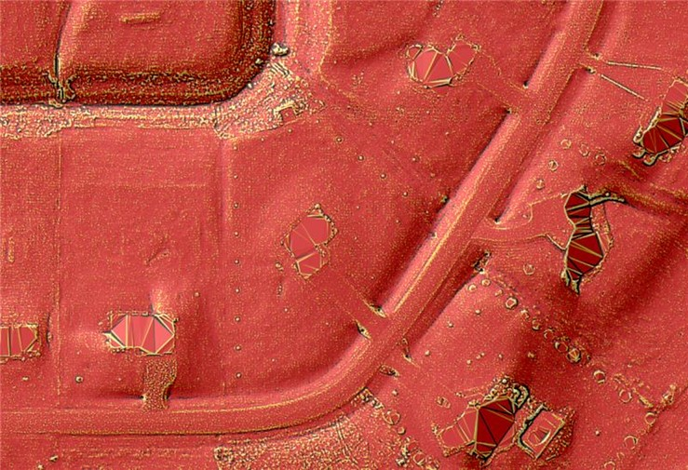
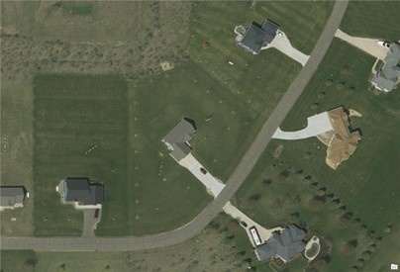
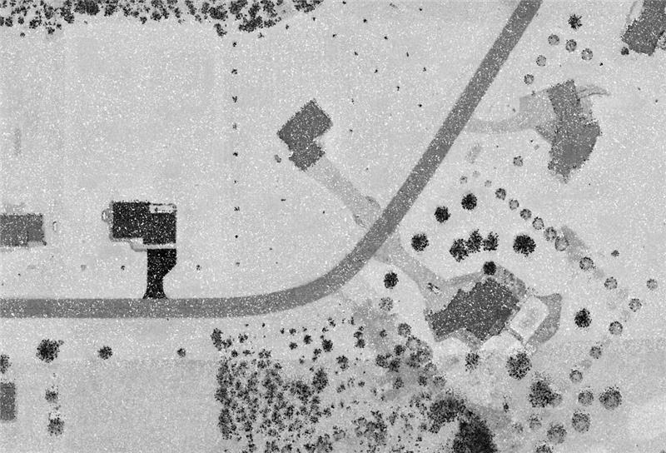
3DGeo Update Sean Vaughn & Rick Moore

Slide 15
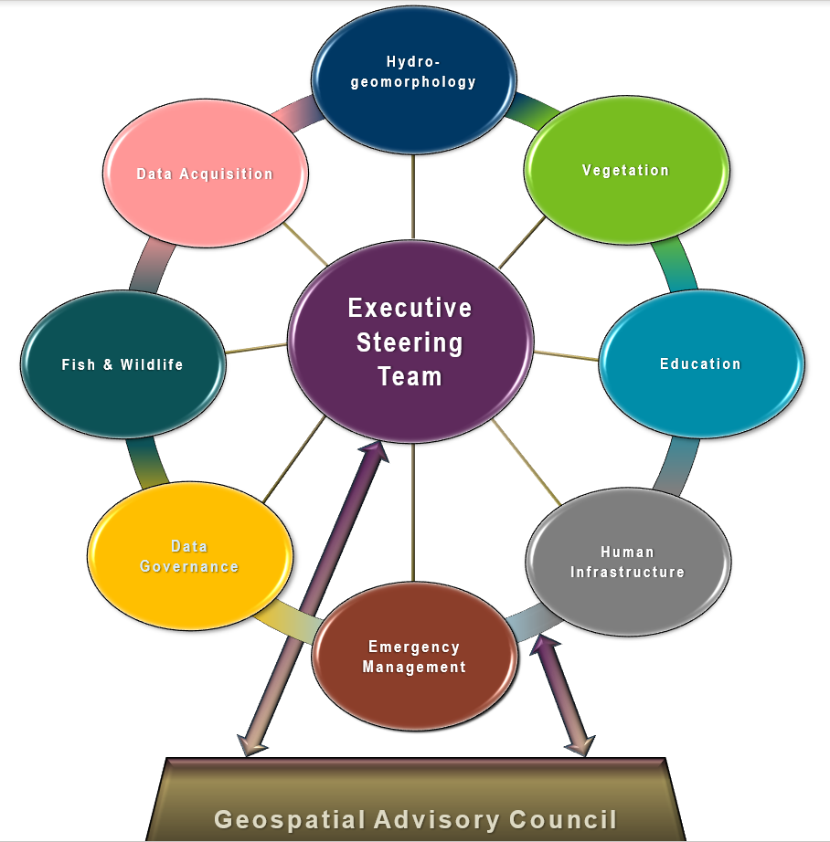
Geospatial Advisory Council (GAC) 3D Geomatics Committee
3D Geomatics Committee
The 3D Geomatics Committee (3DGeo) is a committee under GAC that works to identify and promote the need for planning, funding, acquisition, and management of three-dimensional geomatic data and derived products.
Notes:
Sean – 3DGeo Background
What is the GAC?
The Minnesota Geospatial Advisory Council is the coordinating body for the Minnesota geospatial community.
Cross-section of organizations that include counties, cities, universities, business, nonprofit organizations, federal and state agencies, tribal government, and other stakeholder groups.
What is the 3D Geomatics Committee?
The 3D Geomatics Committee (3DGeo) is a committee under GAC that works to identify and promote the need for planning, funding, acquisition, and management of three-dimensional geomatic data and derived products.
Sector Expertise
Lidar acquisition relies on subject matter expertise from different sectors in 3DGeo

Slide 16
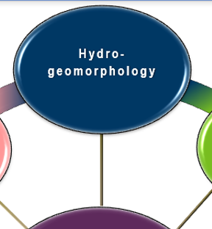
3DGeo - Data Acquisition Workgroup
Mission:
The Hydrogeomorphology Workgroup exists to promote the consistent development of Minnesota's hydrography data and to enable data exchange through coordination, cooperation and standards development..
Co-Chairs
Rick Moore, Jamie Schulz, and Andrea Bergman
Notes:
Sector Expertise
Lidar acquisition relies on subject matter expertise from different sectors in 3DGeo

Slide 17
Hydrogeomorphology Workgroup…
Key Meetings
3DNTM and 3DHP Updates – Guest Introduction – Mitch Bergeson
PA Hydrography Dataset – Geomorphons
Guest Presentation – USGS – “Using Geomorphons to Identify Small Scale Hydrologic Features”
Guest Presentation – Met Council – “Priority Waters Project”
Workplan Progress
Developed roadmap for NXG-Hydro Development – Communication and Outreach
Engaged with national hydrography programs – 3DHP, 3DNTM
Foundational Data Stewards
GAC Streams ID Standard presented for approval
Working with DNR Data Governance Administrator on standards
Partnering with LCCMR funded Lake Inventory Update to inform and guide

Slide 18
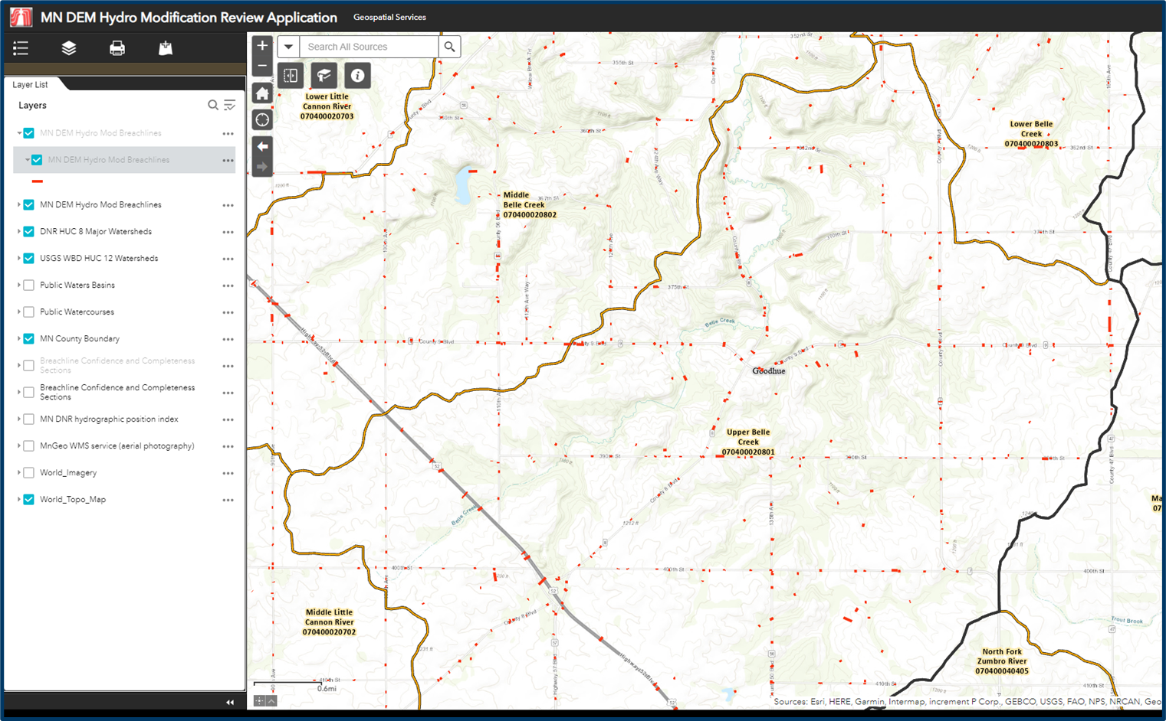
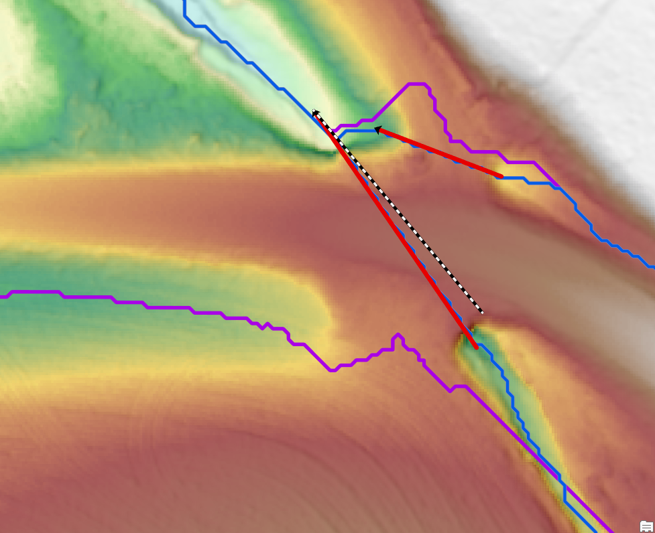
DEM Hydro-modification Subgroup…
Goodhue County High Resolution DEM
Pilot Project to inform future efforts of using existing breachlines with high resolution DEMS.
Breachline Dataset
Update dataset with most recent datasets being completed
Explore database structure for breachlines
DEM Hydro-modification Review Web Application
Detail locations and completeness of datasets
Define project boundaries and data voids
Collaboration and cooperation amongst members
Ongoing discussions of standards and best practics

Slide 19
3DGeo - Data Acquisition Workgroup
Mission:
The Data Acquisition Workgroup promotes procurement of foundational 3D data for Minnesota.
Co-Chairs
Sean Vaughn, Alison Slaats, and Gerry Sjerven
Lidar Acquisition Subgroup:
Alison Slaats (MnGeo), Sean Vaughn (MNIT DNR), Gerry Sjerven (MN Power), Dan Ross (NSGIC), Jennifer Corcoran (DNR), Colin Lee (MnDOT), Matt Baltes (NRCS), Joel Nelson (U of MN), Joe Sapletal (Dakota Co), Mark Reineke (Widseth), and Brandon Krumwiede (NOAA), Clint Little (DNR), Terry Zien (USACOE), Jeff Weiss (DNR).
Notes:
Sector Expertise
Lidar acquisition relies on subject matter expertise from different sectors in 3DGeo

Slide 20
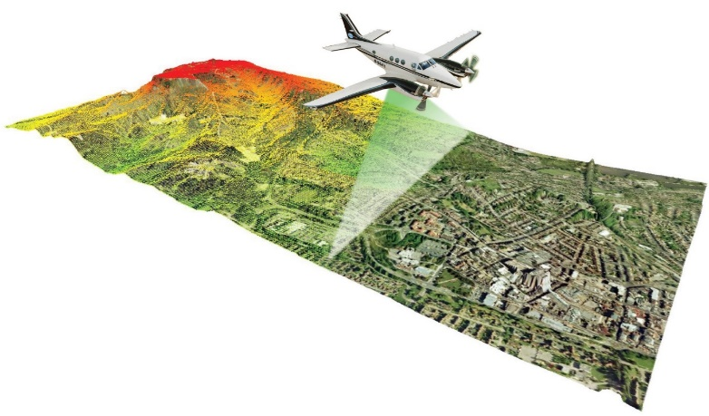
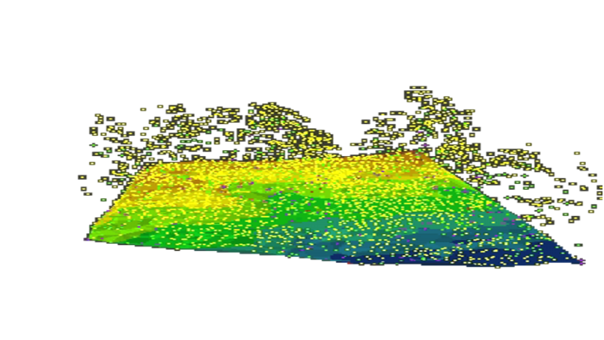
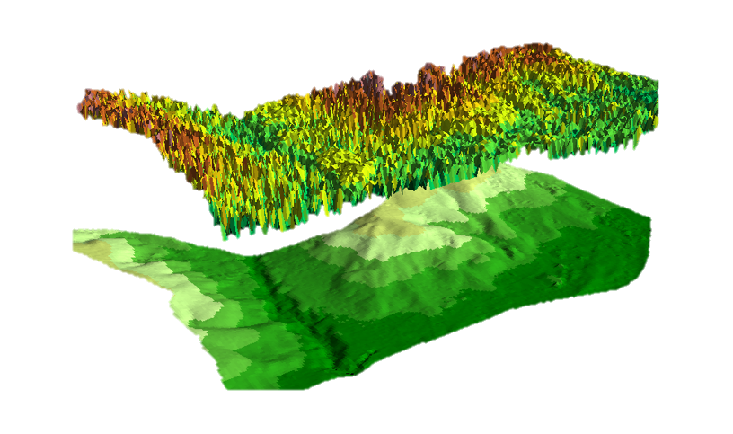
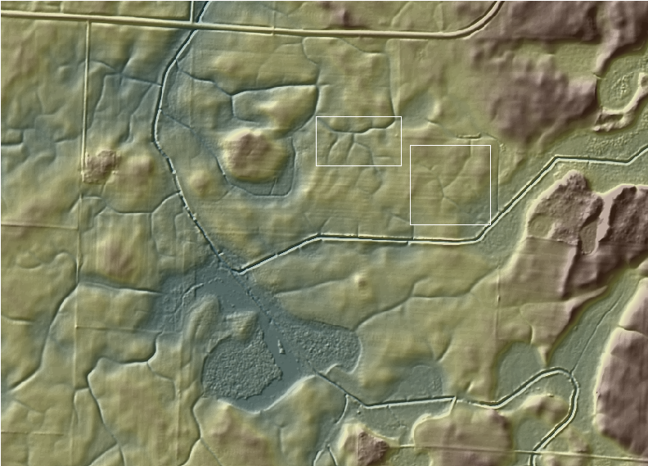
What is Lidar
Lidar Acquisition
Lidar Point Cloud
3D Rendition of Natural
and Built Environments
Point Cloud Classification Feature Identification and Separation of Data for Sector Application
LiDAR-derived 3D Digital Elevation Model (DEM)
Lidar Classification
Painting the Lidar Point Cloud Elevation Values

Slide 21
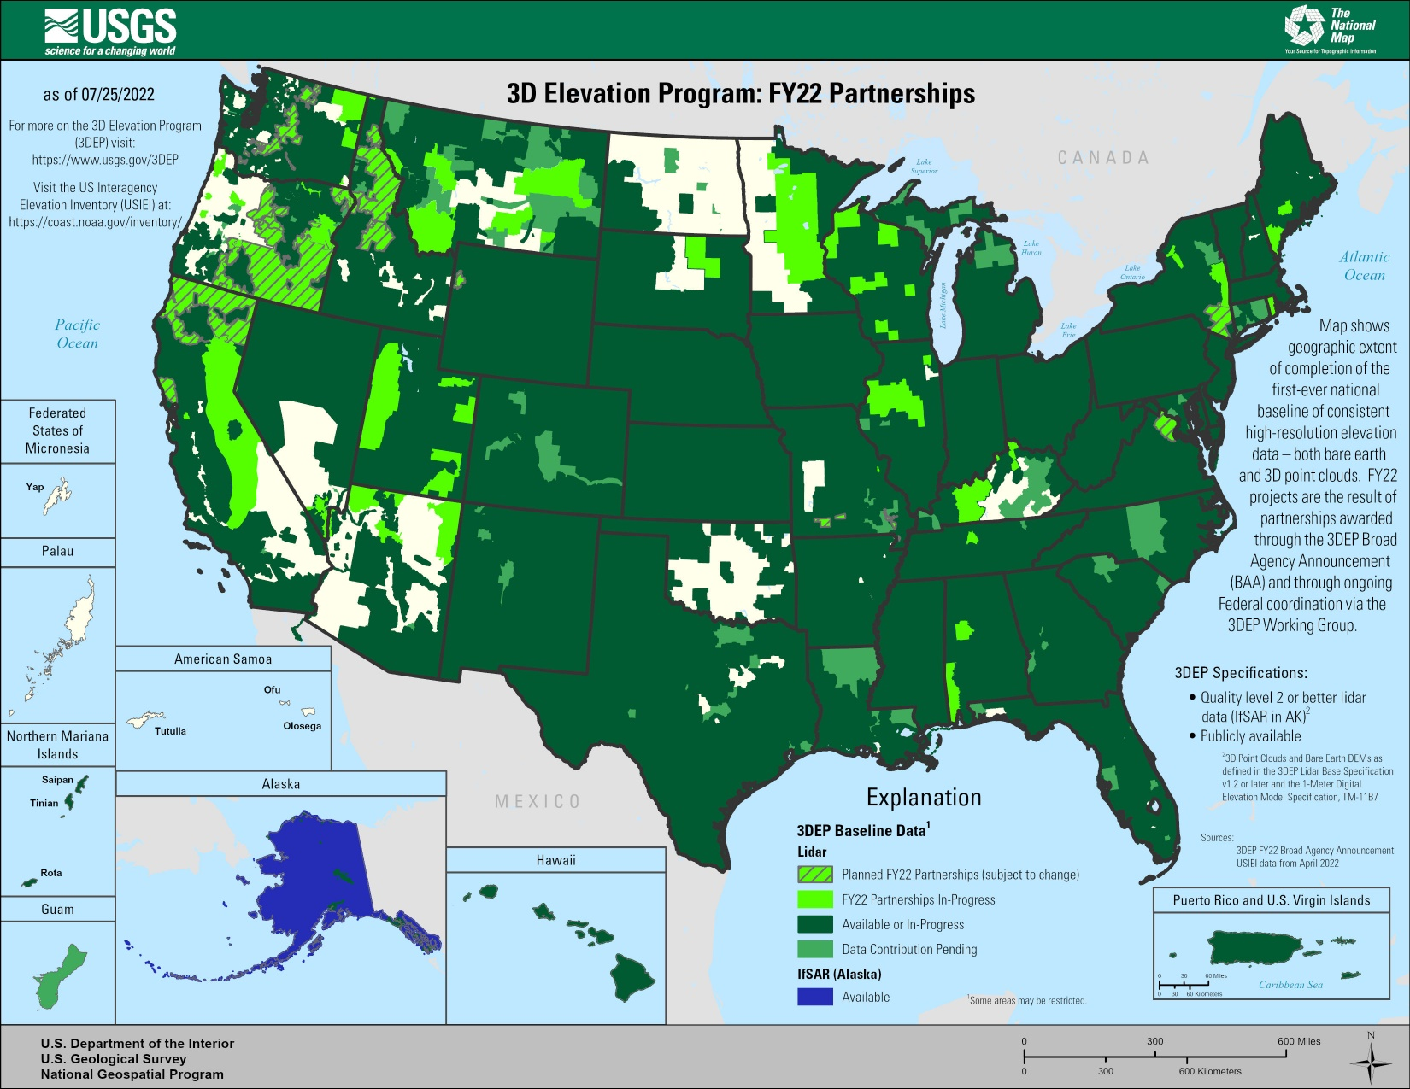
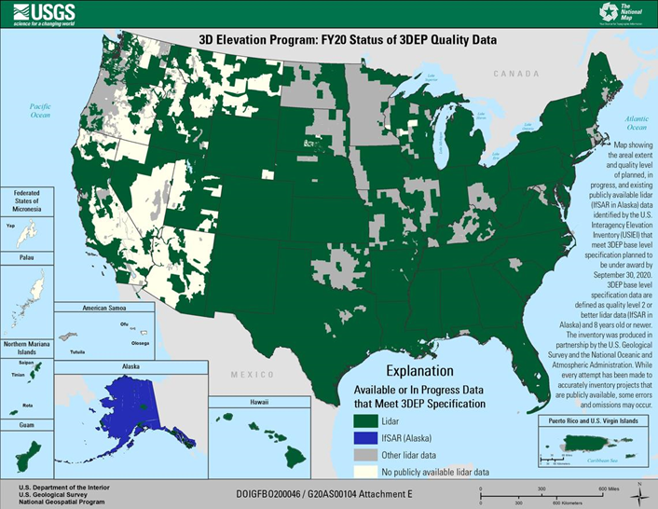
USGS 3D Elevation Program (3DEP)
3D Elevation Program (3DEP)
Systematically guiding the collection of 3D elevation data in the form lidar data for the United States, and the U.S. territories
Broad Agency Announcement (BAA)
Grant coordinating mechanism 3DEP
Guides partnerships between the USGS and other Federal agencies with other public and private entities seeking high-quality 3D lidar elevation data acquisition
Due: October 10 (estimated)

Slide 22
3D Geomatics: Funding, Agreements, and Acquisition
Contributions to Minnesota Lidar ($millions)
Minnesota Partners: $ 6.05
USGS 3DEP: $ 11.60
Other Federal: $ 0.45
Total: $18.09M
Minnesota Funding Partners
48 Funding Partners
51,405 Square Miles of New Lidar
$118* Cost/mi² For MN Partners
* Estimated cost per square mile paid by 48 unique Minnesota funding partners working collaboratively for consistent lidar data acquisition. $118 Value: 1.) is not specific to a 3DGeo Lidar Acquisition Block, 2.) is based on current total Minnesota partner contributions of $6,053,761.44, 3.) does not include federal contributions.

Slide 23
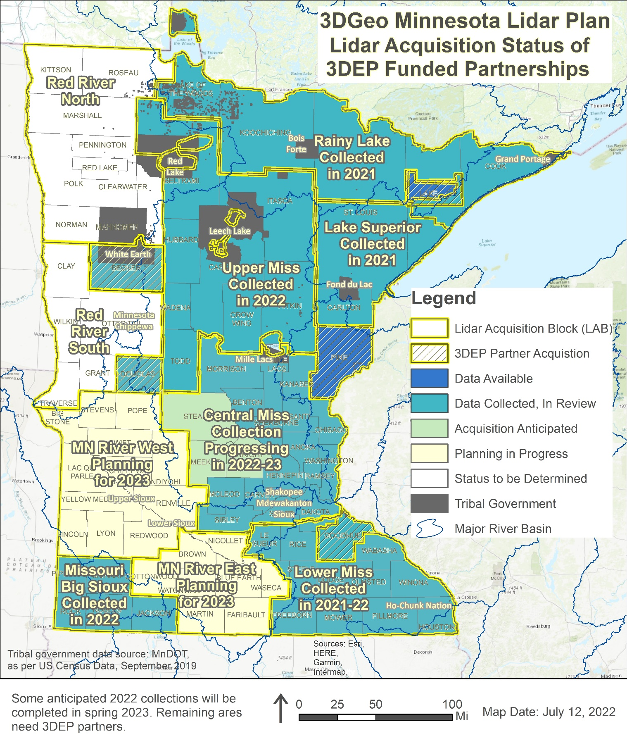
Lidar Acquisition Areas and Blocks of Interest
Lake County area collected in fall 2018, data publicly available
Pine County collected in spring 2019, data publicly available
Goodhue County collected in spring 2020, data in review
Rainy Lake and Lake Superior collected in spring 2021, data delivery fall 2022
Missouri/Big Sioux, Becker and Douglas Counties, and Upper Mississippi collections completed spring 2022, data delivery expected in fall 2023
Central Mississippi partially collected in spring 2022, remaining to be collected spring 2023
Red River Watershed Management Board, with supporting Counties and Watershed Districts collected lidar in fall 2021 within the Red River Watershed
Notes:
*Special note: the Red River Watershed Management Board, with supporting Counties and Watershed Districts, collected lidar in fall 2021. These data are not currently fully approved by USGS and do not yet meet 3DEP standards at this time. As a result, the lidar data is not yet considered part of the statewide MN Lidar Plan.
The 3D Geomatics Data Acquisition Team will be submitting a USGS 3DEP BAA for the entire 3DGeo MN River West Lidar Acquisition Block (LAB) as outlined in the Minnesota Lidar Plan to ensure there are no gaps between the RRWMB and 3DGeo lidar acquisition initiatives.

Slide 24
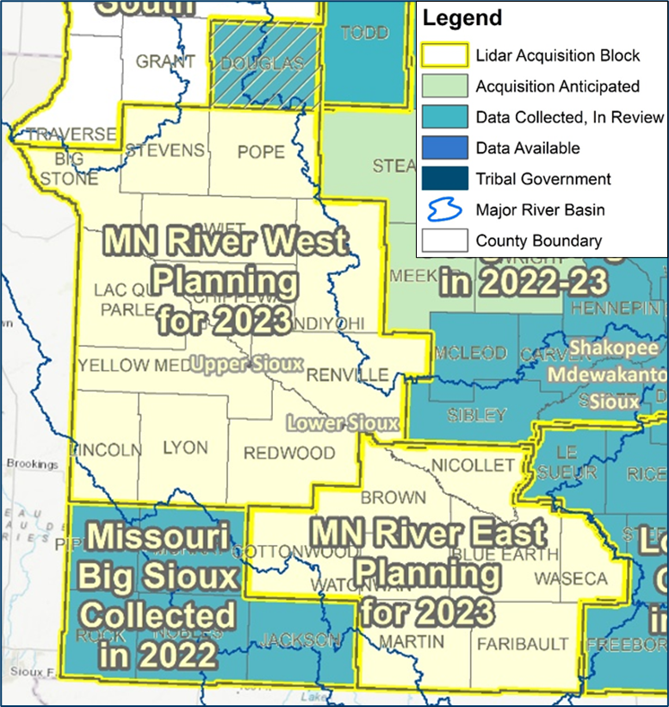
Call to action: Next steps – MN River East & West LAB
Call To Action
3DGeo seeks to identify local champions and funding partners across MN River - East and West LABs for a Spring 2023 lidar acquisition project
2023 - Lidar Collection
Data Delivery Late 2024
Without stakeholder support and funding partnerships established by September 2022, 3DGeo will be forced to withhold its planned LAB grant submission(s) until September 2023.
2024 – Lidar Data Collection
Data Delivery late 2025
3D Geo

Slide 25
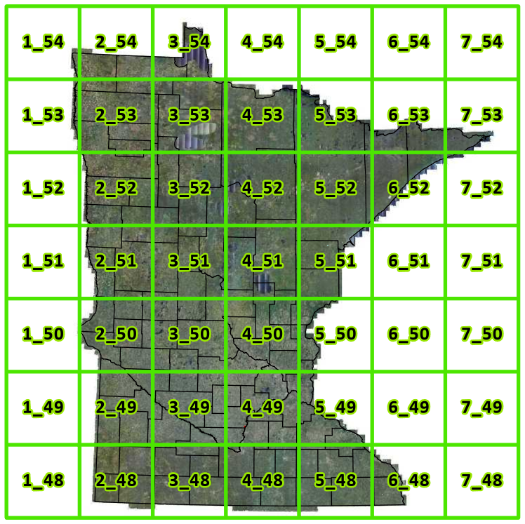
Lidar Acquisition: Minnesota 3D Geomatics - Tiling Scheme
3DGeo Tiling Scheme
Goal:
Develop and make available a uniform, statewide, consistent, gridded index system that aids in alignment of adjacent lidar data procurement projects, brings efficiency to storage of voluminous lidar data, and provides cost savings for data dissemination egress charges.
Description
Comprised of both 1-kilometer x 1-kilometer tiles, and 500-meter x 500-meter tiles maintained as separate tile index files.
Guidance/Description Document
Le Sueur
Olmsted

Slide 26
HD Lidar Examples: Hydrography & Infrastructure Feature Extraction | High Density Lidar ≥30-point/m² | Le Sueur County Lidar Data Collection 2021
Notes:
GIS results provided by Rick Moore
MnDOT Accuracy Test Results
Evaluation of High-Density Quality Level – 0 (HD QL0)
2020 Goodhue County Lidar Procurement Project
3DGeomatics Lidar Acquisition Team Member Colin Lee (MnDOT Photogrammetrist) and MnDOT surveyors from the District-6 office analyzed a sample of high-density quality level-0 (HD QL0), lidar point cloud data (~30 point per square meter) from the 2020 Goodhue County lidar data acquisition.
HD QL0 Criteria
Standard QL0 ≥ 8.0 Pulse Density (ANPD) [pulse/m²]
High Density QL0 ≥ 30+ Points/ m² (exceeds minimum base spec for QL0 with a work order defined additional amount of points equal to or greater than 30 points per sq meter [suggested description described as HD QL0 or HD QL0-30])
Results
Test points represent open, hard, smooth surfaces.
The test results are showing that 90% of the lidar points evaluated have elevation values within 0.033 (ft) to 0.066 (ft) of actual, onsite, vertical survey results.
As expected, a few outliers are falling up to 0.30 (ft) outside of the 90% distribution
Unit Conversion
Converting these results to centimeters, we see that the vertical accuracy of this HD QL0-30 lidar data is within 1.0 (cm) to 2.0 (cm) of onsite, vertical survey results.
These values are better than the minimum lidar base specification of ≤ 0.03 m (≤ 3.0 cm / 1.181 in).
0.033 ft = 0.396 inches = 1.00584 cm
0.066 ft = 0.792 inches = 2.01168 cm
Disclaimer
All publicly funded QL-0 lidar acquisitions must adhere to the USGS Lidar Base Specification vertical accuracy, pulse spacing and density criteria. Although the 2020 Goodhue County QL0 lidar data procurement project collected Quality Level 0 (QL0), Non-vegetated vertical accuracy RMSEz = 5.0 cm as defined by USGS Lidar Base Specifications, the statement of work (SOW) was unique, it specified the acquisition collect lidar points at 30 points per square meter nominal pulsed density.
The Goodhue SOW stated:
Aggregate Nominal Pulse Spacing (ANPS) (m) ≤0.35
Aggregate Nominal Pulse Density (NPD) (pls/m2) ≥ 8.0
DEM cell size (minimum) = 1.5m /1 foot
Point cloud deliverable must ≥30

Slide 27
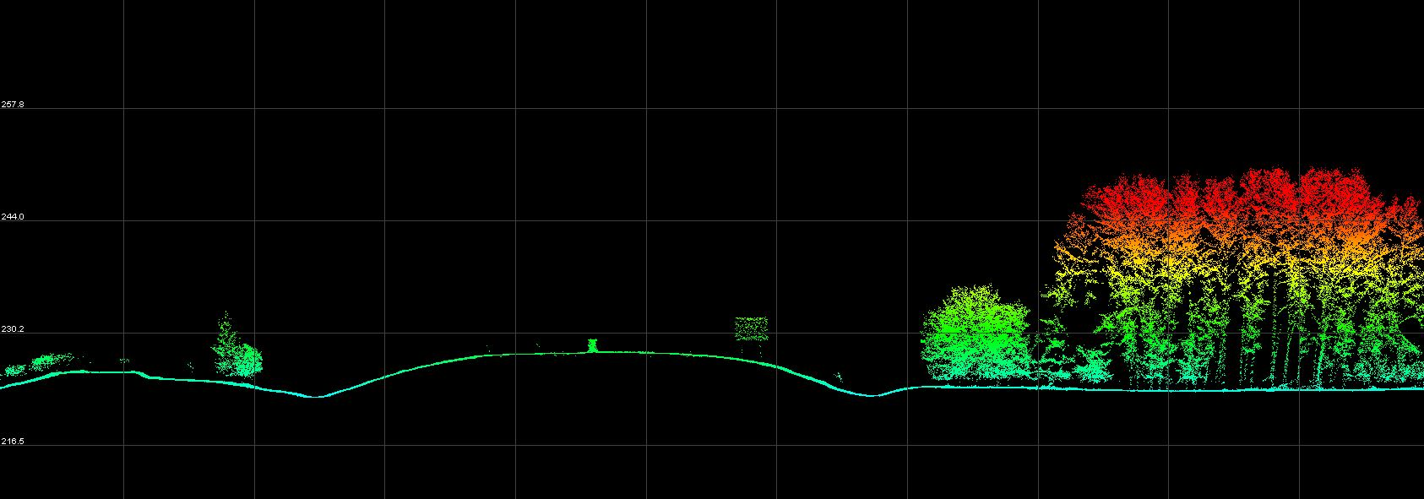
HD Lidar Examples: Hydrography & Infrastructure Feature Extraction | High Density Lidar ≥30-point/m² | Le Sueur County Lidar Data Collection 2021
Notes:
GIS results provided by Rick Moore
MnDOT Accuracy Test Results
Evaluation of High-Density Quality Level – 0 (HD QL0)
2020 Goodhue County Lidar Procurement Project
3DGeomatics Lidar Acquisition Team Member Colin Lee (MnDOT Photogrammetrist) and MnDOT surveyors from the District-6 office analyzed a sample of high-density quality level-0 (HD QL0), lidar point cloud data (~30 point per square meter) from the 2020 Goodhue County lidar data acquisition.
HD QL0 Criteria
Standard QL0 ≥ 8.0 Pulse Density (ANPD) [pulse/m²]
High Density QL0 ≥ 30+ Points/ m² (exceeds minimum base spec for QL0 with a work order defined additional amount of points equal to or greater than 30 points per sq meter [suggested description described as HD QL0 or HD QL0-30])
Results
Test points represent open, hard, smooth surfaces.
The test results are showing that 90% of the lidar points evaluated have elevation values within 0.033 (ft) to 0.066 (ft) of actual, onsite, vertical survey results.
As expected, a few outliers are falling up to 0.30 (ft) outside of the 90% distribution
Unit Conversion
Converting these results to centimeters, we see that the vertical accuracy of this HD QL0-30 lidar data is within 1.0 (cm) to 2.0 (cm) of onsite, vertical survey results.
These values are better than the minimum lidar base specification of ≤ 0.03 m (≤ 3.0 cm / 1.181 in).
0.033 ft = 0.396 inches = 1.00584 cm
0.066 ft = 0.792 inches = 2.01168 cm
Disclaimer
All publicly funded QL-0 lidar acquisitions must adhere to the USGS Lidar Base Specification vertical accuracy, pulse spacing and density criteria. Although the 2020 Goodhue County QL0 lidar data procurement project collected Quality Level 0 (QL0), Non-vegetated vertical accuracy RMSEz = 5.0 cm as defined by USGS Lidar Base Specifications, the statement of work (SOW) was unique, it specified the acquisition collect lidar points at 30 points per square meter nominal pulsed density.
The Goodhue SOW stated:
Aggregate Nominal Pulse Spacing (ANPS) (m) ≤0.35
Aggregate Nominal Pulse Density (NPD) (pls/m2) ≥ 8.0
DEM cell size (minimum) = 1.5m /1 foot
Point cloud deliverable must ≥30

Slide 28
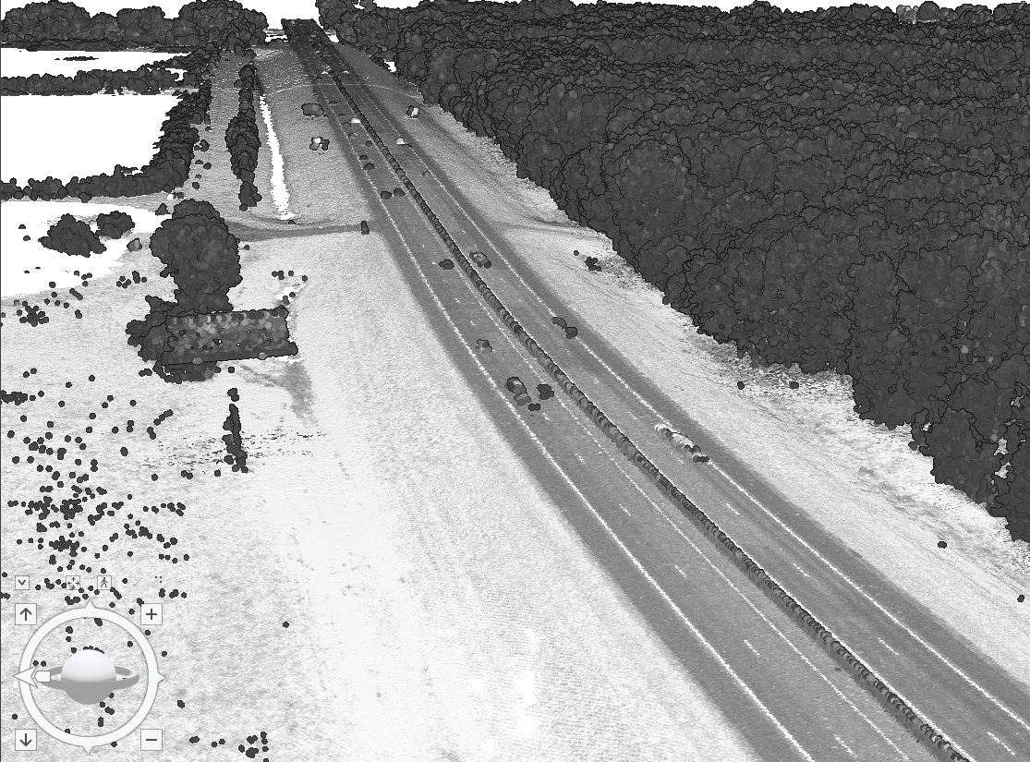
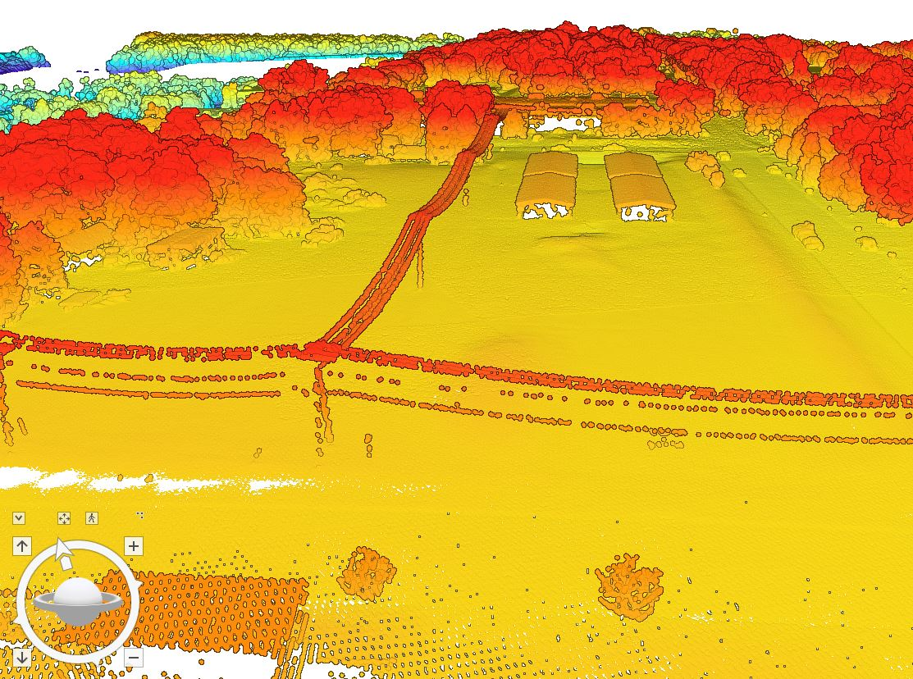
HD Lidar Examples: Hydrography & Infrastructure Infrastructure | High Density Lidar ≥30-point/m² | Le Sueur County Lidar Data Collection 2021
Lidar Point Cloud Intensity Classification
Lidar Point Cloud Elevation Classification
Notes:
GIS results provided by Rick Moore
MnDOT Accuracy Test Results
Evaluation of High-Density Quality Level – 0 (HD QL0)
2020 Goodhue County Lidar Procurement Project
3DGeomatics Lidar Acquisition Team Member Colin Lee (MnDOT Photogrammetrist) and MnDOT surveyors from the District-6 office analyzed a sample of high-density quality level-0 (HD QL0), lidar point cloud data (~30 point per square meter) from the 2020 Goodhue County lidar data acquisition.
HD QL0 Criteria
Standard QL0 ≥ 8.0 Pulse Density (ANPD) [pulse/m²]
High Density QL0 ≥ 30+ Points/ m² (exceeds minimum base spec for QL0 with a work order defined additional amount of points equal to or greater than 30 points per sq meter [suggested description described as HD QL0 or HD QL0-30])
Results
Test points represent open, hard, smooth surfaces.
The test results are showing that 90% of the lidar points evaluated have elevation values within 0.033 (ft) to 0.066 (ft) of actual, onsite, vertical survey results.
As expected, a few outliers are falling up to 0.30 (ft) outside of the 90% distribution
Unit Conversion
Converting these results to centimeters, we see that the vertical accuracy of this HD QL0-30 lidar data is within 1.0 (cm) to 2.0 (cm) of onsite, vertical survey results.
These values are better than the minimum lidar base specification of ≤ 0.03 m (≤ 3.0 cm / 1.181 in).
0.033 ft = 0.396 inches = 1.00584 cm
0.066 ft = 0.792 inches = 2.01168 cm
Disclaimer
All publicly funded QL-0 lidar acquisitions must adhere to the USGS Lidar Base Specification vertical accuracy, pulse spacing and density criteria. Although the 2020 Goodhue County QL0 lidar data procurement project collected Quality Level 0 (QL0), Non-vegetated vertical accuracy RMSEz = 5.0 cm as defined by USGS Lidar Base Specifications, the statement of work (SOW) was unique, it specified the acquisition collect lidar points at 30 points per square meter nominal pulsed density.
The Goodhue SOW stated:
Aggregate Nominal Pulse Spacing (ANPS) (m) ≤0.35
Aggregate Nominal Pulse Density (NPD) (pls/m2) ≥ 8.0
DEM cell size (minimum) = 1.5m /1 foot
Point cloud deliverable must ≥30

Slide 29
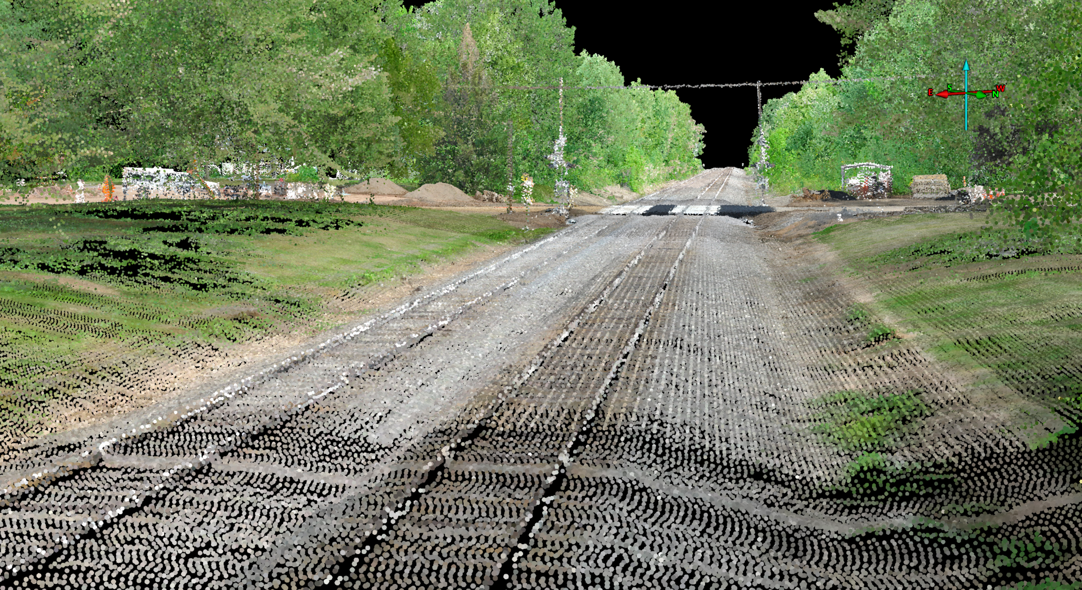
HD Lidar Examples: Infrastructure
Highway/Rail Grade Crossing Inspection
Notes:
Project goals:
Develop a drone-based grade crossing inspection system
Humped crossing analysis
Visual sight lines
Railway infrastructure assessment

Slide 30
Agenda Item 7
Minnesota County GIS Association (MCGISA)
Geoff Maas

Slide 31
MINNESOTA COUNTY GIS ASSOCIATION
The Role of GIS in County Government: Successes and Challenges
October 13, 2022
MN GIS/LIS 32nd Annual Conference & Workshops
Bemidji, Minnesota

Slide 32
What we want to cover today
Panel discussion in two parts:
Part 1: The “What and Why” of MCGISA?
Its Purpose, Function, and Structure
What needs do you have that MCGISA can serve?
Part 2: The Role of GIS in County Government
What is working well?
What challenges do we face?

Slide 33
Part 1:
The ‘What and Why’ of MCGISA

Slide 34
The “What and Why” of MCGISA?
County government fulfills many diverse roles
Many different types of work conducted at the county government level…
Legal/Judiciary
Law Enforcement
Corrections
Emergency Services
Planning
Surveying
Public Health
Assessing
Administration
Waste Management
Land Records
Land Management
Social Services
Veterans Services
Economic Development
Engineering
Parks and Recreation
IT/Information Services

Slide 35
County Professional Organizations

Slide 36
What do these organizations do for their members?

Slide 37
What do these organizations do for their members?
Promote/increase visibility of their profession
Advocate for their profession
Track legislation affecting their profession
Lobby for new or needed legislation
Networking and knowledge sharing
Awards and recognition for outstanding work
Mentorship and scholarships
Promote standards and best practices
Liaison with other groups

Slide 38
Why not GIS too?

Slide 39
MCGISA: Originally formed in 2007 as a non-profit
Original Goals:
1 ) Foster support for GIS among public officials
2 ) Cultivate leadership and professional development through workshops, seminars, and meetings

Slide 40
MCGISA: Originally formed in 2007 as a non-profit
Original Goals:
1 ) Foster support for GIS among public officials
2 ) Cultivate leadership and professional development through workshops, seminars, and meetings
3 ) Provide a forum to share knowledge, information, and experience among the members and identify shared issues

Slide 41
MCGISA: Originally formed in 2007 as a non-profit
Original Goals:
4 ) Advocate MCGISA views and needs to policy makers on regional, state, and federal issues

Slide 42
MCGISA: Originally formed in 2007 as a non-profit
Original Goals:
4 ) Advocate MCGISA views and needs to policy makers on regional, state, and federal issues
5 ) Assist in the use, promotion and advancement of GIS technology in county government
6 ) Support the development and implementation of standards

Slide 43
MCGISA
How can we respond to the continually increasing use of and demand for GIS?
Increasing demand for the work we do and can provide:
More publicly available GIS data
Publicly facing web mapping applications
Geospatial analysis for problem solving
Voting, demographics, commissioner districts, etc.
‘Data driven’ decision making
NG9-1-1 needs for our GIS data

Slide 44
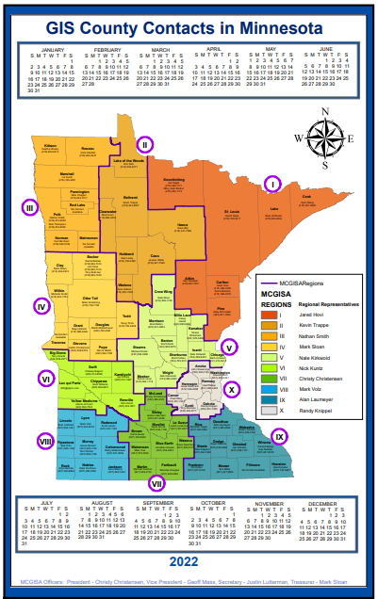
MCGISA Structure
Officers (4)
President, Vice President
Treasurer, Secretary
Regional Representatives (10)
Ten Regions
(Align with the AMCo regions)
By-Laws
Govern meetings, dues, actions
(Need to be revisited)

Slide 46
What do we want MCGISA to do?

Slide 47
What do we want MCGISA to do?
What role does this organization play?
What kinds of functions does it have?
What should it provide its members?

Slide 48
What do we want MCGISA to do?
Improve information sharing among county GIS departments
Awards and recognition for county GIS work
Individuals
Projects
Departments
Mentorship and scholarships to GIS students
Liaison/partner with other county-level groups
(MNCITLA, MACS, MNCCC, etc.)

Slide 49
What do we want MCGISA to do?
Increase the visibility of our work to our leadership and to other professions;
Meaningful connections to other disciplines that can leverage GIS in county government
Promote the increase in both the quality and availability of geospatial data;

Slide 50
What do we want MCGISA to do?
Increase/enhanced exchange of knowledge between counties – mutual assistance on shared problems
Provide an effective means for sharing our concerns and challenges
We are an officially affiliated professional organization with Association of Minnesota Counties

Slide 51
What resources can MCGISA provide?
Resources that support shared needs
Notification on actions by state and federal government that may impact GIS work at the county level
White papers, research, foundational knowledge base available to all county GIS practitioners on shared topics

Slide 52
Part 2:
The Role of GIS in County Government
Successes and Challenges

Slide 53
The Role of GIS in County Government
Examples of success
What is working well?
Examples of successful projects
Challenges:
What challenges do we face?

Slide 54
One of the main reasons for the panel discussion:
Discussion/input on the challenges we face
Funding, Staffing, Project Prioritization
Support from leadership
Etc.

Slide 55
Break

Slide 56
Agenda Item 9
Sector Report
Heather Albrecht

Slide 57
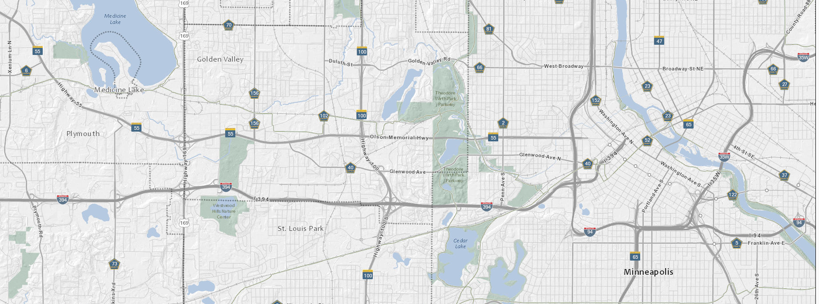
Hennepin GIS
Hennepin County Information Technology

Slide 58
Topics
A little about Hennepin GIS & MnGAC At-Large Rep
Hennepin GIS produces data and creates maps in support of Hennepin County's mission to enhance the health, safety and quality of life of our residents and communities in a respectful, efficient and fiscally responsible way.

Slide 59
How we fit in
Operations
Information Technology
Development Services
Business and Operations Intelligence
Hennepin GIS + Community Connectivity
Enterprise Development

Slide 60
Who are we
Coordinators
Analysts
Developers
Database administrator
Systems administrator Business analyst
Hennepin GIS
Hennepin GIS is a team of geographers,
analysts, designers and technology
professionals.

Slide 61
Our focus
Maps and visualization
Spatial analysis and location intelligence
Software support and licensing Application development and configuration Data administration Collaboration and program support
Exploration and discovery
Hennepin GIS works to support
and sustain innovative use of
geospatial technology across the organization.
Hennepin GIS

Slide 62
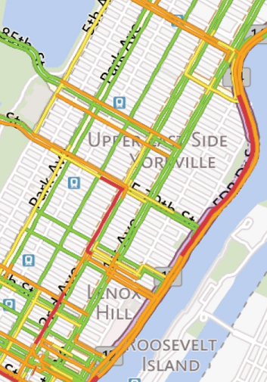
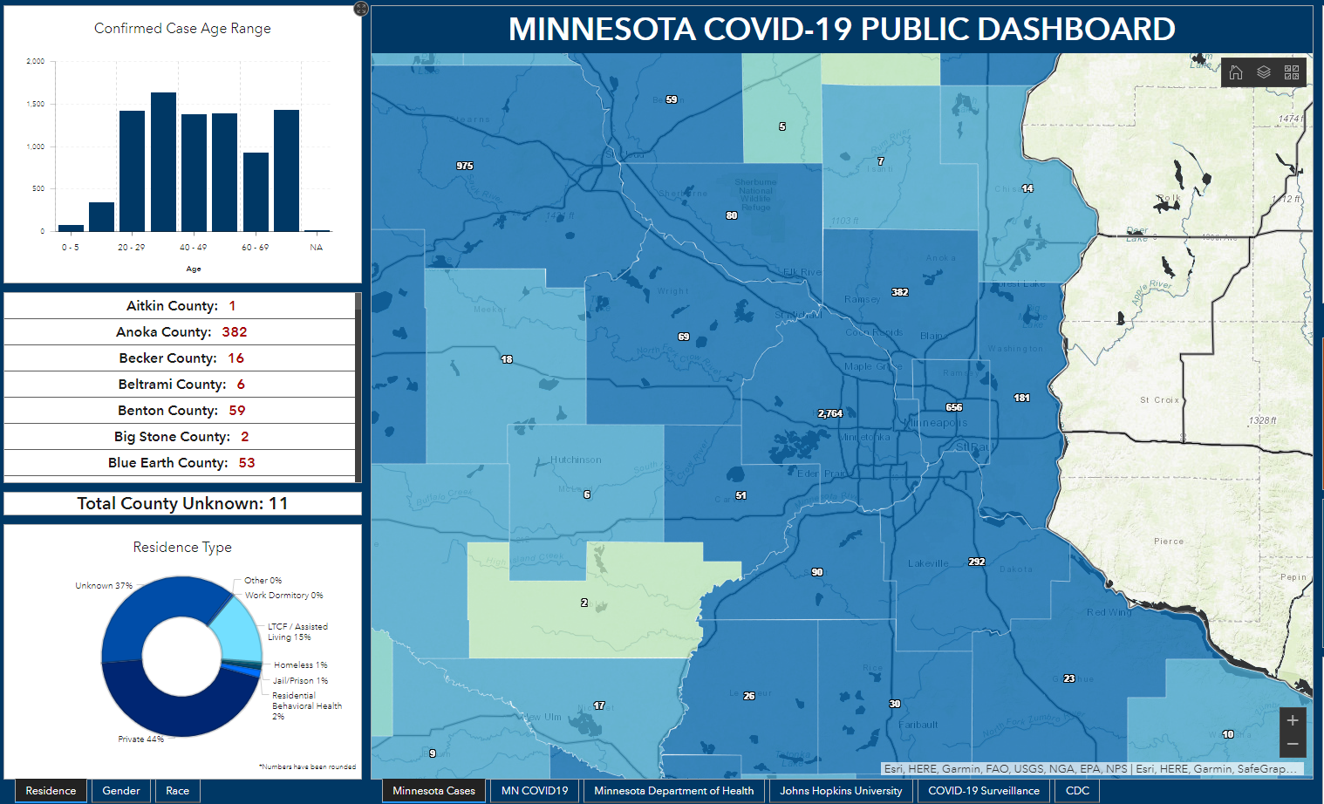
Hennepin GIS
Approach
Business systems
Focus on platform
Information Products
Process
&
Analyze
Detect Monitor Predict
Real-time
Data and map services
Graphic adapted from Esri

Slide 63
Mn Geospatial Advisory Council At-Large Rep
Standards Committee
Cross jurisdictional collaboration
3D Geomatics Committee
Hennepin GIS remote sensing program
Outreach Committee
Promote free and open data & development of statewide datasets

Slide 64
Contact
Jesse Reinhardt, GIS + Community Connectivity
612-596-9058
jesse.reinhardt@hennepin.us
Thanks!
Heather Albrecht| GIS + Community Connectivity heather.albrecht@hennepin.us
Contact gis.info@Hennepin.us
Web https://www.hennepin.us/gis Twitter https://twitter.com/HennepinGIS

Slide 65
Agenda Item 11
NSGIC Membership
Alison Slaats

Slide 66
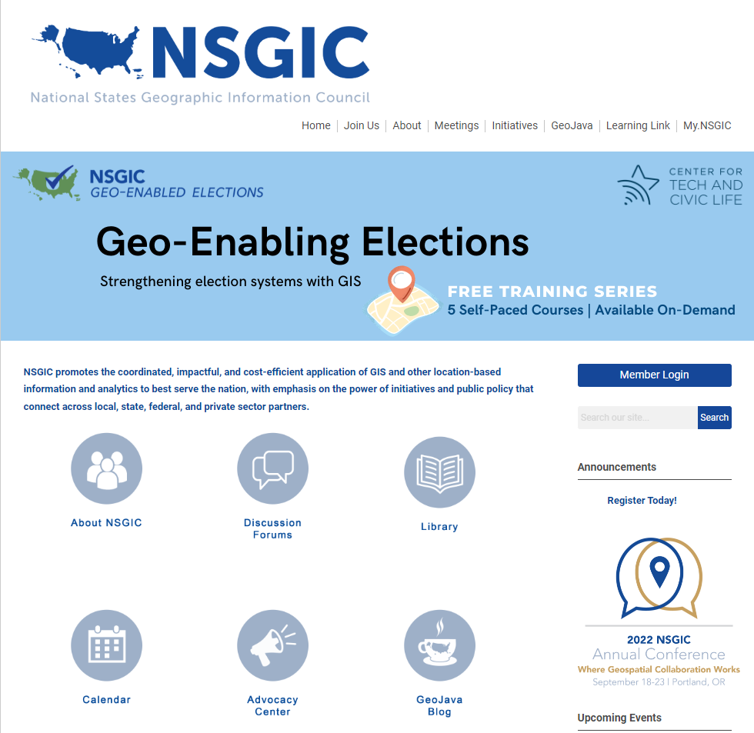
National States Geographic Information Council (NSGIC)
Every GAC member has a membership in NSGIC
NSGIC is a state-led forum for developing, exchanging and endorsing geospatial technology and policy best practices.
NSGIC facilitates connections between people and organizations across multiple sectors.
2 conferences per year (annual and mid-year)
Many issues that Minnesota is working on have groups at NSGIC: 3D Elevation, Parcel and Land Records, Elections and Redistricting, and more
Learn more: https://www.nsgic.org/

Slide 67
Agenda Item 12
Legislative Updates
Alison Slaats
Surveyor-led team will pursue PLSS legislation
MnGeo will request increase in appropriation for surveyor position, lidar data storage and distribution support, and to support additional foundational dataset work

Slide 68
Agenda Item 13
Annual Priority Survey
Cory Richter

Slide 69
Why Create Priorities?
To create a voice for the MN geospatial community
To direct work plans of the GAC and its committees
To advise MnGeo on needs of the community
To allow other organizations to compare priorities and align efforts
To inform outreach and policy related efforts
Having clear direction helps motivate people to participate

Slide 70
GAC Priorities Process
Create a list of proposed projects and initiatives
From GAC members and committee chairs
Outreach to sectors
Assess the value of each – degree of business need
MN Geospatial Priorities Survey
Assess likelihood of success of each - owner, work team, champion, funding
Preliminary priority calculation
GAC discusses and adjusts

Slide 71
GAC Priorities for Survey
Project or Initiative Name | Status
Lidar Data | Active
Updated & Aligned Boundary Data | Active
Parcel Data | Active
Road Centerline Data | Active
MnGeo Image Service Improvements | Active
Critical Infrastructure Data Workflow | Active
Address Points Data | Active
Underground Utilities Data Sharing Team | Active
U.S. National Grid Materials | Active
Geodata Archive Implementation | Active
Hydro-DEMs | Active
Culvert Data Standard | Active

Slide 72
GAC Priorities for Survey
Project or Initiative Name | Status
Remonumentation of all Section Corners | Active
Success Stories for Geospatial Technology | Active/Recruitment underway
Geospatial Commons Advisory Group | Recruitment underway
CJIS Data GIS Best Practices | Active
NG9-1-1 Geospatial Forum | Recruitment underway
Parks Data Standard | Inactive
Summary Crime Data | Inactive
Basemap Services | Inactive
Strategy Team for All Types of Imagery | Inactive
State Business License Data | Inactive
Snow Emergency Parking Data Practices | Inactive
Street Parking Restrictions Data Standard | Inactive
Inventory of MN GeoData Assets | Inactive

Slide 73
Priorities Survey Timeline
September
Set survey list
Early October
Create & open survey
Announce at GIS/LIS
Mid-November
Close survey, score
December
Set 2023 priorities

Slide 74
Agenda Item 14
Updates on GAC Priority Projects and Initiatives
Cory Richter

Slide 75
Updates on GAC Priority Projects and Initiatives
Most recent success
Experiencing a barrier?
Next task

Slide 76
GAC Priorities
Project or Initiative Description | Status | Project Owner | Champion
New Lidar Acquisition | Active | Gerry Sjerven | Alison Slaats
Updated and Aligned Boundary Data | Active | Preston Dowell | Alison Slaats
Parcel Data | Active | Alison Slaats | Mark Kotz
Road Centerline Data | Active | MnGeo | Alison Slaats
Image Service Improvements | Active | Jim Bunning | Alison Slaats
Critical Infrastructure Data | Active | Stacey Stark | Steve Swazee
Address Points Data | Active | MnGeo | Alison Slaats
Underground Utilities Data | Active | Steve Swazee | Barb Cederberg
U.S. National Grid Materials | Active | Randy Knippel | Randy Knippel
Archiving Implementation | Active | Ryan Mattke | many
Accurate Hydro-DEMs | Active | Sean Vaughn | many
Culvert Data Standard | Active | Rick Moore | Jonathan Lord

Slide 77
GAC Priorities
Project or Initiative Description | Status | Project Owner | Champion
Remonumentation of Section Corners | Active | Pat Veraguth | Alison Slaats
Success Stories for Geospatial Technology | Recruitment
Geospatial Commons Advisory Group | Recruitment
Criminal Justice Info Best Practices | Active | Britta Maddox
NG911 Forum | Recruitment
Parks Data Standard | Inactive
Summary Crime Data | Inactive | Britta Maddox
Basemap Services | Inactive
Strategy Team for All Types of Imagery | Inactive
State Business License Data | Inactive
Snow Emergency Parking Restriction Data | Inactive
Street Parking Restrictions Data Standard | Inactive
Geospatial Data Asset Inventory | Inactive

Slide 78
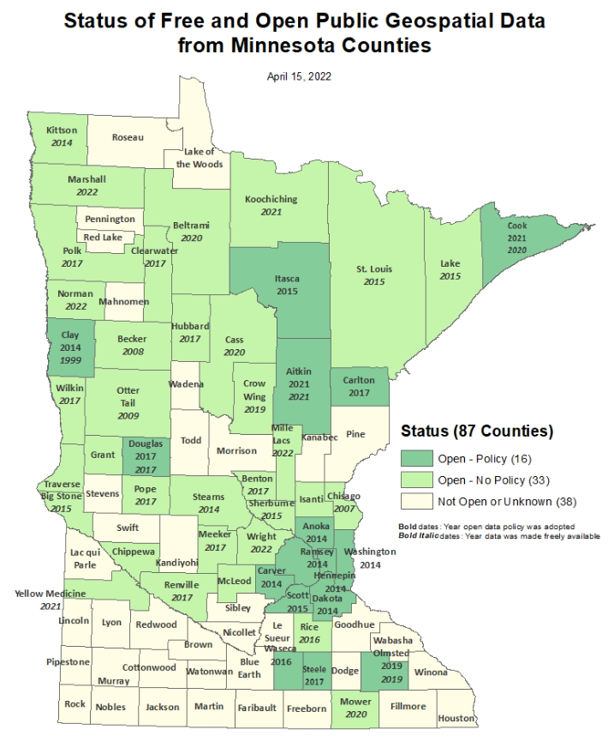
Status of Free and Open Data Public Geospatial Data
Status | Number of Counties | Total
Open - Policy | 16 | 49
Open - No Policy | 33
Not Open or Unknown | 38 | 38
Data current as of April 15, 2022 (no change since then)
https://gisdata.mn.gov/dataset/bdry-mn-county-open-data-status

Slide 79
New Lidar Acquisition
Already covered earlier in this meeting.

Slide 80
Updated and aligned boundary data
Most recent success:
If you are experiencing a barrier:
Next Task:

Slide 81
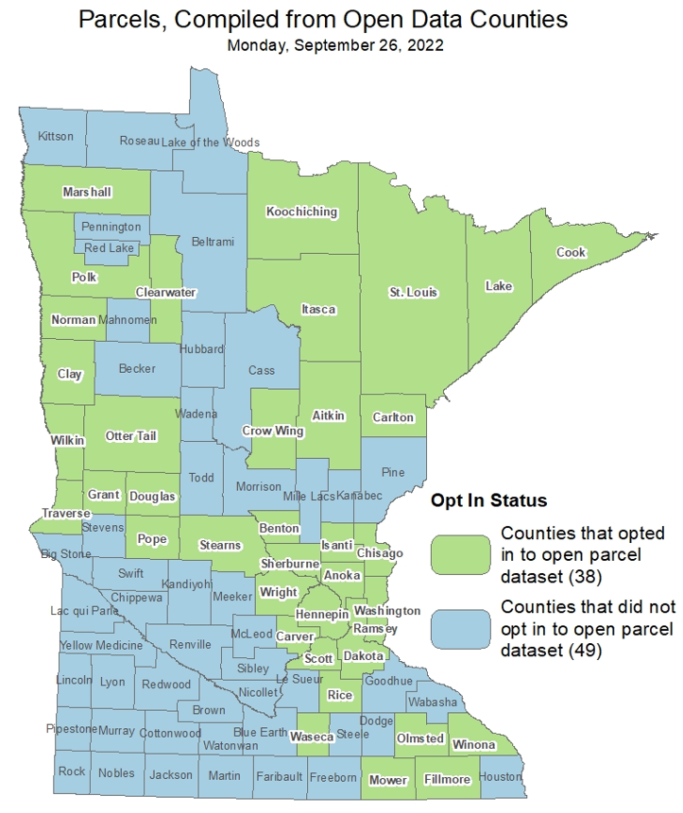
Statewide publicly available parcel data
Most recent success:
Individual outreach to counties from PLRC team
Addition of open parcels from following counties: Fillmore, Lake, Olmsted, Winona, Wright
If you are experiencing a barrier:
Next task:
Continuing individual outreach to counties from PLRC team
https://gisdata.mn.gov/dataset/plan-parcels-open

Slide 82
Road Centerline Data & Address Points Data
Most recent success:
More counties are submitting their data through the NG9-1-1 data ECN 1Spatial Portal. Progress can be seen on the NG9-1-1 hub on the status page.
If you are experiencing a barrier:
Final 1Spatial validation steps need to be completed so that MnGeo can pull data in streamlined process.
Need to define “opt-in” process to ask counties if they’d like to be included in public dataset (MnGeo, GAC Outreach Committee, input from MCGISA)
Next task:
Complete 1Spatial validation process & steps (ECN, 1Spatial, MnGeo)
Create process to move data from 1Spatial to public dataset (MnGeo)
Outreach to counties to ask if they’d like to “opt-in” included in public dataset (MnGeo, GAC Outreach Committee, input from MCGISA)

Slide 83
Improvements to the MnGeo Image Service, such as Web Mercator support, tiling, and complementary options such as “composite of latest leaf off imagery”, and downloading options
Most recent success:
Added county imagery from Steele County to WMS
If you are experiencing a barrier:
Time constraints to work on recommendations of committee, and did not accomplish removal of suggested retirement image layers
Lyon county data delayed due to processing issue
Next task:
Adding county imagery from Lyon County
In discussion: Le Sueur, Lincoln, and Aitkin Counties

Slide 84
Critical Infrastructure Assessment
Most recent successes:
Recruitment of workgroup members. Now representing federal, state, and local jurisdictional interests. State agencies include HSEM, MnGeo, MDH, COMM, and MDOT.
Best available information is cataloged in “C.I. resource site” on MnGeo website. We are learning about new data initiatives all the time.
If you are experiencing a barrier:
Finding avenues to promote statewide spatial C.I. data use beyond the GIS community.
Next tasks:
Review NREL (National Renewable Energy Lab)-prepared report CI data + Reliability and Equity metrics. Review and identify other uses for these data.
Workflow development: How can we help HIFLD (Homeland Infrastructure Foundation-Level Data) get info from the states and how can national collaborations help us meet our goals?

Slide 85
A project team to develop geospatial data sharing methodologies to support the state’s underground utilities community
Most recent success:
Prototype system functionality is complete (prototype can aggregate diverse utility geospatial data and make available for other project identified needs).
Article featuring UUMPT Leadership Team member Geoff Zeiss of Ottawa, Canada was published in July issue of Damage Prevention-Pro.
2. If you are experiencing a barrier:
3. Next task:
Presentation at MN GIS/LIS October 13-14
Gopher State One Call is preparing to contract for development of Open Source product to leverage concepts and approaches used during development of prototype.

Slide 86
Maps, procedures, templates and other materials to help all levels of government implement the U.S. National Grid
Most recent success:
Worked with SharedGeo to complete a new USNG mapbook publishing application on USNG Center
If you are experiencing a barrier:
Next task:
Scheduled for two presentations at upcoming MN GIS/LIS Conference, October 13-14

Slide 87
Archiving Minnesota geospatial data
Most recent success:
Conducted three interviews with representatives from MnDOT, MnGeo, and the Metropolitan Council to learn more about their aerial imagery collections
If you are experiencing a barrier:
Next tasks:
Attend the GIS/LIS conference to present our poster
Work with GIS/LIS to distribute our community survey
Complete a final report by the next GAC Quarterly meeting

Slide 88
Accurate hydro-DEMs (hDEM) that serve modern flood modeling and hydro-terrain analysis tools, and the development of more accurate watercourses and watersheds
Most recent success:
If you are experiencing a barrier:
Next task:

Slide 89
Development of a culvert data standard for data sharing across the geospatial and infrastructure asset management communities
Most recent success:
Initial email sent out to subject matter experts and individuals identified who volunteered to participate.
Researching Culvert Data practices of other states to identify best practices.
If you are experiencing a barrier:
Culvert Data Standard will become high priority in Fall 2022. Crossover of key personnel between Culvert Standard and DEM Hydro-modification membership has delayed formation of new subgroup.
Next task:
Schedule Kickoff Meeting in October to bring interested parties together.
Recruit additional members and map out the process in creating the standard.

Slide 90
Remonumentation of all section corners
Already covered earlier in this meeting.

Slide 91
CJIS Data GIS Best Practices
Already covered earlier in this meeting.

Slide 92
Agenda Item 15
Announcements

Slide 93
Next Meeting
December 14
Will be remote only (not hybrid)

Slide 94
Adjourn
Thank you

