Slide 1
Minnesota Geospatial Advisory Council
September 9, 2020

Slide 2
Welcome
Introductions
Approve agenda
Approve May minutes

Slide 3
Agenda
Time | Topic
11:10 | Committee summaries - Review and accept
11:15 | Approve Damage Assessment Standard & Standards Update
11:30 | Remonumentation update
11:35 | One Minnesota update
11:45 | Underground Utilities Tiger Team update
11:55 | GIS/LIS Consortium new ad-hoc committees: Professional Development; Equity Advocates
12:05 | Break
12:15 | Outreach Committee chair
12:25 | Geospatial Commons Advisory Committee
12:35 | NSGIC conference and GAC participation
12:45 | Sector reports: Federal; Greater MN County
1:05 | Break
1:15 | GAC priority projects and initiatives updates
1:35 | Legislative updates
1:45 | Announcements
2:00 | Adjourn

Slide 4
Agenda Item 2
Committee Summaries - Review and accept

Slide 5
Agenda Item 3
Approve Damage Assessment Standard & Standards Update
Mark Kotz, Cory Richter

Slide 6
Damage Assessment Data Standard
Purpose
Single, commonly accepted set of attributes
Guide local governments in data collection to support State/Federal disaster assistance

Slide 7
Damage Assessment Data Standard
Proposed by Damage Assessment Data Standard Project Team of EPC
Leaders: Brad Anderson, Cory Richter
Earlier key stakeholder review
Formal 90-day GAC public review (ended 8/19/20)
Few comments - Minor tweaks
Approved by Standards Committee 9/2/20 - Request GAC approval

Slide 8
Standards Update
Address Point Data Standard and Road Centerline Data Standard
Minor modifications for compatibility for NG 9-1-1
Public review ending 10/12/20
Trails and Bikeways Data Standard
Standards Committee approved for 90-day public review

Slide 9
Agenda Item 4
Remonumentation Update
Patrick Veraguth

Slide 10
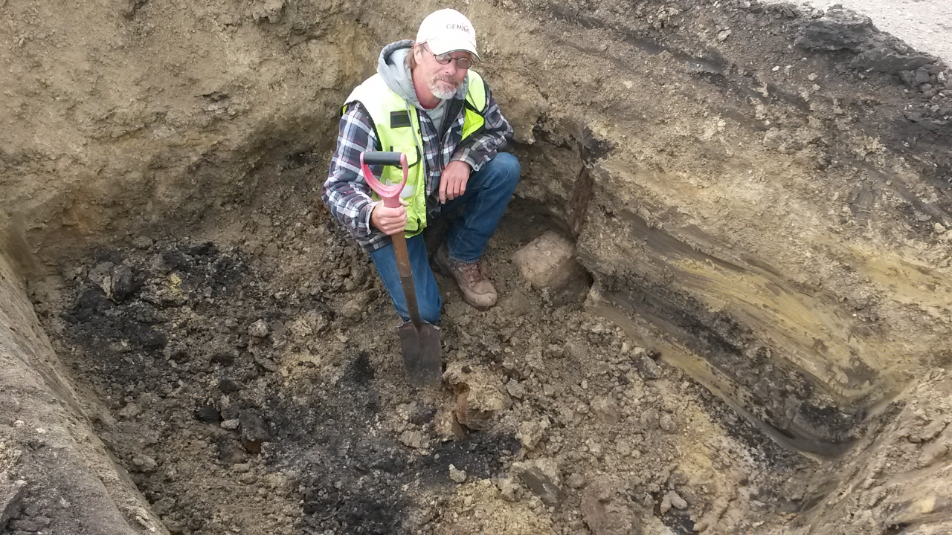
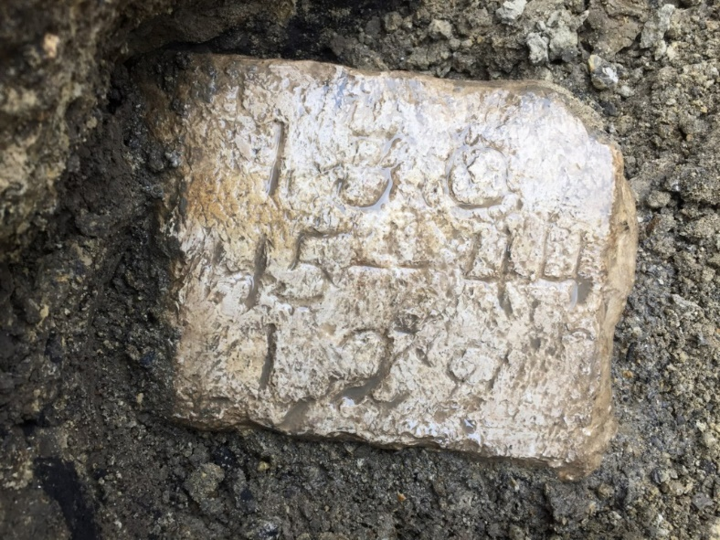
MACS PLSS Pilot Project Update
By Patrick D. Veraguth, LS
Douglas County Surveyor
Minnesota Geospatial Advisory Council
September 9, 2020

Slide 11
What are the two most important GIS Layers?

Slide 12
Why do we need to Remonument Minnesota?
Original Monuments gone
Surveyors not filing Corner Certificates
Increased risk of Property disputes
Inequitable Taxation
Disagreements about resource rights
Confusion over Easement location
Unnecessary expenditures by citizens and local governments
Foundation for all property descriptions in Minnesota
Develop Statewide high accuracy Geo-referenced Parcel Map (GIS apps need higher accuracy)
Notes:
Does anyone think this is a bad idea?
Getting harder to find and set PLSS corners.
Protect the Public

Slide 13
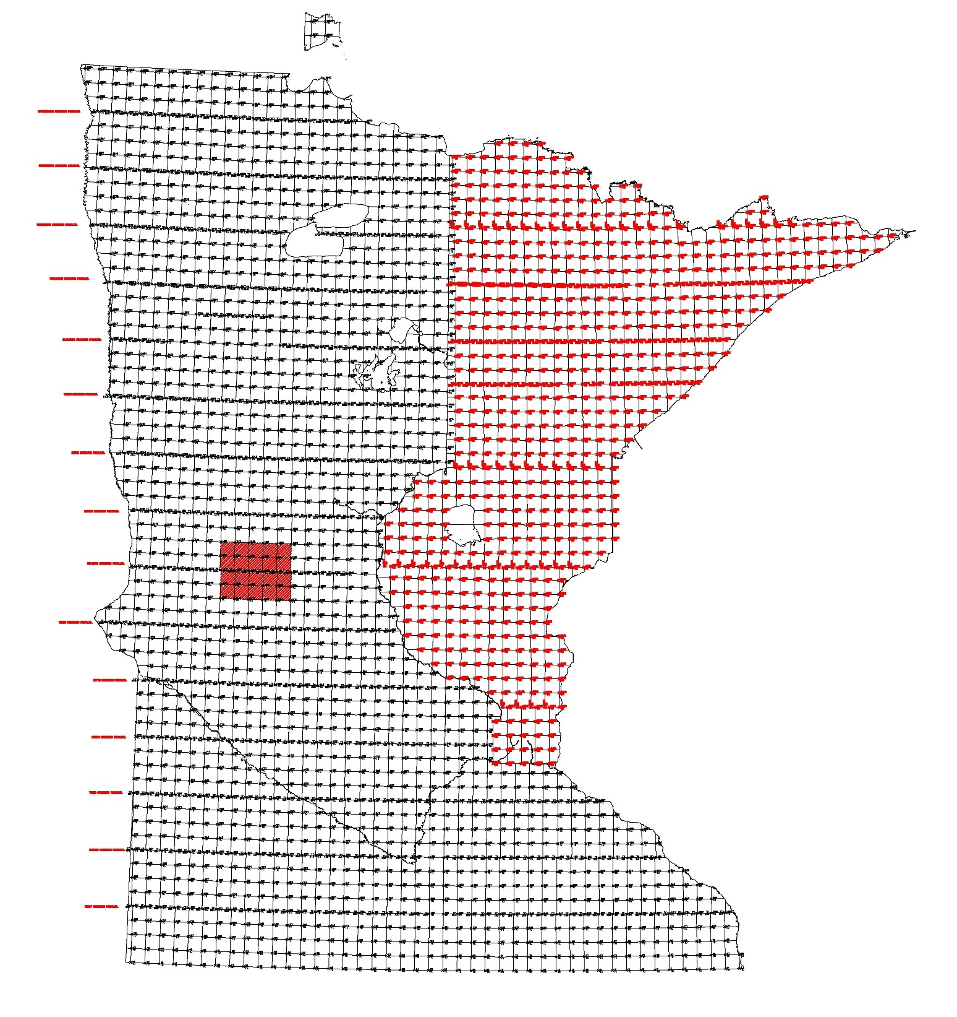
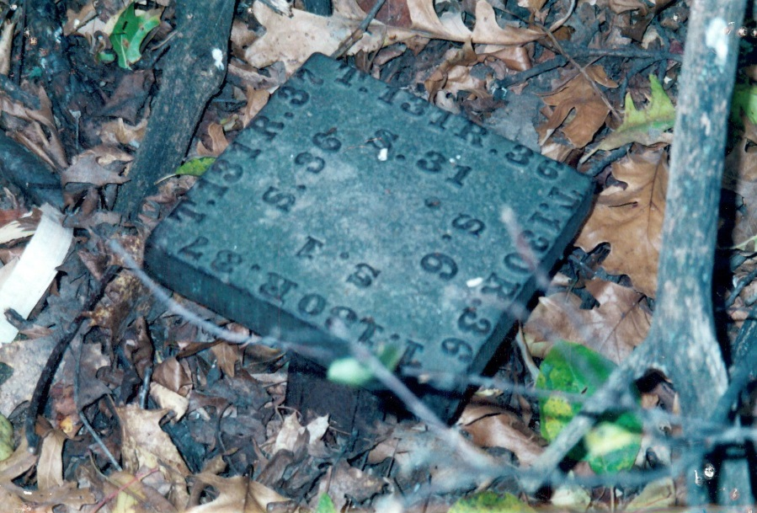
How many Section Corners are in Minnesota?
300,000+ PLSS Corners
How many Township Corners are in the state?
2840 Township Corners
Notes:
Project to get Recorders and Counties involved in this process!

Slide 14
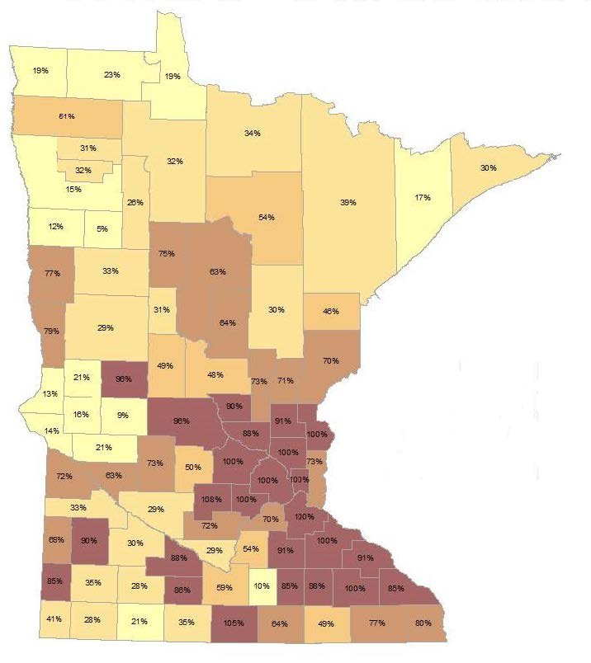
Percentage of corners certified in each county
Notes:
11 Counties at 100%
Pope County 11,000 People

Slide 15
Notes:
26 Fulltime County Surveyors
35 Part-time County Surveyors
26 No County Surveyor

Slide 16
Legacy Funds and Trust Funds
Notes:
ENRTF RFP for 2020 have to be in by March 15, 2019
LCCMR Board of 17 members
Work with staff

Slide 17
Notes:
68 out of 273 projects were picked for 2019 totaling $54 Million.

Slide 18
LCCMR Grant County Project
Notes:
Senator Bill Ingebritsen
Senator Torrey Westrom
Lake Agassiz

Slide 20
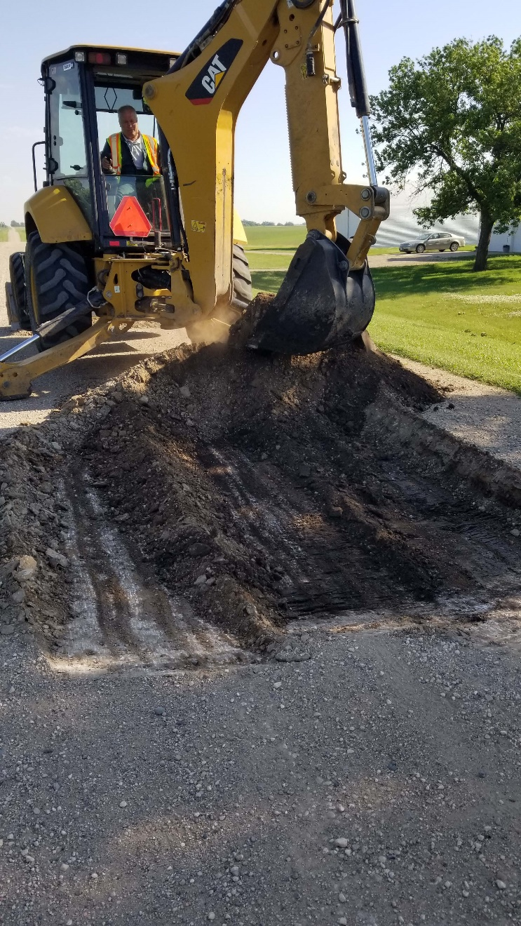
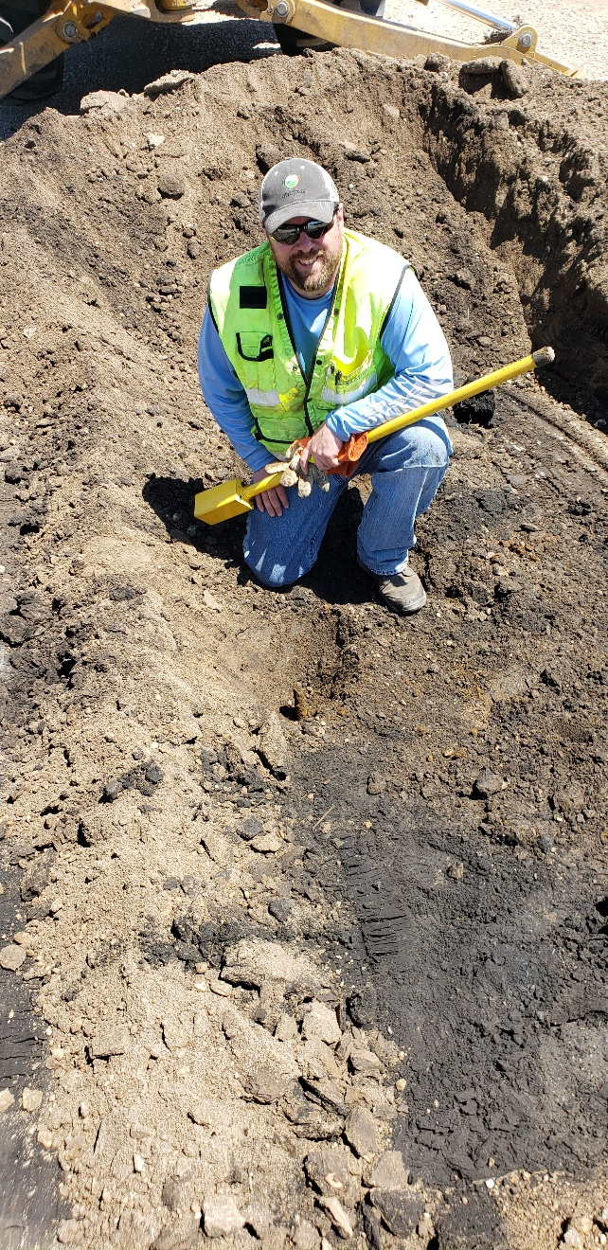
Excavations

Slide 21
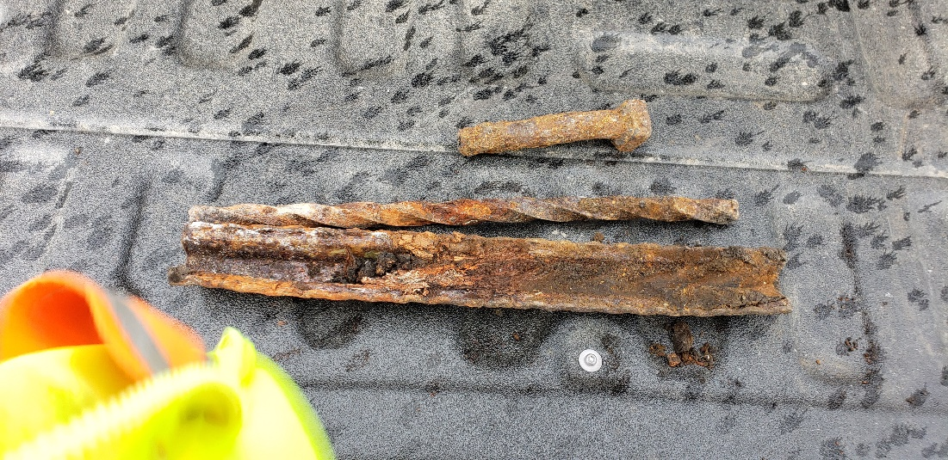
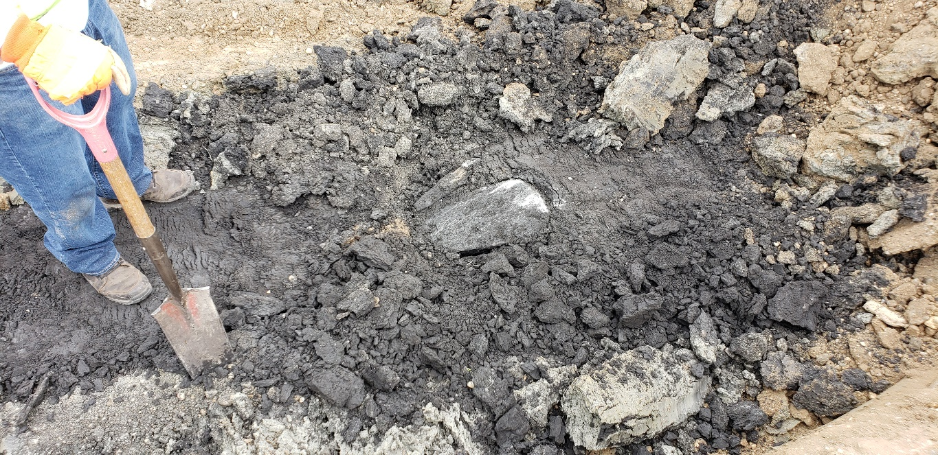
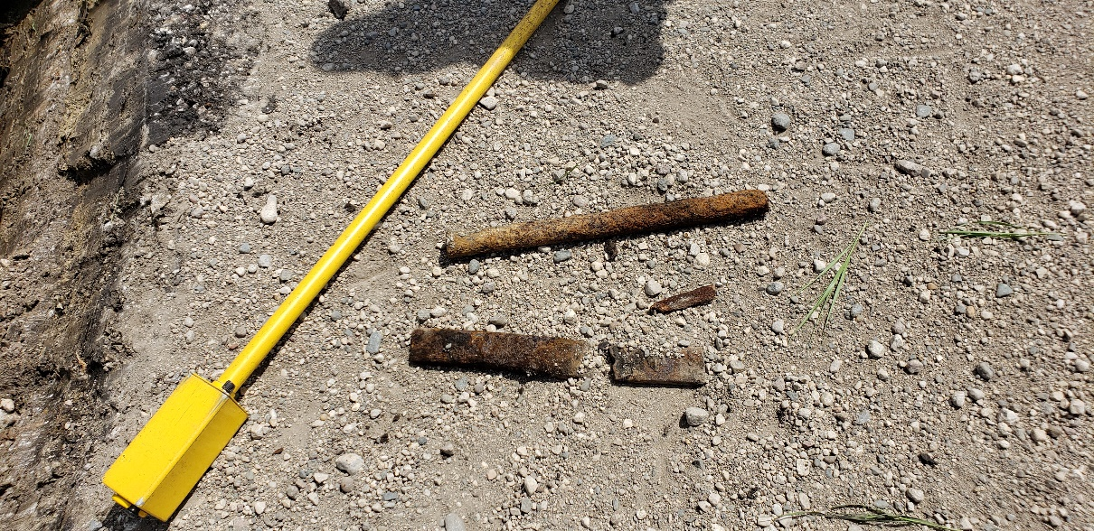
Monuments

Slide 22
Signage and monuments

Slide 24
So what have we learned
Takes a lot of work and money
The whole application process took a lot of time
RFP Process took a lot of time
We will see if it finishes under budget
Full time County Surveyor the best option
Can spend the time needed to certify the correct corner location

Slide 25
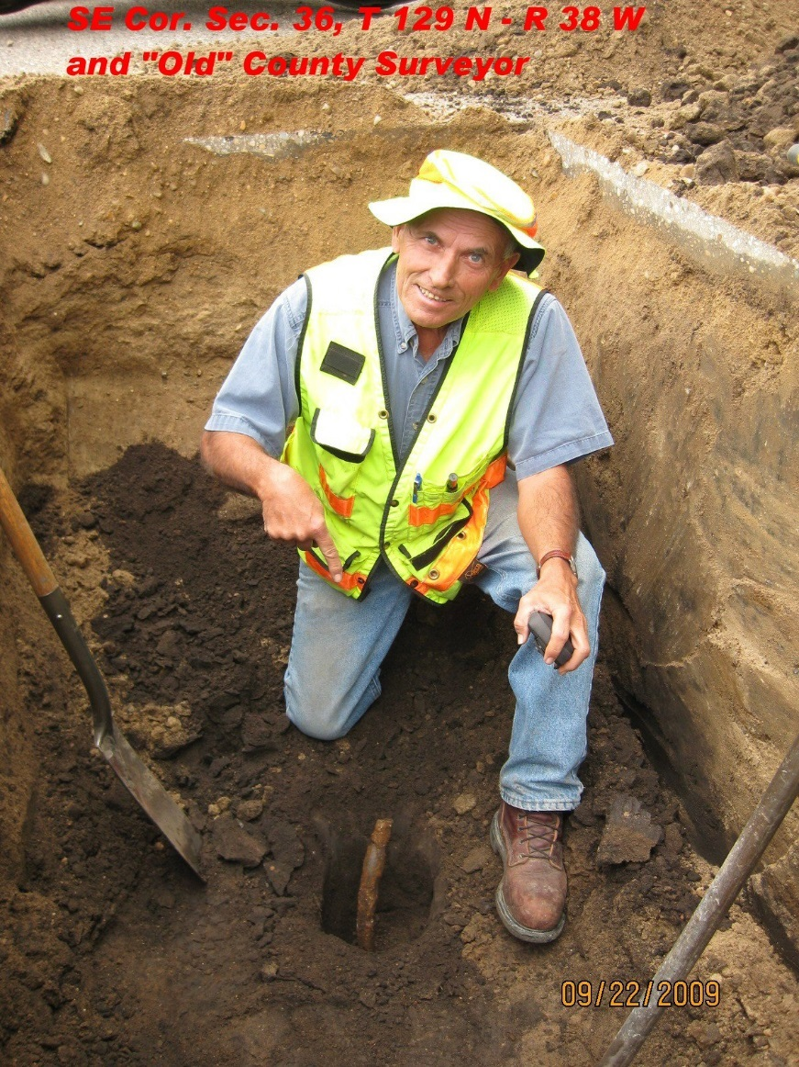
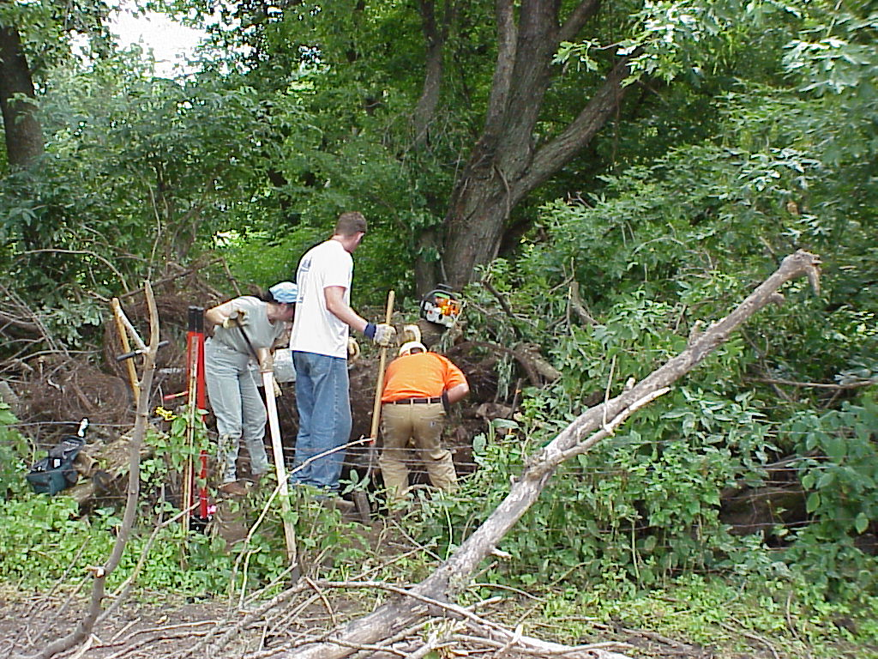
Questions/Discussion
Thank You!

Slide 26
Agenda Item 5
One Minnesota update
Renee Huset

Slide 27
“GIS enables us to know what is where, understand the relationships amongst different kinds of things, and analyze those data to solve problems, improve processes, and make better decisions. Period.”

Slide 28
Agenda Item 6
Underground Utilities Tiger Team Update
Steve Swazee

Slide 29
Underground Utilities Mapping
Project Team
Brief for MGAC
September 9, 2020

Slide 30
Emergency Preparedness Committee Structure
Chair
Vice Chair
Leadership Team
Project Teams
Data
Critical Infrastructure
Damage Assessment
MN Structures Collaborative
Underground Utilities Mapping
Education
GEMS
Intern Training (On hold)
Outreach
Conferences
Online
(In rebuild)
Response
Geospatial Assistance
Situational Awareness Sharing Initiative (MNSAV)
U.S. National Grid
GIS Support
17 volunteers

Slide 31
Eating the Elephant one pound
at a time…

Slide 32
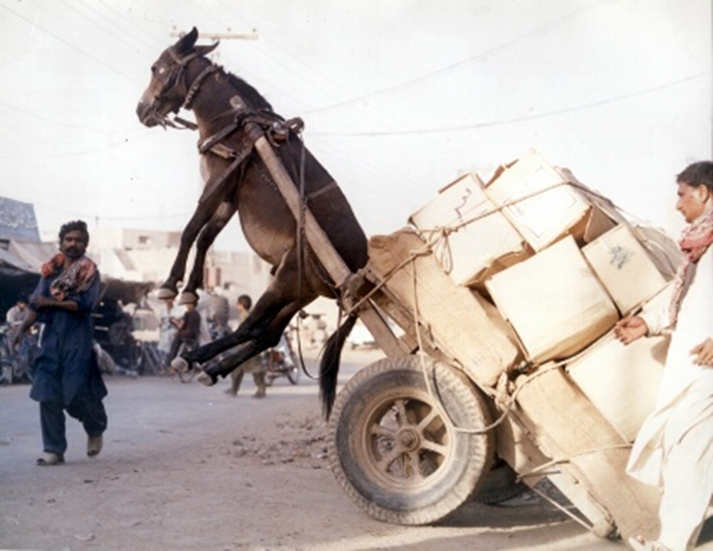
Leadership Plan
=
Chair - Barbara Cederberg
“Operational Control”
=
Vice Chair - Steve Swazee
“Administrative Control”

Slide 33
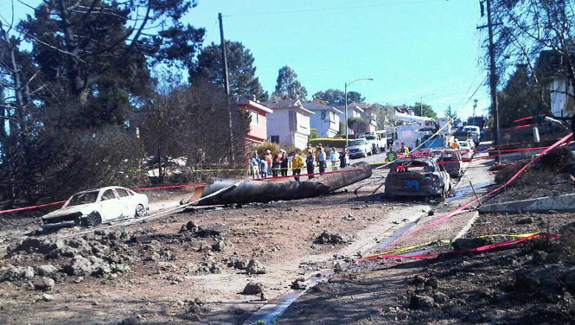
San Bruno, California Pipeline Explosion
September 9, 2010
Quick Facts:
To meet demand, PG&E boosted psi in Line 132
Explosion registered as an earthquake
8 Dead/499 impacted
$600 million in lawsuit settlements
PUC fine – $1.6 billion
Federal/state pending – $4.0 billion
In his justification for boosting pressure, Arnett noted that … Hoffman showed him a series of emails from 2009. In one, an engineer cited “tons of errors in GIS” in the database related to the San Bruno and other nearby lines. Another engineer’s email that same year concluded: “We do not trust GIS to be correct” but added, “got to trust something, though.”
Arnett admitted that he only made a “cursory review” of the GIS database when he authorized the spiking of the line.

Slide 34
What are “The Issues”
Monday, June 22, 2020: Gopher State One Call
handled 7,000 calls for locates
Facility Operator Utility Mapping – Locating, GIS data, Mapping
Are recent advancements in geospatial technology being leveraged?
What are the standards for capturing, storing or sharing locate data?
Loss of corporate locate knowledge through retirements?
Locate Data Flows & Mgt. – GIS data flow to locators & excavators
Underground utilities location information for emergency responders?
Data sharing between owners, locators and excavators before digging?
Outreach – Publicize capability and safety impact
How, when, and to whom do we “report”?
What additional resources should be recruited?
Regulations/Security – Use and availability of GIS data
Are there legal restrictions on sharing information?
What are the corporate hurdles on sharing info with others?

Slide 35
Barbara Cederberg | COO, Gopher State One Call
Steve Swazee | Chair, MGAC EPC; Executive Director, SharedGeo
Adam Worm | GIS Analyst, St Paul Regional Water Services
Andy Berg | Engineering & System Operations, Connexus Energy
Andy Wasilk | Xcel Energy
Bob Basques | GIS Systems Developer, City of St. Paul
Brad Anderson | GIS Manager, City of Moorhead
Brandon Keinath | GIS Programmer Analyst, Minnesota Power
Damon Nelton | GIS Manager, Ellingson Companies
Dave Hunstad | Electric Manager, Hutchinson Utility Commission
David Phillips | GIS Project Specialist, Major Projects, Enbridge Inc.
Dean Parker | General Counsel - GSOC, Hinshaw & Culbertson LLP
Dr. Geoff Zeiss | Owner, Between the Poles
Gerry Sjerven | Environmental Services, ALLETE, Inc.
Joe Rubbelke | Utility Logic
Justin Lutterman | GIS Manager/Address Coordinator, Le Sueur County
Karin Strub | Media Communications Manager, dp-PRO
Keith Novy | Manager, Damage Prevention Department, Center Point Energy
Kendell Hillis | Grad student
Keven Maxa | Engineering Supervisor, Austin Utilities
Michelle Anderson/Rich Riewer | GIS Coordinator, Beltrami Electric Cooperative, Inc.
Mike Mendiola | Minnesota Office of Pipeline Safety
Nick Roehrdanz | GIS Manager, Technical Design Services
Sam Richert/Justin Larson | Senior Operations Manager, Damage Prevention, Xcel Energy
Scott Landes | President, Infrastructure Resources/Rhino Markers
Travis Beran | Subsurface Solutions
Troy Schultz | President, Technical Design Services

Slide 36
Mission
The Underground Utility Mapping Project Team will work to improve locate efficiencies and accuracy, reduce damage to the state’s underground infrastructure, and improve operational and construction safety by leveraging current and emerging GIS technologies through cross community collaboration which develops best practices and promotes technology solutions.

Slide 37
Administrative Support
Charter/Work Plan
Products and services the Project Team will provide are to be determined but it is anticipated at a minimum a best practices document will emerge from this effort.
1st Year Goals (2020):
Creation of administrative structure and tools as needed to support team efforts
Establishment of regular Project Team meetings
Development of sub-teams with specific areas of focus and a respective project list
1st Year Goals (2021):
Completion of at least one “low hanging fruit” action item by each sub-team
Delivery of at least one presentation about overall team efforts at an established community appropriate conference (or webinar)
Publication of at least one article about the Project Team in a publication of importance to the industry

Slide 38
Operations - Project Team Structure
Small Group starting point:
Facility Operator Utility Mapping – Locating, GIS data, Mapping Travis Beran (Where’s our stuff?)
Locate Data Flows & Mgt. – GIS data flow to locators & excavators Bob Basques (Telling others where your stuff is)
Outreach – Publicize capability and safety impact Karin Strub (Finding the audience(s)/crafting the message)
Regulations/Security – Use and availability of GIS data Dean Parker (Understanding what is possible)

Slide 39
Next Steps/Next Meeting Info
Small Group Meetings (4):
Tuesday, August 11 – Thursday, September 10
Leadership meeting – develop the deconfliction plan:
Friday, September 11, 10:00 am
Next Project Team meeting date
Thursday, September 17, 1:00 pm
Paperwork - EPC Websites
Back side: mgacepc.net
Front side: mgacepc.org

Slide 40
Closing Points
The utility community wants HELP!
Expansive, important issue – largely missed by the U.S. GIS community - U.S. well behind Europe
The MGAC structure has created the opportunity for this nationally unique Project Team to get out of the gate
Online collaborative tools are critical to success
“We are committed to keeping this effort from becoming a way for one vendor or another from taking over the process and steering it for their own benefit. However, the vendor world potentially has much to contribute to this process.”
“A society grows great when old men plant trees whose shade they know they shall never sit in.” Unknown

Slide 41
Questions?

Slide 42
Minnesota is one of the nation’s most geospatially advanced states:
University of Minnesota - Jack Dangermond (Esri), Polar Geospatial Center
Open Source - MN DNR (DNRGPS), MapServer, GeoMoose
Professional organizations - MN GIS/LIS, multiple user groups
Geospatial nonprofit - SharedGeo
Formal government offices - LMIC, now MnGeo; MetroGIS
State Council enacted in law
The Minnesota Geospatial Advisory Council is a legally enacted Minnesota state government entity under Minnesota statute 16E.30.
By extension, the Emergency Preparedness Committee serves as the state's principal organization for promoting, coordinating, and standardizing Geographic Information System (GIS) use across all levels of the Minnesota Emergency Services Sector.

Slide 43
Agenda Item 7
GIS/LIS Consortium New Ad-Hoc Committees
Professional Development Andy King-Scribbins; Megan Sisko
Equity Advocates Cory Richter
Higher Ed & K12 Committee Cory Richter

Slide 44
Agenda Item 7
Professional Development
Work closely with other Consortium committees on activities related to professional development
Careers in GIS panel discussion
Consortium mentorship program
Ad hoc resume reviews and job coaching
Consortium jobs posting page
Networking events
Coordinate with other regional professional development groups

Slide 45
Agenda Item 7
Equity Advocates
Projects
Polling
Toolkits
Equityadvocates.slack.com
Minnesota
Wisconsin
North Dakota
Adding more...

Slide 46
Agenda Item 7
Education Committee update
Split into Higher Ed and K12
Scholarships & mentoring
Coordinate Educators Day
Promote connections between the geospatial profession and educators

Slide 47
Break

Slide 48
Agenda Item 9
Outreach Committee Chair
Kari Geurts
Notes:
To cover:
Update on the plan
What is GAC role

Slide 49
Agenda Item 10
Geospatial Commons Advisory Committee
Mark Kotz

Slide 50
Geospatial Commons Advisory Committee
Mission statement:
To provide advice, guidance and strategic direction for the Minnesota Geospatial Commons and Minnesota’s collaborative geospatial data sharing program, from the broad perspective of the Minnesota geospatial data stakeholder community.

Slide 51
Geospatial Commons Advisory Committee
Objectives and Deliverables
Represent the MN geospatial data stakeholder community
Define and advocate for needs of community
Define enhancements to MN geospatial data sharing program
Provide guidance and advice on governance, policy, support and usage
Mechanism for outreach and feedback with community

Slide 52
Geospatial Commons Advisory Committee
Objectives and Deliverables:
Help operating agency (MnGeo) and implementation team to communicate with the broader community about challenges and opportunities for the Commons
Act as a sounding board for MnGeo and implementation team
Help to envision next generation of the Commons
Note: this committee is not a technical committee and does not provide technical implementation advice. Some members of this committee may also participate in technical groups.

Slide 53
Geospatial Commons Advisory Committee
Resource requirements and timing:
Committee will meet as needed, at least annually
Should have a rep from MnGeo and a rep from implementation team
Must have a strong, open and trusting relationship with MnGeo and the Commons implementation team
No specific members identified

Slide 54
Agenda Item 11
NSGIC Conference and GAC Participation - Dan Ross
Council of Councils
September 16th 1-3 PM
Please attend and share thoughts and hear from Council members in other states
Cory will be serving on a panel – thank you Cory!

Slide 55
NSGIC Conference
September 21-25
Free to all Council members
Variety of live and on demand sessions
Agenda - https://nsgic.mclms.net/en/agenda
Great networking opportunity
Don’t forget to register for both events
C of C - https://nsgic.memberclicks.net/2020-council-forum#/
Conference - https://nsgic.memberclicks.net/2020ACReg?servId=7613#/

Slide 56
Agenda Item 12
Sector Report
Federal: Kory Thurnau
Notes:
To cover:
Update on the plan
What is GAC role

Slide 57
Agenda Item 12
Greater Minnesota Counties Sector Report
Minnesota PLSS Work
Patrick D. Veraguth
Douglas County Surveyor

Slide 58
Geospatial Executive Summit
MACS, MSPS and GIS/LIS Consortium
Virtual meeting sometime in October
Chris Mavis is setting meeting up

Slide 59
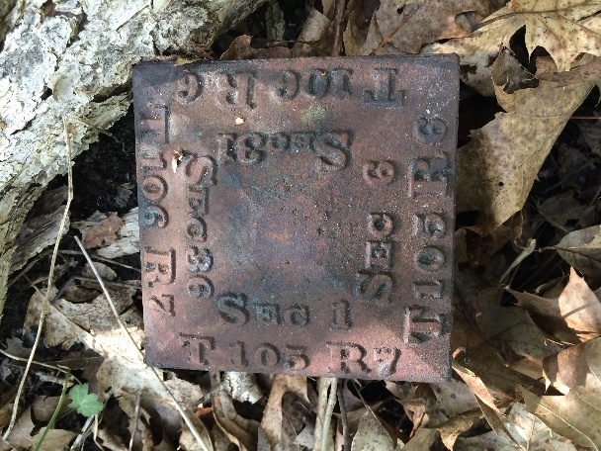
Township Corners
Notes:
1875 Statutes

Slide 63
Arrowhead Collaboration in NE Minnesota Project
Working on a standard
Lake County is working on 1000 corner certificates
St. Louis County is working on 300 miles of road (clearing trees and paving)

Slide 64
MnGeo Survey Coordinator

Slide 65
Why do we need a Survey Coordinator?
Statewide parcel map
Each County is different
Each County’s data is different
1/3 have a full time County Surveyor
1/3 have a part time County Surveyor
1/3 have no County Surveyor
Some Counties are fully remonumented with a maintenance program
Some have little to no remonumentation

Slide 67
Wisconsin PLSS Finder
https://maps.sco.wisc.edu/surveycontrolfinder/#7/44.730/-90.143/PLSS/terrain

Slide 68
MACS GIS PLSS SITE
http://slcgis.maps.arcgis.com/apps/MapSeries/index.html?appid=2755f3c5c1d043198c069d95d4544f37
Notes:
Show all certified and Non-certified corners

Slide 69
Need to spread word about Surveyor Coordinator
County Engineers, County Surveyors, County Recorders
MnDOT, MN DNR, US Corps of Engineers, USFWS, USFS
Title companies, GIS Professionals
AMC, County Boards and State legislators

Slide 70
Break

Slide 71
Agenda Item 14
Updates on GAC priority projects and initiatives
Cory Richter

Slide 72
GAC Priorities
GAC Rank | Project or Initiative Description | Status | Project Owner | Champion
1 | All Data Free and Open | Active |  | many
2 | Updated and Aligned Boundary Data | Active | Preston Dowell | Dan Ross
3 | Archiving Implementation | Active | Ryan Mattke | many
4 | Parcel Data | Active | Alison Slaats | Mark Kotz
5 | Image Service Improvements | Active | Alison Slaats | Dan Ross
6 | Accurate Hydro-DEMs | Active | Sean Vaughn | many
7 | Road Centerline Data | Active |  | Dan Ross
8 | New Lidar Acquisition | Active | Gerry Sjerven | Dan Ross
9 | EM Damage Assess Data Standard | Active | Brad Anderson, Cory Richter
10 | Address Points Data | Active |  | Dan Ross
11 | U.S. National Grid Materials | Active | Randy Knippel | Randy Knippel
12 | Parks and Trails Data Standard | Active
13 | NG9-1-1 Forum | Inactive

Slide 73
GAC Priorities
GAC Rank | Project or Initiative Description | Status | Project Owner | Champion
14 | Underground Utilities Forum | Active | Steve Swazee
15 | Basemap Services | Inactive
16 | Unmanned Vehicle Metadata Guide | Inactive
17 | Geospatial Data Asset Inventory | Inactive
18 | Critical Infrastructure Custodian | Inactive
19 | Culvert Data Standard | Active | Rick Moore | Rick Lorenzen

Slide 74
Agenda Item 15
Legislative Updates
Dan Ross

Slide 75
Legislative Update
Lidar project request to LCCMR
Hydro modified DEM, forest research and assessment, data storage and dissemination, education
Were not successful in this effort
Still in the planning - 2 budget change items for MnGeo
Survey Coordinator position
$18 M for lidar cost share
Chances are small given the current state budget

Slide 76
Agenda Item 16
Announcements or other business

Slide 77
Adjourn
Next meeting is Wednesday, December 9, 2020

