Slide 1
Free & Open Geospatial Data
Realizing the Benefits to Governments, Businesses and
Citizens in Expanding Data Availability
Presentation to Statewide Geospatial Advisory Council
Geoff Maas, MetroGIS Coordinator
January 10, 2014

Slide 2
Three Things:
What is MetroGIS?
What does “free and open” data mean?
Examples and benefits

Slide 3
What Is MetroGIS?
A voluntary collaborative of interests…
Governments at all levels
Academia
Non-Profits
Private Sector (utilities, real estate, etc.)
…who produce, consume and share GIS data in the metro;
Since 1996, the Metropolitan Council has provided:
Financial backing for the collaborative;
Administrative oversight of its operation;
Stability and guidance;

Slide 4
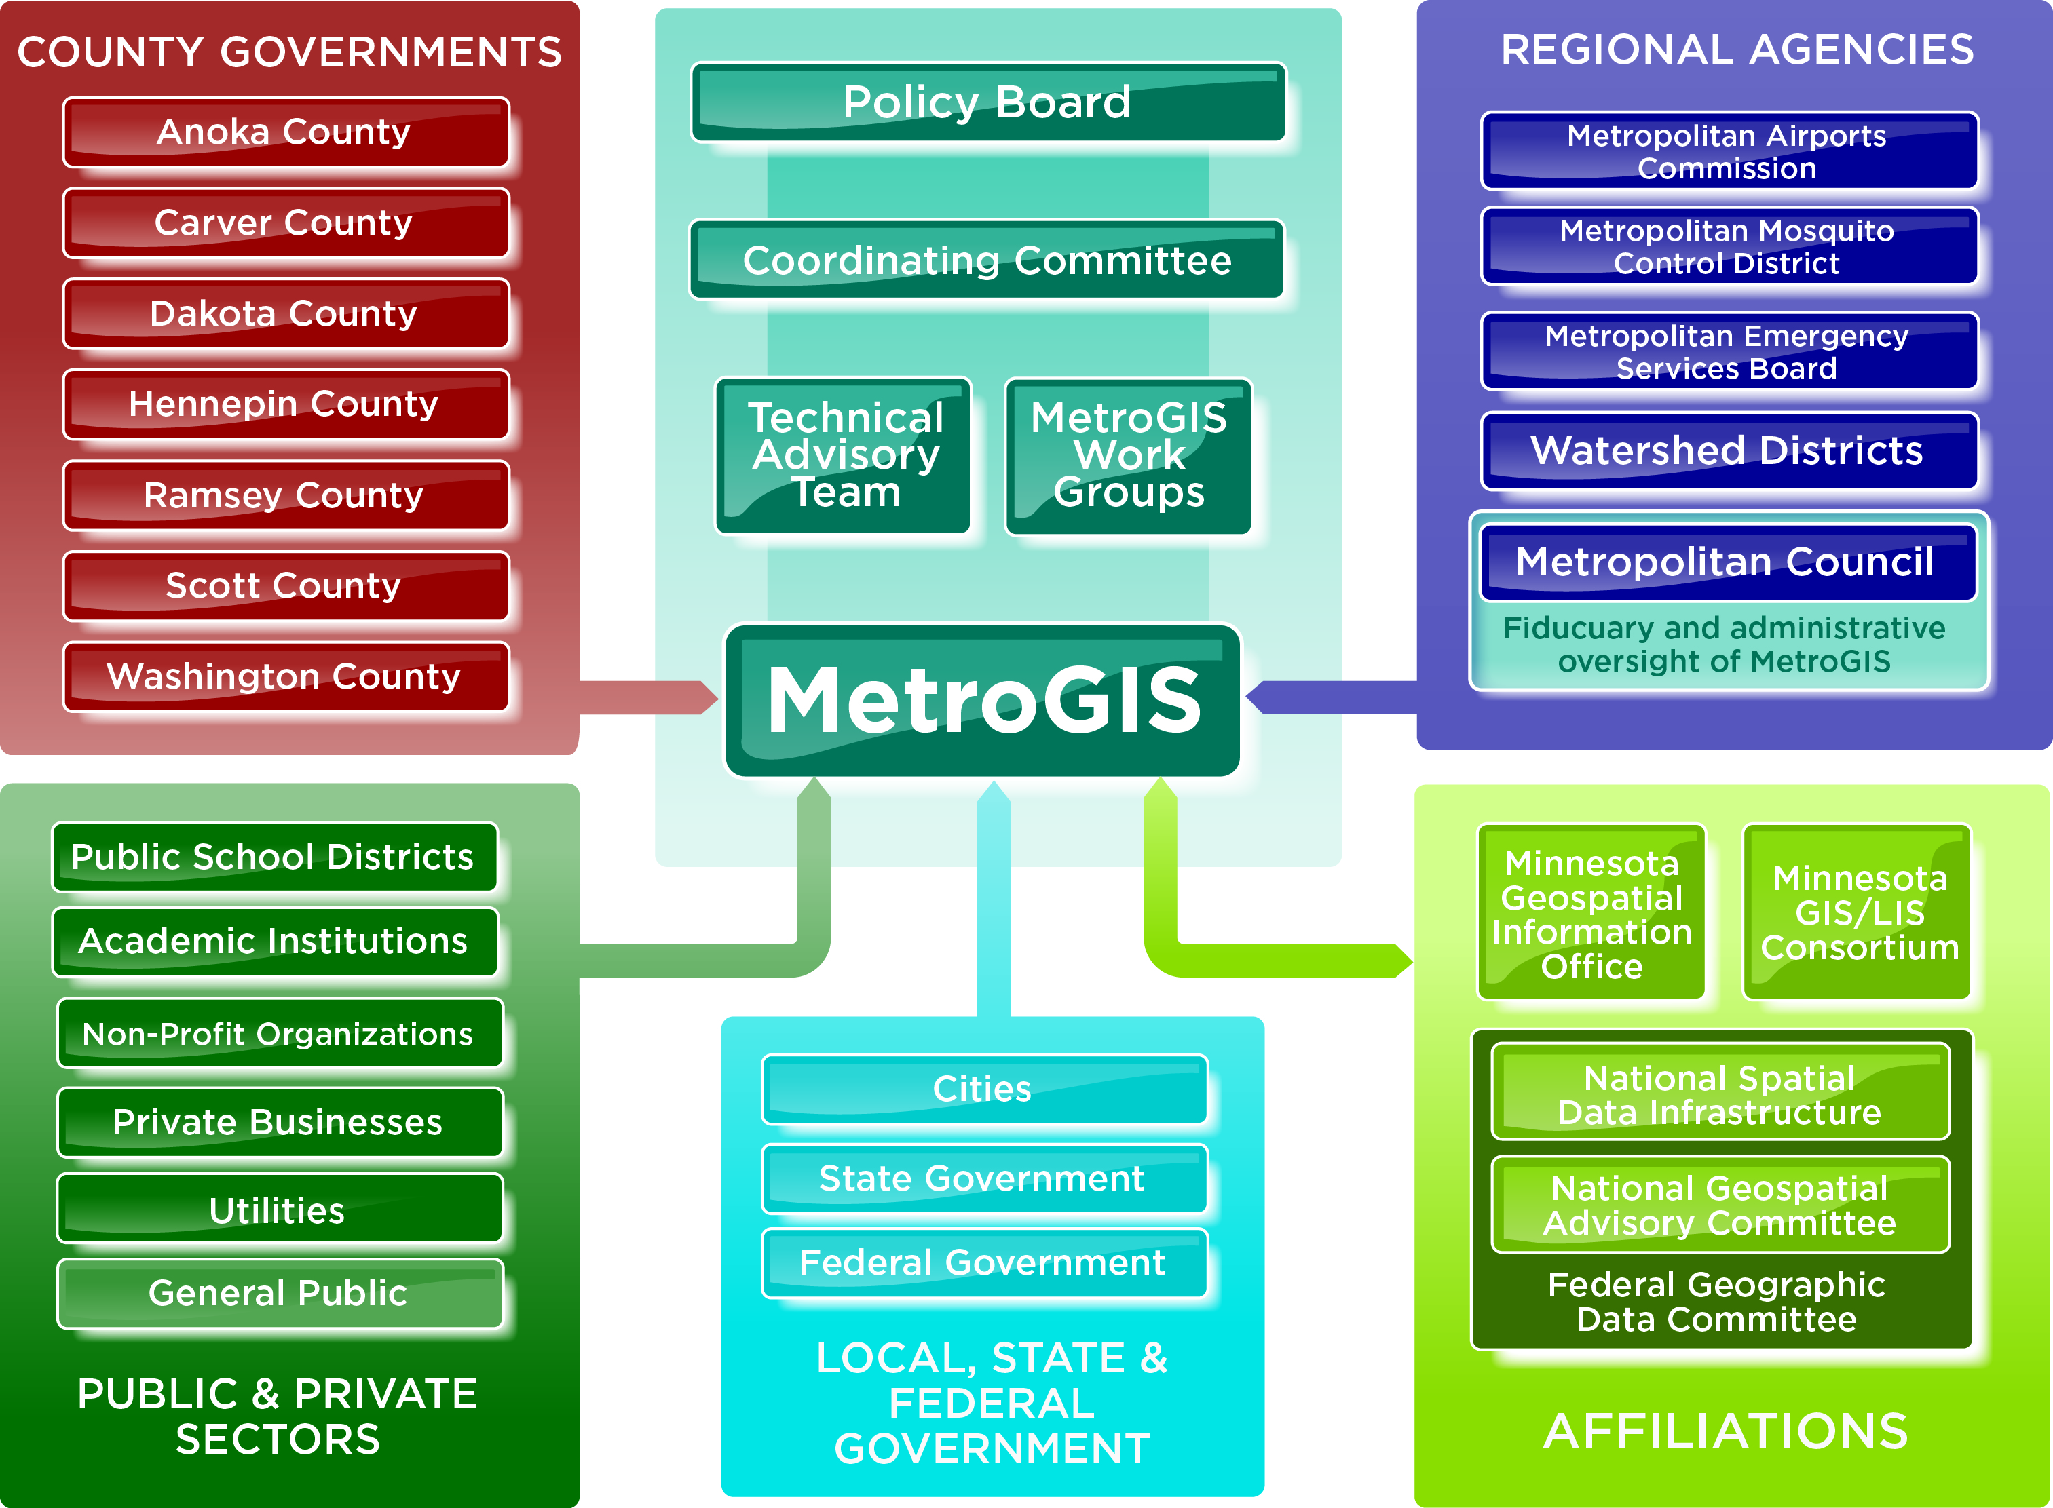

Slide 5
What Does MetroGIS do?
Core Maintenance Functions
Maintain the datafinder.org clearinghouse;
Manage the Regional Parcel Dataset
Manage the NCompass Road Data licensing and distribution;
Maintain the metrogis.org website (being re-designed);
On-going governance;
Projects & Research
Development of data and data standards
Research into issues of importance to the stakeholders;
Advocacy & Outreach
Promotion and facilitation of data sharing in the region;
Support of legislation that promotes GIS, data availability;
Advocate for the importance of GIS/geospatial work;
Liaison between agencies engaged in GIS in the region;

Slide 6
Current MetroGIS Work:
Free & Open Data Research/Advocacy
Support for Statewide Centerlines Initiative
Regional Address Point Development & Aggregation
New MetroGIS Website (Planned Launch in April 2014 )
Expanding Private/Public Data Partnerships
Increase GIS collaboration beyond the Metro
Regional Stormsewer Dataset Research & Development
Support for the Minnesota Geospatial Commons

Slide 7
Foundational Statements
Open sharing of data between interests and agencies…
…reduces their operating costs;
…identifies and eliminates redundant effort;
…saves tax payer money;
…ensures that data comes from the authoritative source;

Slide 8
Free & Open Data Context:
GIS isn’t just data, maps, apps, etc.
There are:
Laws and Statutes…
Agency Policies & Practices…
Business Needs and…
Funding Considerations…
…which govern our work

Slide 9
Brief “Evolution of GIS Policy”
1980s: Development Costs
Emergence of GIS in government; Offset costs with licensing/fees
1990s: Growth of GIS & Recognition of Value to External Partners
Establishment of MetroGIS, parcel data license
2000s: Maturity and Expansion
Internet mapping, smart phones, significant decrease in costs, rise in computing power
2010s: Continued Expansion & Public Expectations for Data
Ever-increasing ‘public appetite’ for data, “explosion” of uses/computing power;

Slide 10
What does “free and open” data mean?

Slide 11
Terminology: “Free”
No charges or fees would be assessed to data consumers for public geospatial data in its native electronic format;
“Public Geospatial Data”
Electronic geospatial data: MN Stat. Chapter 16E, Section 30, Subd. 10
Public data: MN Stat. Chapter 13, Section 2
MN Stat. Chapter 13, Section 3, Subd. 3(d)
City or county data producers retain the ability to charge for the cost of making and certifying copies or for providing custom work (requested maps, custom ‘cuts’ of the data, etc.)
MN Stat. Chapter 13, a.k.a. Data Practices Act
Legal language hasn’t fully ‘kept pace’ with the technology that it governs;

Slide 12
Terminology: “Open”
Data consumers would not be required to sign a
license agreement to access and use the data;
Data consumers would be able to share the data with other parties; notify of authoritative source
No restrictions on the use of the data;
A disclaimer describing the accuracy and original initial intended use would run with the data;
MN Stat. Chapter 466, Section 3, Subd. 21 exempts municipalities from tort liability for GIS data they produce and release;

Slide 13
Terminology: “Open”
‘Open’ refers to public data only, it does
not include data produced or maintained
by government agencies that are:
Not Public
Confidential
Private
Nonpublic
Protected Nonpublic
…as defined in MN Stat. Chapter 13, Section 2

Slide 14
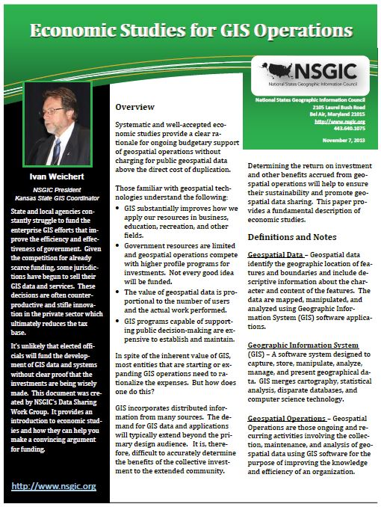
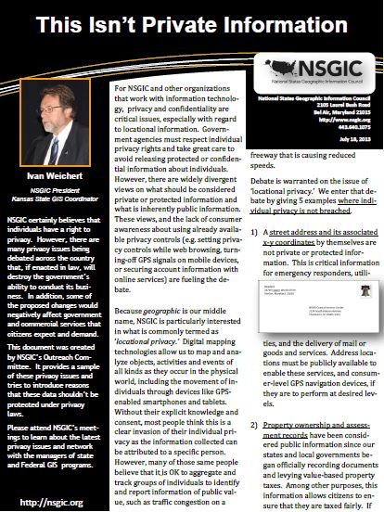
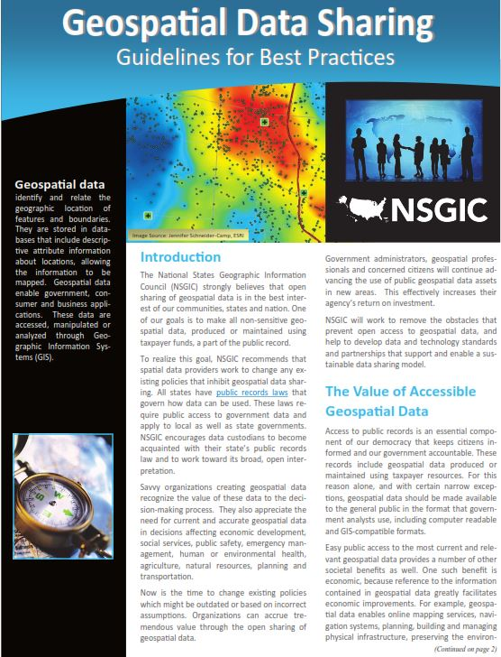
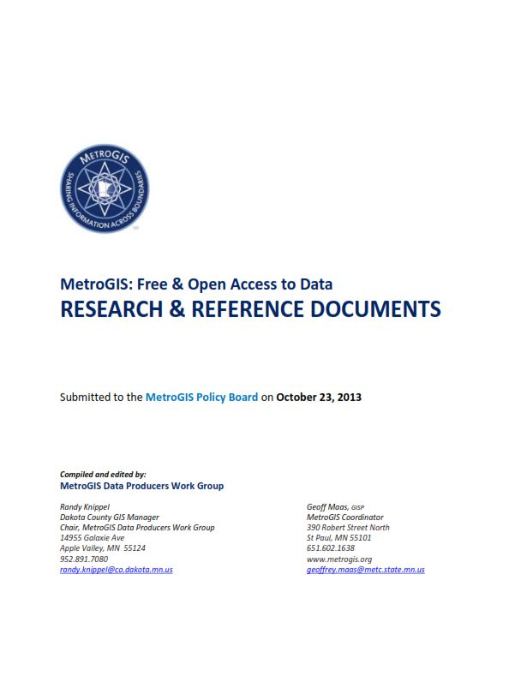
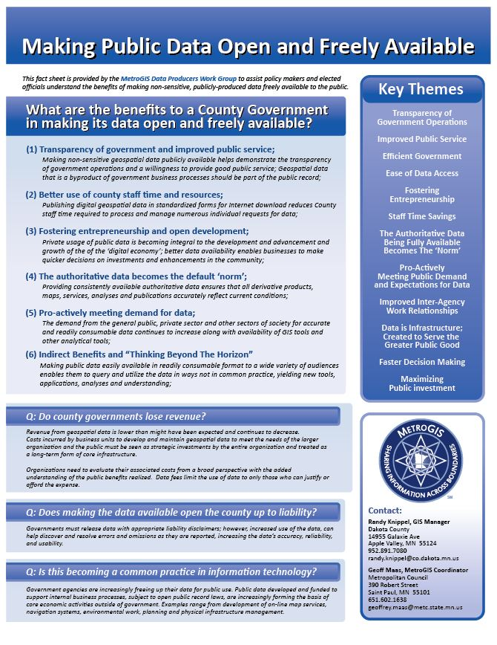
Free & Open Data: Four Tasks
#1 - Demonstrate the
Benefits Of Making
Data Freely Available
MetroGIS has assembled a body of research and resources demonstrating the benefits;
Working to communicate the value of free and open data to our senior management and elected officials;
http://www.metrogis.org/teams/workgroups/free_open_data/index.shtml

Slide 15
Free & Open Data
#2 - Understanding the Legal Framework Governing
Data Availability;
Case law examples;
Lack of applicable state-level case law examples in MN;
Examining case law examples from other states.
Existing statute language governing data access:
Chapter 13 (Data Practices Act);
Chapter 16E, Section 30, Subd. 11 (Gov-To-Gov);
Trying to avoid…
Numerous different (possibly conflicting) interpretations of state statues to apply locally; wide variation in practices and data availability;

Slide 16
Free & Open Data
#3 - Covering the Issues of Liability to Data Producers;
Clarity for Data Producers
Ensure that data producers are covered from liability when responding to requests, voluntary publishing of the data, etc.;
Specific exemption from liability for GIS data in statute:
Chapter 466, Section 3, Subd. 21(a)
Exempts a municipality from claims to the alleged or actual
inaccuracies in its data;
Chapter 466, Section 3, Subd. 21(b)
GIS data is subject to the presumption of Chapter 13, Section 1, Subd. 3
Government data are public data;

Slide 17
Free & Open Data
#4 - Change to Existing Policies;
Trend is moving away from the sale and licensing of GIS data
If a county or municipality wishes to pro-actively and voluntarily make its data freely available…
Chapter 13, Section 1, Subd. 3; ‘Gov data are public and accessible…’
Chapter 13, Section 3, Subd 1; ‘All data shall be public…’
Chapter 13, Section 3, Subd 2(a); ‘Establish procedures…’
Chapter 16E, Section 30, Subd 11 ‘Government to government…’
Chapter 466, Section 3, Subd. 21(a) ‘GIS data exempt from tort liability…’
Chapter 466, Section 3, Subd. 21(b) ‘GIS data subject to ‘13.01.Subd 3’…

Slide 18
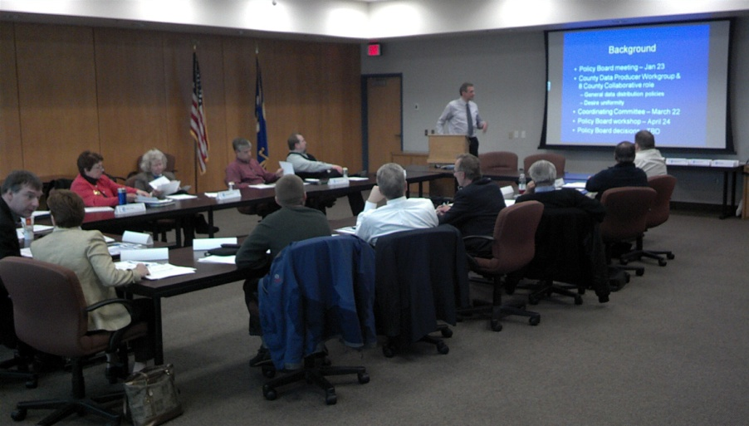
MetroGIS Policy Board
Comprised of:
6 County Commissioners
1 County IT Director
1 Metropolitan Council representative
2 Metro City mayors
1 Watershed District Board Chair
October 23, 2013
Adopted a Resolution of Support for free and open public geospatial data;
Directed a Letter of Support and research materials to each County Board Chair and County Administrator of the Seven Metropolitan Counties

Slide 19
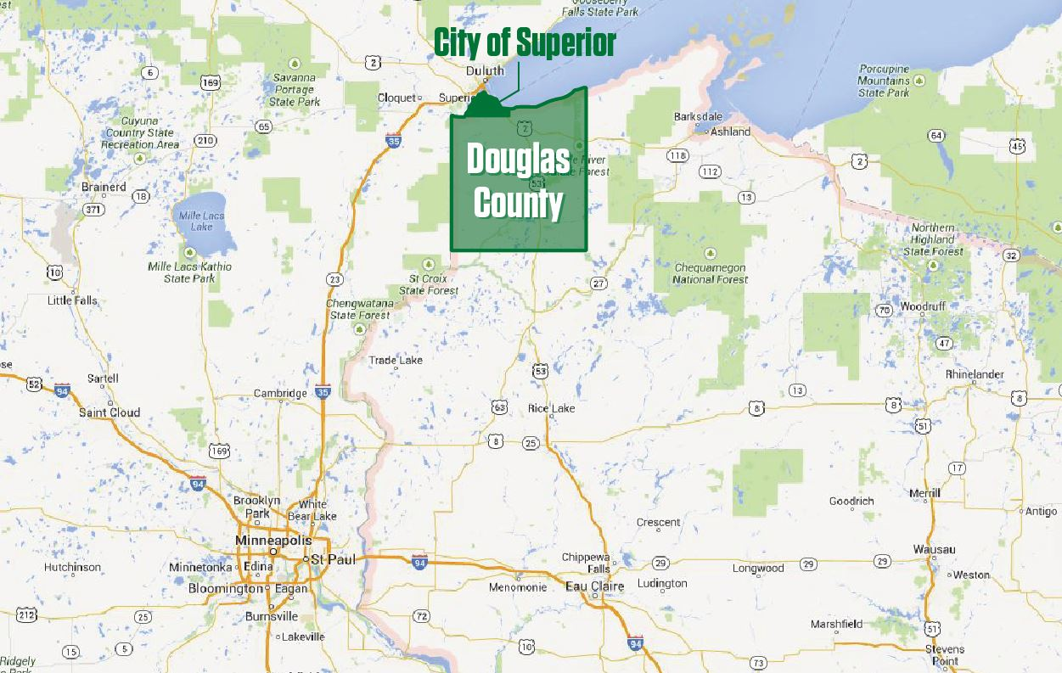
So what does ‘Free & Open Data’ look like?
Case Example:
City of Superior/Douglas County, Wisconsin

Slide 20
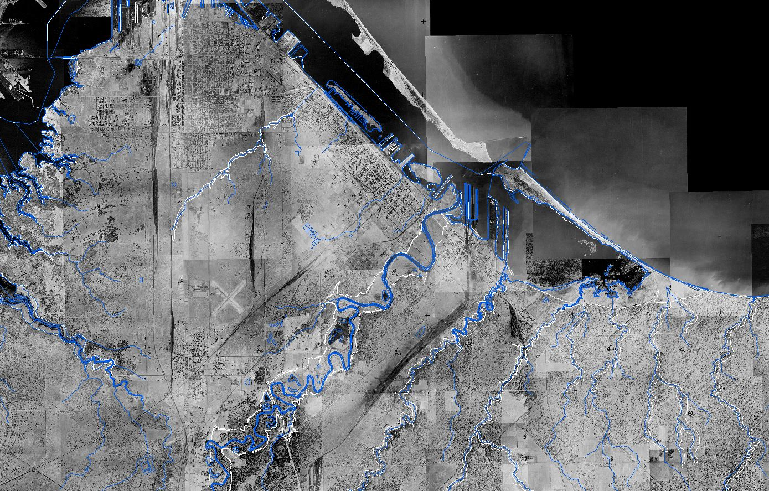
Hydrography
Aerial Imagery: 1948 to 2013
City of Superior & Northern Douglas County, Wisconsin

Slide 21
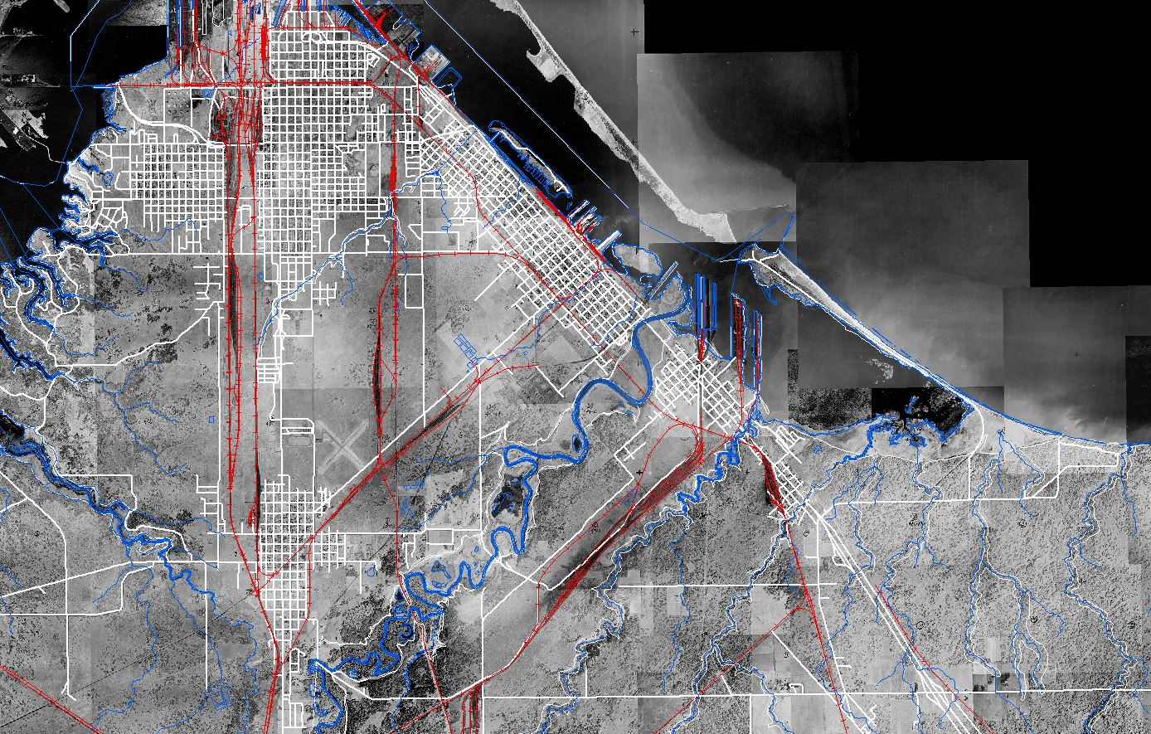
Hydrography
Aerial Imagery: 1948 to 2013
Railroads
Road Network
City of Superior & Northern Douglas County, Wisconsin

Slide 22
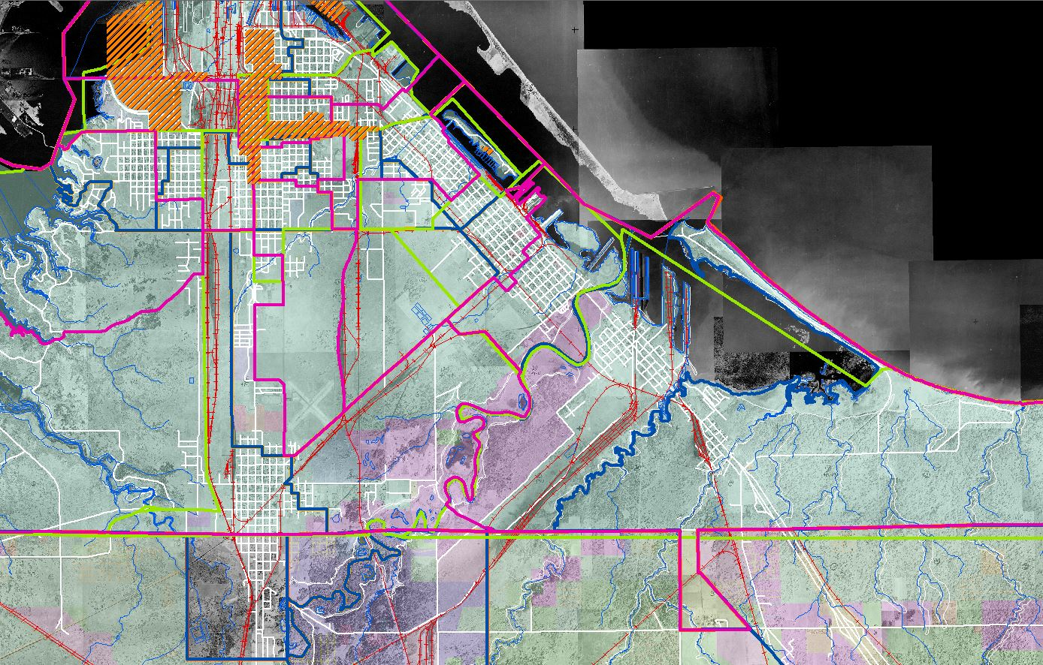
Hydrography
Aerial Imagery: 1948 to 2013
Railroads
Road Network
Municipal Boundaries
Administrative Districts
Special (TIF, etc.) Districts
Planning & Zoning
City of Superior & Northern Douglas County, Wisconsin

Slide 23
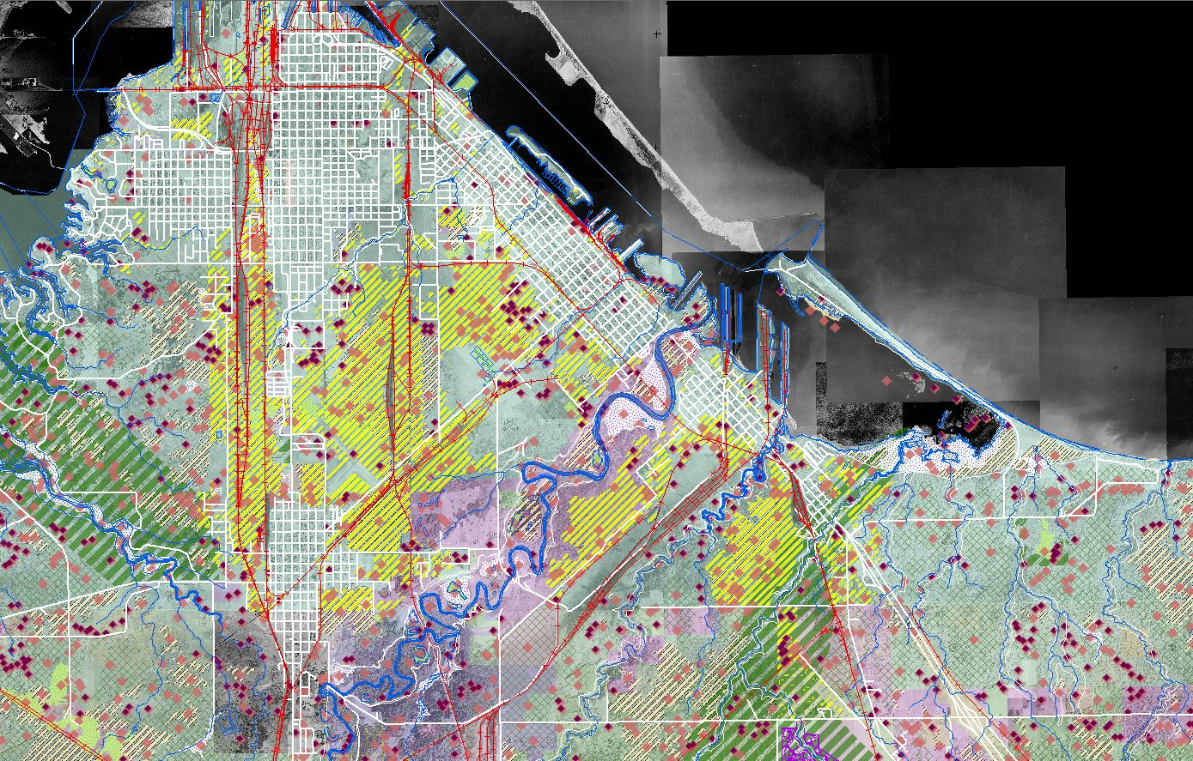
Hydrography
Aerial Imagery: 1948 to 2013
Railroads
Road Network
Municipal Boundaries
Administrative Districts
Special (TIF, etc.) Districts
Planning & Zoning
Environmental Data
Special Protection Areas
City of Superior & Northern Douglas County, Wisconsin

Slide 24
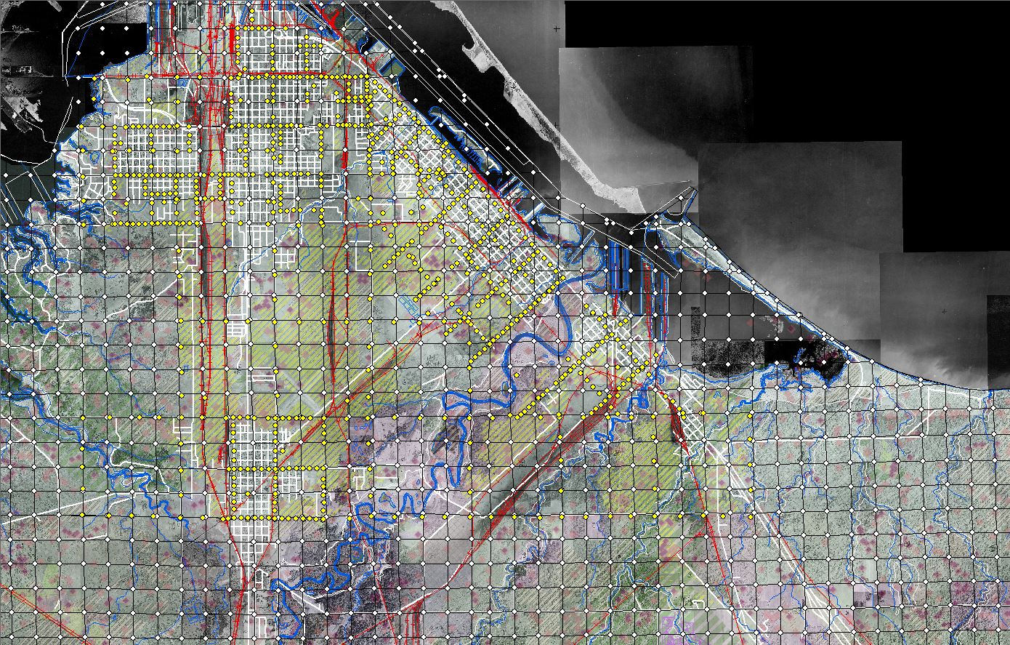
Hydrography
Aerial Imagery: 1948 to 2013
Railroads
Road Network
Municipal Boundaries
Administrative Districts
Special (TIF, etc.) Districts
Planning & Zoning
Environmental Data
Special Protection Areas
PLSS & Survey Data
City of Superior & Northern Douglas County, Wisconsin

Slide 25
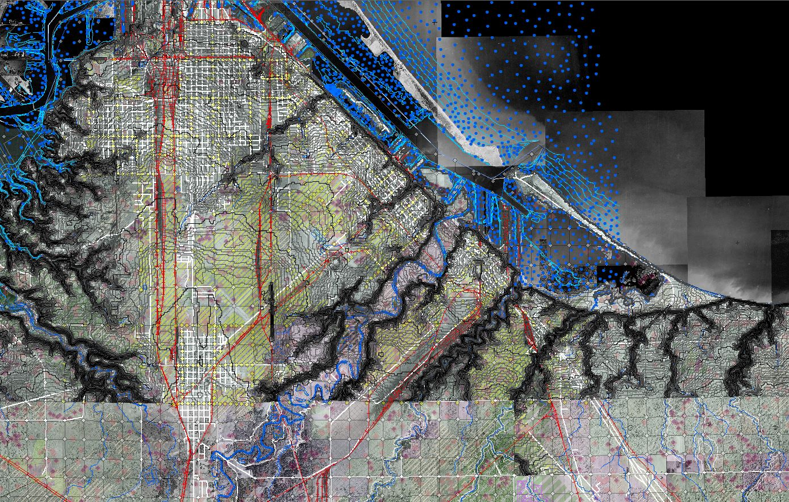
Hydrography
Aerial Imagery: 1948 to 2013
Railroads
Road Network
Municipal Boundaries
Administrative Districts
Special (TIF, etc.) Districts
Planning & Zoning
Environmental Data
Special Protection Areas
PLSS & Survey Data
1’, 5’ & 10’ Contours
Bathymetric Soundings
City of Superior & Northern Douglas County, Wisconsin

Slide 26
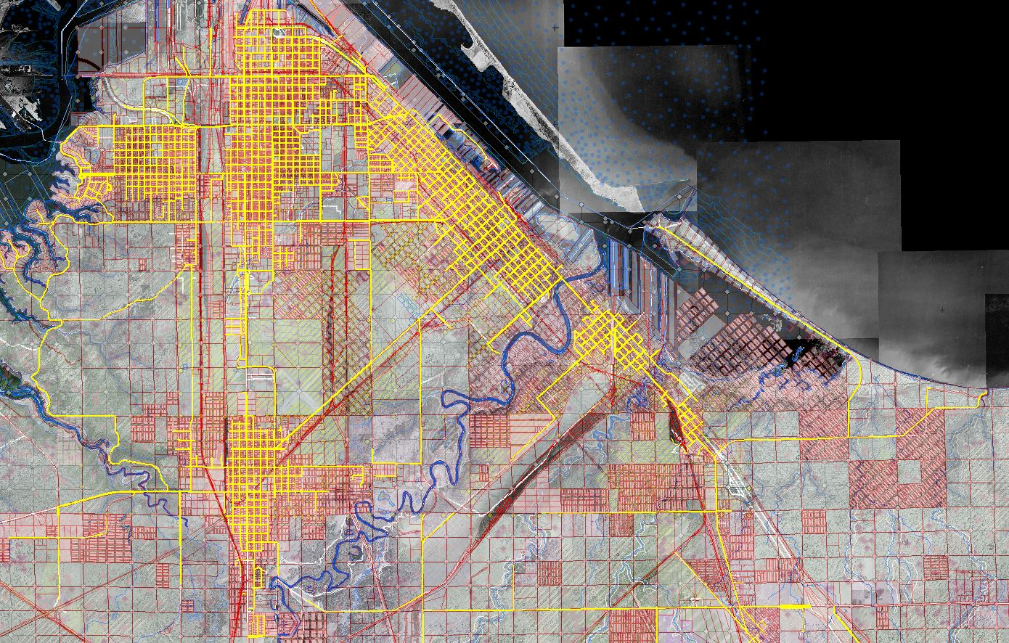
Hydrography
Aerial Imagery: 1948 to 2013
Railroads
Road Network
Municipal Boundaries
Administrative Districts
Special (TIF, etc.) Districts
Planning & Zoning
Environmental Data
Special Protection Areas
PLSS & Survey Data
1’, 5’ & 10’ Contours
Bathymetric Soundings
Tax Parcels
Right of Way
City of Superior & Northern Douglas County, Wisconsin

Slide 27
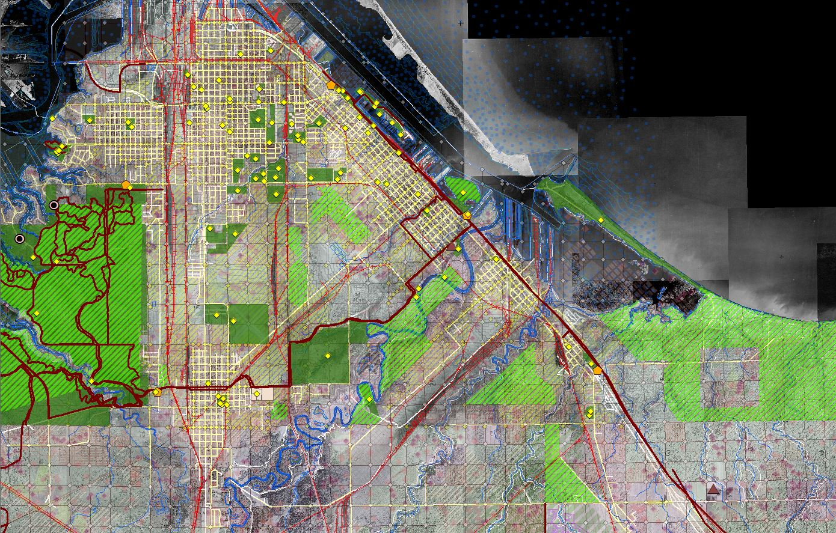
Hydrography
Aerial Imagery: 1948 to 2013
Railroads
Road Network
Municipal Boundaries
Administrative Districts
Special (TIF, etc.) Districts
Planning & Zoning
Environmental Data
Special Protection Areas
PLSS & Survey Data
1’, 5’ & 10’ Contours
Bathymetric Soundings
Tax Parcels
Right of Way
Park and Recreation Data
Trail Networks
Historic Sites
Cultural Points of Interest
Natural Points of Interest
City of Superior & Northern Douglas County, Wisconsin

Slide 28
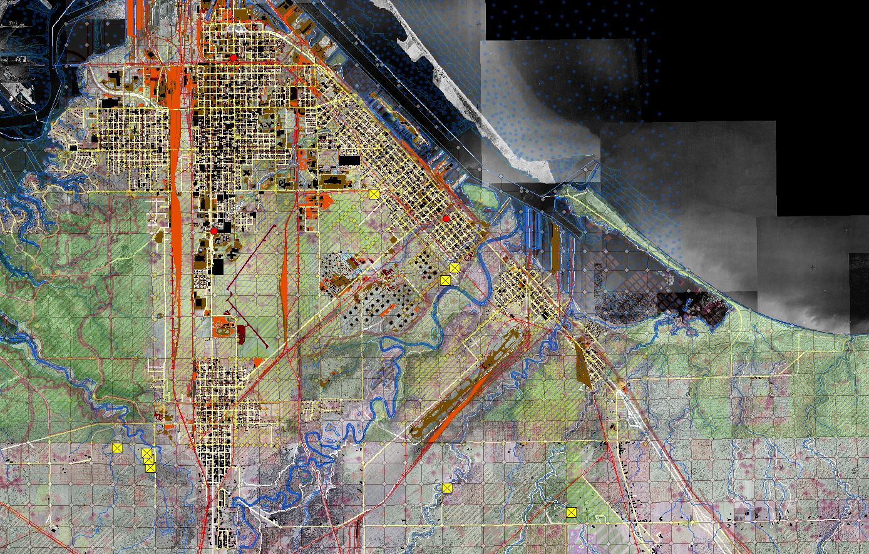
Hydrography
Aerial Imagery: 1948 to 2013
Railroads
Road Network
Municipal Boundaries
Administrative Districts
Special (TIF, etc.) Districts
Planning & Zoning
Environmental Data
Special Protection Areas
PLSS & Survey Data
1’, 5’ & 10’ Contours
Bathymetric Soundings
Tax Parcels
Right of Way
Park and Recreation Data
Trail Networks
Historic Sites
Cultural Points of Interest
Natural Points of Interest
Impervious Surfaces
All Building Footprints
Cemeteries
Public Buildings
City of Superior & Northern Douglas County, Wisconsin

Slide 29
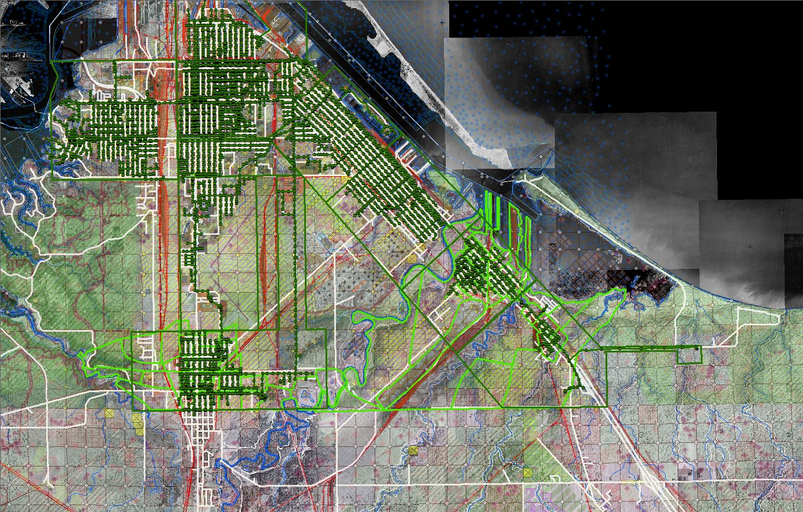
Hydrography
Aerial Imagery: 1948 to 2013
Railroads
Road Network
Municipal Boundaries
Administrative Districts
Special (TIF, etc.) Districts
Planning & Zoning
Environmental Data
Special Protection Areas
PLSS & Survey Data
1’, 5’ & 10’ Contours
Bathymetric Soundings
Tax Parcels
Right of Way
Park and Recreation Data
Trail Networks
Historic Sites
Cultural Points of Interest
Natural Points of Interest
Impervious Surfaces
All Building Footprints
Cemeteries
Public Buildings
Sanitary Sewer
Sewersheds + Service Districts
City of Superior & Northern Douglas County, Wisconsin

Slide 30
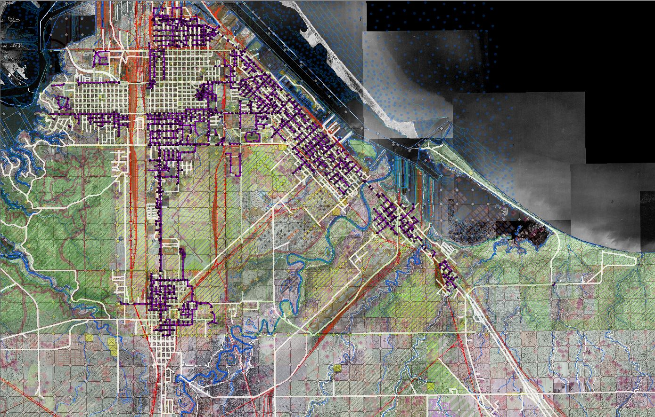
Hydrography
Aerial Imagery: 1948 to 2013
Railroads
Road Network
Municipal Boundaries
Administrative Districts
Special (TIF, etc.) Districts
Planning & Zoning
Environmental Data
Special Protection Areas
PLSS & Survey Data
1’, 5’ & 10’ Contours
Bathymetric Soundings
Tax Parcels
Right of Way
Park and Recreation Data
Trail Networks
Historic Sites
Cultural Points of Interest
Natural Points of Interest
Impervious Surfaces
All Building Footprints
Cemeteries
Public Buildings
Sanitary Sewer
Sewersheds + Service Districts
Stormsewer Network
Stormwater Outfalls
City of Superior & Northern Douglas County, Wisconsin

Slide 31
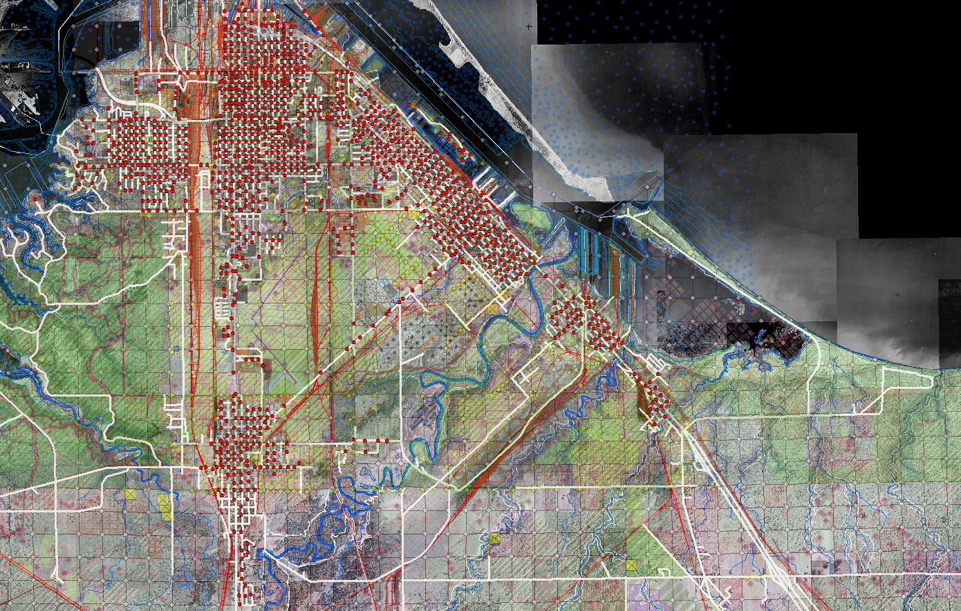
Hydrography
Aerial Imagery: 1948 to 2013
Railroads
Road Network
Municipal Boundaries
Administrative Districts
Special (TIF, etc.) Districts
Planning & Zoning
Environmental Data
Special Protection Areas
PLSS & Survey Data
1’, 5’ & 10’ Contours
Bathymetric Soundings
Tax Parcels
Right of Way
Park and Recreation Data
Trail Networks
Historic Sites
Cultural Points of Interest
Natural Points of Interest
Impervious Surfaces
All Building Footprints
Cemeteries
Public Buildings
Sanitary Sewer
Sewersheds + Service Districts
Stormsewer Network
Stormwater Outfalls
Fire Hydrants
City of Superior & Northern Douglas County, Wisconsin

Slide 32
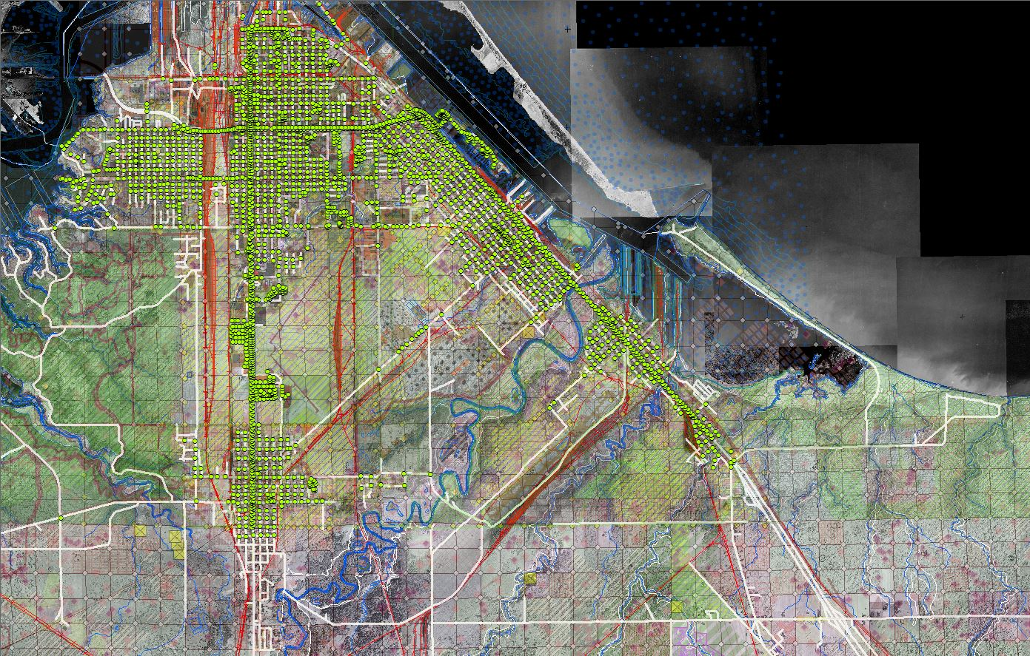
Hydrography
Aerial Imagery: 1948 to 2013
Railroads
Road Network
Municipal Boundaries
Administrative Districts
Special (TIF, etc.) Districts
Planning & Zoning
Environmental Data
Special Protection Areas
PLSS & Survey Data
1’, 5’ & 10’ Contours
Bathymetric Soundings
Tax Parcels
Right of Way
Park and Recreation Data
Trail Networks
Historic Sites
Cultural Points of Interest
Natural Points of Interest
Impervious Surfaces
All Building Footprints
Cemeteries
Public Buildings
Sanitary Sewer
Sewersheds + Service Districts
Stormsewer Network
Stormwater Outfalls
Fire Hydrants
Streetlights
City of Superior & Northern Douglas County, Wisconsin

Slide 33
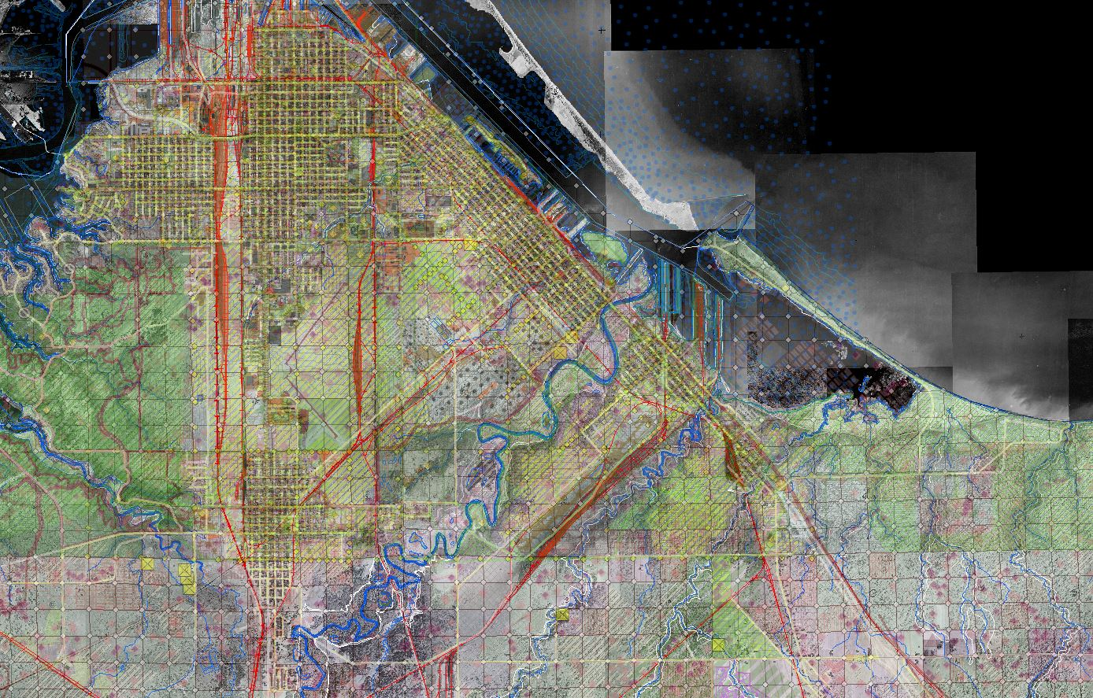
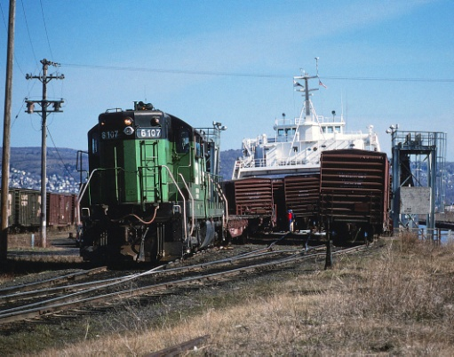
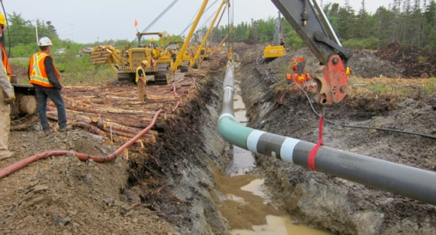
Free & Open Data practices encouraged and supported by the legal counsel of both the
City of Superior and Douglas County, Wisconsin
Significant benefits to a wide consumer base:
Railroads
Telecommunications
Pipelines
Real Estate and Development
Electric and Gas Utilities
Insurance/Risk Assessment
Duluth Seaway Port Authority
Port Authority of Superior
U. S. Army Corps of Engineers (Vessel Yard)
U. S. Coast Guard (Duluth Marine Safety Unit)
Historical Societies
Colleges & Universities
Commercial & Industrial Forest businesses
Federal, state and regional governments
City of Superior & Northern Douglas County, Wisconsin

Slide 34
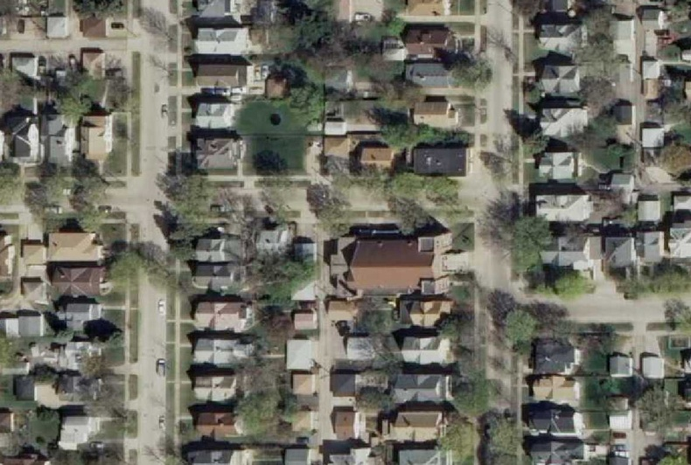
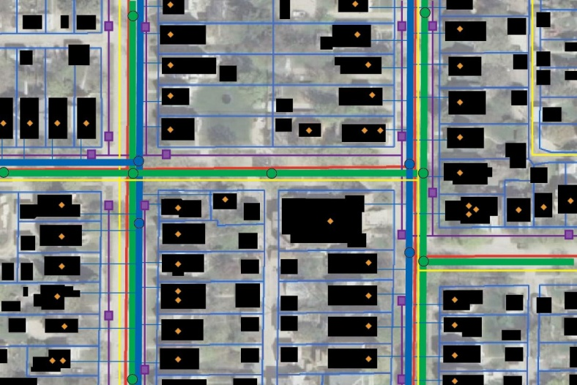
“Data Is Infrastructure”
Real World Features
Virtual Representations
Roads, pipes, buildings, parcels, manholes, sidewalks, hydrants, etc.
All the physical assets of a the city, county, agency or jurisdiction;
The virtual representations (and the data that accompanies them) are a form of infrastructure themselves used for tracking, mapping, modeling, applications development, routing, analysis, mapping, etc.

Slide 35
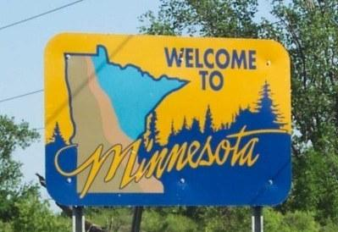
Creating a “Data Rich Minnesota”
Benefits to Government:
Transparency of operations;
Increased level of public service;
Pro-actively (vs. reactively) meeting
the demand for data;
The authoritative data being available is the norm;
Less staff time handling licenses,
fees, data transfer, etc.;
“Return” value

Slide 36
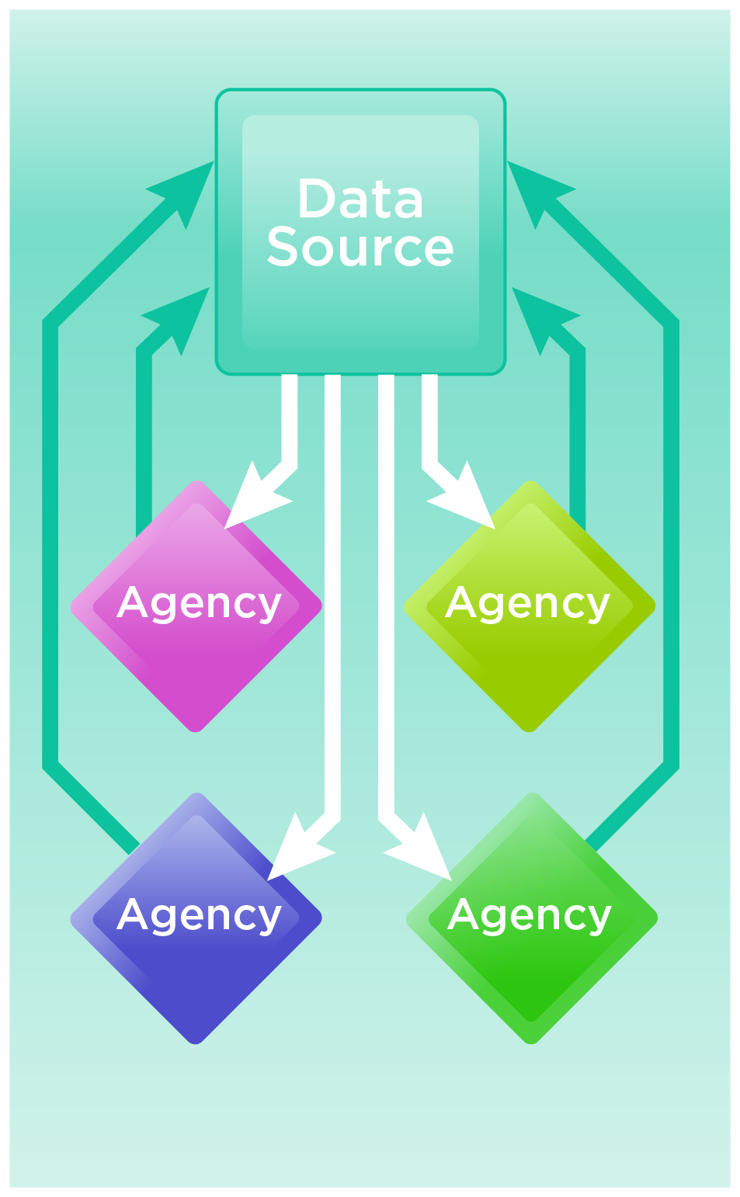
Creating a “Data Rich Minnesota”
Benefits to Government:
Transparency of operations;
Increased level of public service;
Pro-actively (vs. reactively) meeting
the demand for data;
The authoritative data being available is the norm;
Less staff time handling licenses,
fees, data transfer, etc.;
“Return” value

Slide 37
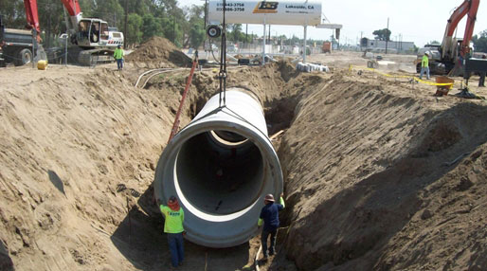
Creating a “Data Rich Minnesota”
Benefits to the Business Community:
Facilitates and stimulates the
“Information economy”/ “App economy”
Data consuming industries can operate more reliably, efficiently and cost-effectively when they can immediately acquire data and services they need;
Insurance, real estate, telecom, utilities, pipelines, railroads, etc.
A data-rich environment enables our region and our state to be more economically competitive;

Slide 38
Final Thoughts:
GIS data is a public investment for the benefit of all; enhancing access maximizes that investment.
The on-going investment in developing and maintaining GIS data is justified by government business processes;
Government entities can proactively collaborate to distribute the costs of
GIS data; (e.g. data development, maintenance of data clearinghouses)

Slide 39
Thank you!
Questions? Comments?
Geoff Maas, GISP
MetroGIS Coordinator
651.602.1638
geoffrey.maas@metc.state.mn.us

